Slide 2
Food sampling – how do you look for what you want to find?
Julian M Cox
Associate Dean (Education)
Faculty of Science, University of New South Wales, Sydney NSW 2052, Australia

Slide 3
How is microbiological analysis important to management of food safety?

Slide 4
Issues and risk
Attribution
  Where does it come from?
Source?
Food to humans
Origin to food
  Food animal?
  Environmental source?
    Primary production
    Processing environment

Slide 5
Issues and risk
Sampling
  number of samples and confidence
  nature of foods

Slide 6
Organisms in foods?
A
B
C

Slide 7
Issues and risk
History through processing
  Bacillus cereus and rice
  What does a low count mean?
Criteria
  are they applicable?
  product testing versus process management
  food manufacturing versus foodservice

Slide 8
Issues and risk
Prevalence
  Rate of contamination
  Exposure assessment
Population
  level of contamination
  refine exposure assessment
Salmonella and SALMONELLA
  Enteritidis versus Sofia

Slide 9
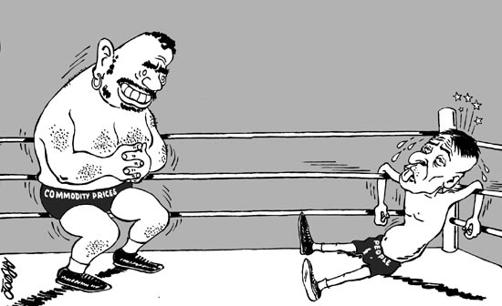
The Salmonella fight...
Enteritidis
Sofia

Slide 10
SALMONELLA and Salmonella
Salmonella Enteritidis
  Colonises chickens very well
  Highly virulent in chickens
  Illness in humans
  Major public health concern
Salmonella Sofia
  Colonises chickens very well
  No disease in chickens
  No illness in humans
  No public health concern

Slide 11
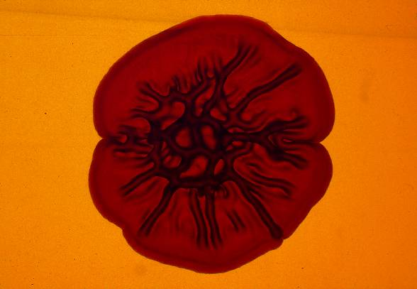
Salmonella Enteritidis

Slide 12
SALMONELLA and Salmonella
Salmonella Enteritidis
  Colonises chickens very well
  Highly virulent in chickens
  Illness in humans
  Major public health concern
Salmonella Sofia
  Colonises chickens very well
  No disease in chickens
  No illness in humans
  No public health concern

Slide 13
Salmonella Sofia

Slide 14
What is required to assist food safety management?
Traditionally, detection
  presence or absence (or is it?)
Issues
  acceleration
    how fast can we/do we need to go?
    low numbers, physiological state (injury)
    background flora, matrix
    need recovery, amplification (growth)

Slide 16
Analyte

Slide 17
Bacteria

Slide 18
Viruses

Slide 19
What is required to assist food safety management?
Issues, continued
  Darwinian selection: H₂S, lactose
  cultural selection
    competition, bias
  enumeration
    risk assessment needs numbers
    numbers – of what?

Slide 20
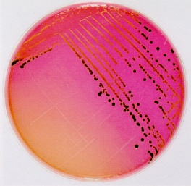
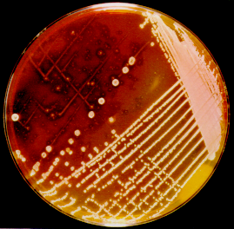
Lactose-positive Salmonella

Slide 21
What is required to assist food safety management?
Issues, continued
  Darwinian selection: H₂S, lactose
  cultural selection (test methods, harmonisation)
    competition, bias
    Salm. and dyes, Y&M diluent (salt)
  enumeration
    risk assessment needs numbers
    numbers – of what?

Slide 22
What test do I use?
What works for you!
Rapid/alternative vs traditional
Plate media (chromogenics)
PCR

Slide 23
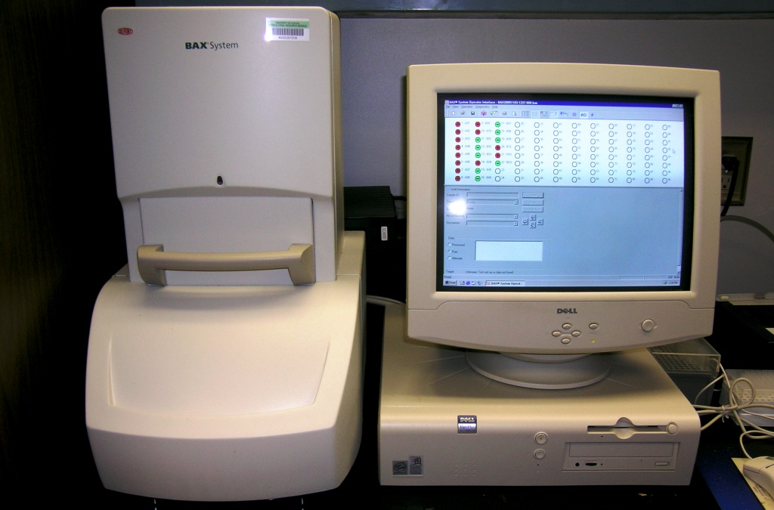
BAX vs Culture

Slide 24
BAX vs Culture
USDA protocol
  BAX screening, plate positives
Previous studies, spiked samples
Analysis:
  natural carcass rinses
  plate ALL samples

Slide 25
Results
360 rinses tested
213 BAX vs 193 culture-positive
  181 TP, 135 TN, 32 ‘FP’, 12 FN
  5.6% FN, 15% FP
  FNs definitive, but FPs??
  if all false are truly false, equivalent?

Slide 26

False-positives?
False false-positives…
True true-positives…
True false-positives…
False true-positives…

Slide 27
Results
360 rinses tested
213 BAX vs 193 culture-positive
  181 TP, 135 TN, 32 ‘FP’, 12 FN
  5.6% FN, 15% FP
  FNs definitive, but FPs??
  if all false are truly false, equivalent?

Slide 28
Summary
Search for the ‘truth’ in testing
  Sampling: how many, subsampling
  Testing
    many impacts on testing (target, background)
    information from testing (quant vs qual)
    what is there and how much (of each)?
Truth informs risk assessment and meaningful food safety plan design

Slide 29
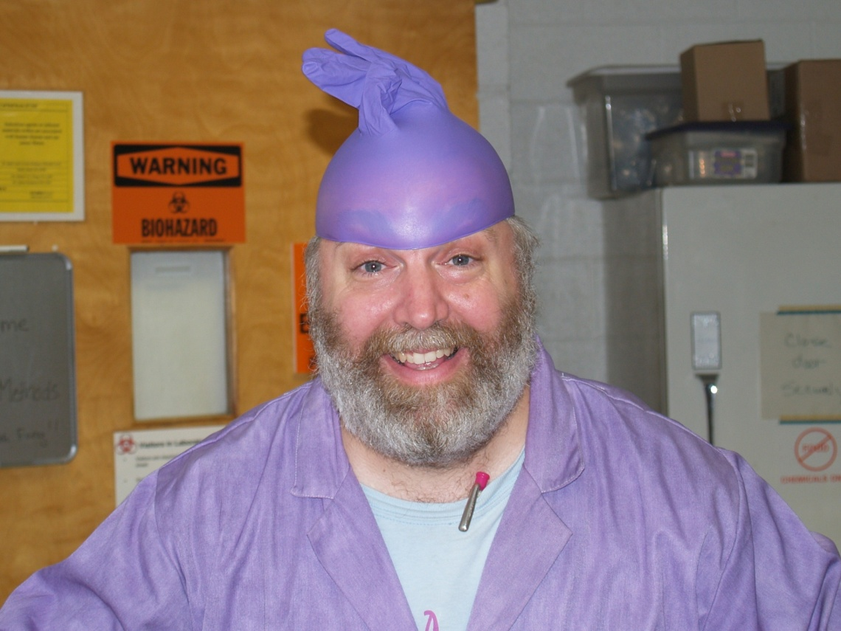
Anyone have
questions?

