Slide 1
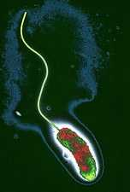
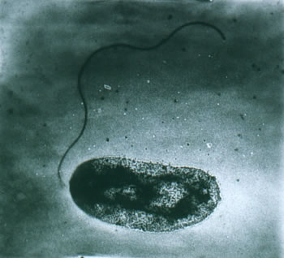
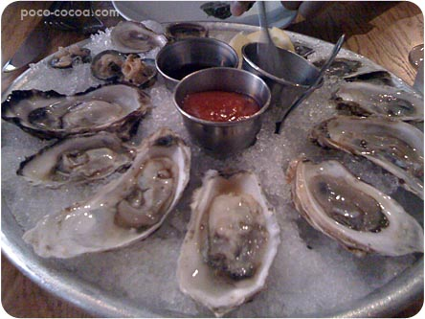
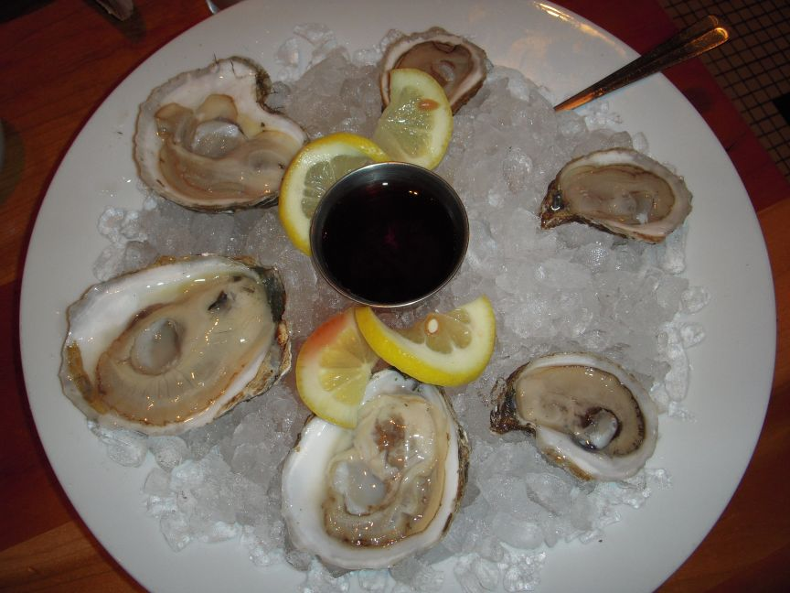
Evaluation of the Efficacy of a Commercial Heat Shock Method for Reduction of Vibrio vulnificus and Vibrio parahaemolyticus in Gulf of Mexico Oysters
Abdallah Al-dakheelallah, Greg Bolton,
David Green, Lee-Ann Jaykus
February 22, 2012

Slide 2
Vibrio vulnificus
95% of all seafood-related deaths in the US
Sporadic cases of illness (no reported outbreaks)
Raw / partially cooked, or cross-contaminated seafood.
Present in oysters in warmer months
Indigenous to marine waters
Notes:
95% of all seafood-related deaths in the US.
Raw/partially cooked, or cross-contaminated seafood.
Present in 50% of oysters in summer.
No correlation between V. vulnificus and fecal colifom levels.

Slide 3
Vibrio vulnificus
Infective dose: ~100 CFU/g (immuno-comp.)
Illness: Septicemia (50% mortality)
Gastroenteritis
              Wound infections
Notes:
-Septicemia: Individuals with underlying chronic disease such as liver disease, diabetes, cirrhosis, or leukemia, or those who take immunosuppressive drugs or steroids are particularly susceptible to primary septicemia. The pathogen enters the blood stream, resulting in septic shock, rapidly followed by death in about 50% of cases.
-Gastroenteritis: All individuals whether healthy or immuno-comp. who consume foods contaminated with this pathogen are susceptible to gastroenteritis.

Slide 4
Vibrio parahaemolyticus
Discovered: 1950, outbreak in Japan.
First U.S. outbreak: 1971, Maryland (crabmeat)
Outbreaks: most common in Japan and SE Asia
Leading cause of seafood-related illness in the U.S. (34,664 cases/yr).
Notes:
Discovered: 1950, foodborne outbreak in Japan.
First US outbreak: 1971, Maryland (crabmeat).
Raw / partially cooked, or cross-contaminated shellfish, esp. oysters, and other seafood.
V. parahaemolyticus: Leading cause of seafood-related illness in the U.S. (34,664 cases/yr).

Slide 5
Vibrio parahaemolyticus
Infective dose: >1,000,000 CFU/g
Main illness: diarrhea, abdominal cramps, headache, nausea, vomiting
Other illness: Septicemia; Wound infections.
Notes:
Infective dose -- A total dose of greater than one million organisms may cause disease; this dose may be markedly lowered by coincident consumption of antacids (or presumably by food with buffering capability).
Main symptom: Watery and/ or bloody diarrhea, abdominal cramps, headache, nausea, vomiting
Possibly: Septicemia; Wound infections.

Slide 6
Control and Intervention
Vibrios are extremely sensitive to heating
Adequate steaming / cooking will eliminate V. parahaemolyticus & V. vulnificus (consumers prefer oysters to be raw)
Refrigeration is critical (Rapid multiplication occurs if oysters are not refrigerated)
Important role for education of foodservice sector and consumers
Possible interventions: “depuration” , irradiation, freezing, mild heating, high pressure
Notes:
Vibrios are extremely sensitive to heating

Slide 7
Shellfish Safety in the U.S.
The NSSP (National Shellfish Sanitation Program)
  Established in 1925
  Human fecal contamination
The ISSC (Interstate Shellfish Sanitation Conference)
  Organized in 1982
  Memorandum of Understanding with FDA in 1984
The FDA
  V. vulnificus illness reduction plan with ISSC
  Targeted 60% illness reduction by 2008
  Mandate of PHP
Notes:
The first official effort to promote shellfish sanitation was the establishment of the National Shellfish Sanitation Program (NSSP) in 1925.
At the time of the establishment of the NSSP, indigenous bacterial pathogens like V. vulnificus and V. parahaemolyticus had not yet been identified.
And so their purpose was the protection of shellfish harvesting waters from human fecal contamination.

Slide 8
Shellfish Safety in the U.S.
The NSSP (National Shellfish Sanitation Program)
  Established in 1925
  Human fecal contamination
The ISSC (Interstate Shellfish Sanitation Conference)
  Organized in 1982
  Memorandum of Understanding with FDA in 1984
The FDA
  V. vulnificus illness reduction plan with ISSC
  Targeted 60% illness reduction by 2008
  Mandate of PHP
Notes:
the Interstate Shellfish Sanitation Conference ISSC was organized in 1982 to further promote shellfish sanitation.
It is a cooperation btwn industry, academia, state, and federal public health agencies.
It has signed a MOU with the FDA in 1984 to work concordantly.

Slide 9
Shellfish Safety in the U.S.
The NSSP (National Shellfish Sanitation Program)
  Established in 1925
  Human fecal contamination
The ISSC (Interstate Shellfish Sanitation Conference)
  Organized in 1982
  Memorandum of Understanding with FDA in 1984
The FDA
  V. vulnificus illness reduction plan with ISSC
  Targeted 60% illness reduction by 2008
  Mandate of PHP
Notes:
In 2001, FDA designed a V. vulnificus illness reduction plan with the ISSC targeting a 60% illness reduction by 2008
The failure of this plan to achieve it’s 60% target led to the FDA’s intention to mandate PHP

Slide 10
Examples Post Harvest Processes
Depuration
Irradiation
Individual Quick Freezing (IQF)
High Hydrostatic Pressure (HHP)
Notes:
Depuration is a controlled purification
Freshly harvested oysters are washed and placed in a clean aquatic environment allowing them to naturally open and purge particulates and microbes.
There are many modifications for the depuration process, such as manipulation of salinity, water flow, water temperature, or the addition of antimicrobial compounds.

Slide 11
Examples Post Harvest Processes
Depuration
Irradiation
  Irradiation source
  Dose & Log₁₀ rd
  Available facilities
Notes:
The irradiation process can use Gamma-rays, X-rays, or machine generated electrons.
For half-shell oysters: 1.0 kGy causes 6-log₁₀ reduction.
For whole-shell oyster: 3.0 kGy causes 6-log₁₀ reduction.
Florida has the only oyster irradiation facility in the U.S.

Slide 12
Examples Post Harvest Processes
Depuration
Irradiation
Individual Quick Freezing (IQF)
  Extended frozen storage
  The quick freezing step & raw qualities
  In use by several processors
Notes:
IQF requires extended frozen storage to be effective.
Most inactivation of Vibrio occur during the frozen storage.
The quick freezing step is important to keep the raw qualities of the oyster.
Currently there are several processors using this technology in the U.S. Gulf of Mexico region.

Slide 13
Examples Post Harvest Processes
Depuration
Irradiation
Individual Quick Freezing (IQF)
High Hydrostatic Pressure (HHP)
  Steps
  Packaging/shipping
  Parameters
Notes:
The oysters are separated by size and loaded in stainless steel cylinder tubes for pressurization then packaged on ice in waxed corrugated boxes in preparation for shipping.
120s at 293 MPa is enough to reduce Vibrio by 3.52-log₁₀.

Slide 14
Evaluation of a Heat-Shock Process
Evaluate an existing heat-shock treatment used for oyster shucking
Determine if this method met FDA and ISSC criteria as an approved Post-Harvest Process (PHP)
    <30MPN/g & 3.52 log₁₀ reduction.
Notes:
The purpose of this study was to evaluate, and modify if necessary, an existing heat-shock treatment routinely used by North Carolina oyster processors to facilitate oyster shucking, for its efficacy in reducing Vibrio vulnificus and Vibrio parahaemolyticus levels. In addition, the study was to determine if this method met FDA and ISSC requirements for recognition under the NSSP guidelines as an approved Post-Harvest Processing (PHP) method.

Slide 15
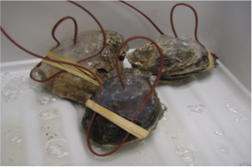
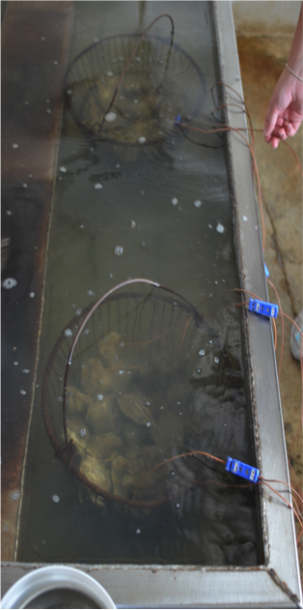
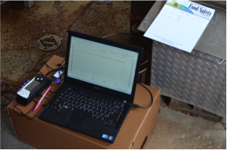
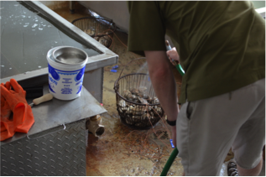
Evaluation of a Heat-Shock Process
  Oysters (12-15)
  Wired baskets
  Thermocouples (3)
  Heating tank (60°C)
  Time (0, 6, 8, and 10 min)
  Water spray/ice
  Shipped to NCSU

Slide 16
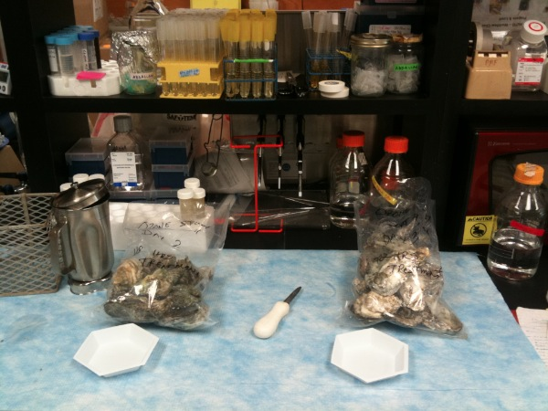
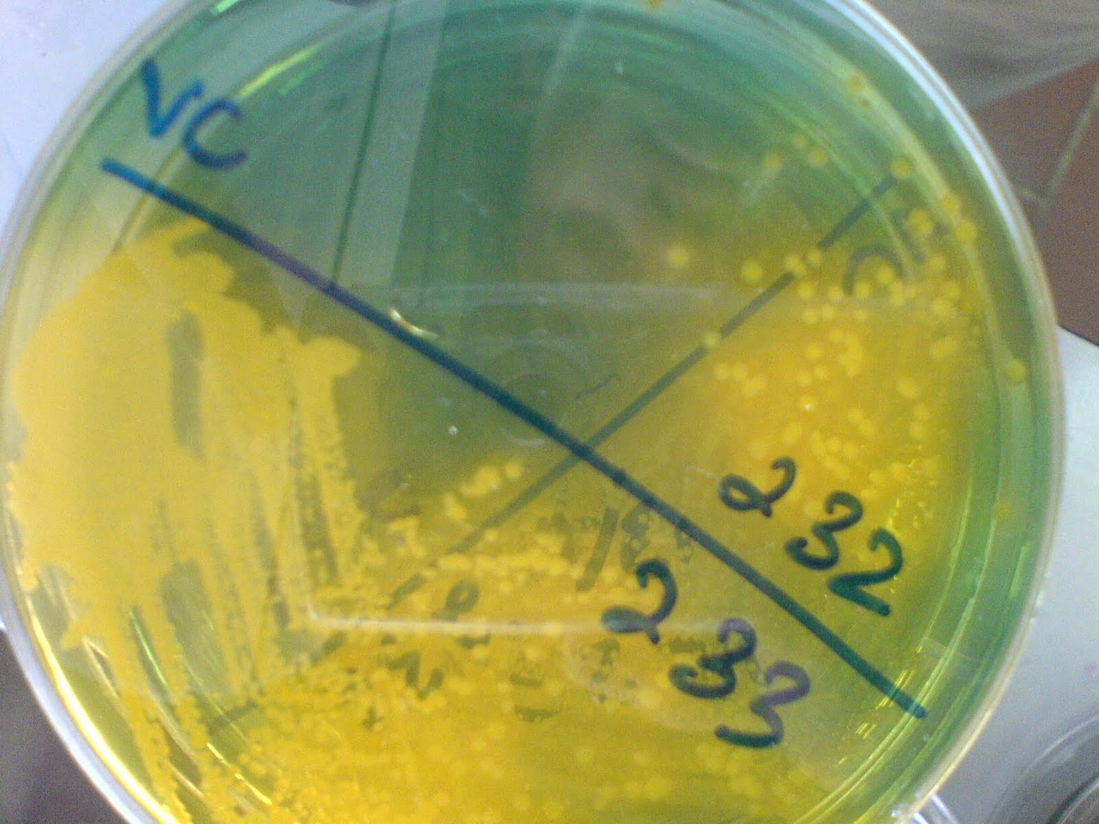
Evaluation of a Heat-Shock Process
Microbiological Analysis
  -Most Probable Number (MPN):
Homogenize oyster sample with same amount of 1xPBS
Make a serial dilution using 1xPBS
Incubate at 37°C for 18-24 h
Selective Agar:
Streak on TCBS or mCPC
Incubate at 37°C for 18-24 h
Compare results to MPN tables
Inoculate APW MPN tubes for enrichment

Slide 17
Temperature profiles

Slide 18
Evaluation Results – Log₁₀ reduction

Slide 19
Evaluation Results – Log₁₀ reduction

Slide 20
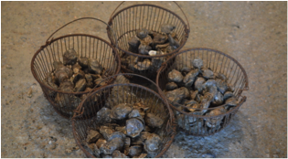
Recommendations
  10 minute treatment achieves:
  <30MPN/g & >3.52 log₁₀ rd
  Hold tank temperatures
      Need better temp. control
      Need better recirculation
  Internal oyster temperature
    Location of oysters during processing

Slide 21
Acknowledgement
The Jaykus lab (NC State Univ.)
Saudi Food and Drug Authority
North Carolina Sea Grant
Ardy’s Oysters

Slide 22
Thank you!

