Slide 1
Abu Dhabi Food Control Authority (ADFCA)
Hygienic Status of Salads Displayed at Cold Buffets in Abu Dhabi Hotels
Abdellatif Eldaw (PhD),
Anwar Alsaad (PhD),
Hassan Al Marzouqi (BSc)

Slide 2
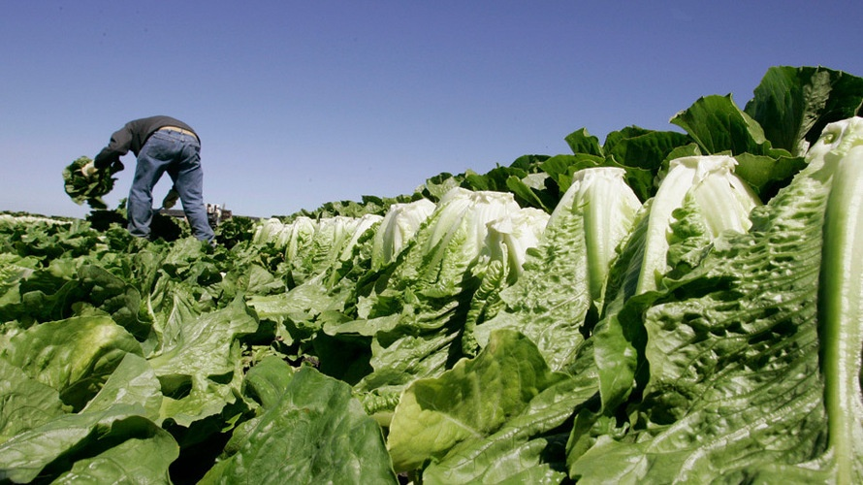
Hygienic Status of Salads Displayed at Cold Buffets in Abu Dhabi Hotels
Duration of the Study : 3 years ; 2006, 2007 and 2009

Slide 3
Hygienic Status of Salads Displayed at Cold Buffets in Abu Dhabi Hotels
Salad , leafy greens and ready-to - eat food including fresh non pasteurized juices are known for their susceptibility to microbial contamination¹.
Salmonella and E. coli 0157:H7 food related
outbreaks in different parts of the world have been reported ².

Slide 4
Hygienic Status of Salads Displayed at Cold Buffets in Abu Dhabi Hotels
Concerns over the leafy greens are growing at international level.
The joint WHO-FAO Expert Meeting on Microbiological Hazards associated with fresh produce (2008) concluded that leafy green vegetables should be given the highest priority in terms of fresh produce safety³.

Slide 5
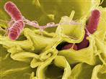
Salad and Fresh Produce –Related Food Episodes
Global Data and Information

Slide 6
From 1996 to 2006, in USA, seventy-two foodborne illness outbreaks were associated with the consumption of fresh produce. Factors (for incidence and reporting) include: aging population , global trade increase , a more complex supply chain, ……

Slide 7
……. Improved surveillance and detection of foodborne illness, improvements in epidemiological investigation, and increasingly better methods to identify pathogens
(ref :http://www.cfsan.fda.gov/guidance.html (2008)

Slide 8
In 2000, at least 140 people in Denmark, Germany, Iceland, the Netherlands and the UK were infected by S. typhimurium DT204b. The outbreak was associated with iceberg lettuce, A similar S. typhimurium DT104 outbreak occurred in the UK the same year and caused 361 cases of illness.

Slide 9
In the same year , 2007 , at least 50 people in Iceland and the Netherlands became ill after consuming shredded, pre-packed lettuce.

Slide 10
Other leafy greens too have been involved in outbreaks, such as the 100 cases of Salmonella in Denmark, Norway and Sweden that was eventually linked to rocket lettuce grown in Italy..^{A,B}
Ref:
A- Prepared salads and public health. Little, C.L. & Gillespie, I.A. Journal of Applied Microbiology, 2008, 105, 1729-43
.B-Spinach-associated Escherichia coli O157:H7 outbreak, Utah and New Mexico, 2006. Grant, J. et al.Emerging Infectious Diseases, 2008, 14(10)

Slide 11
There were 27 outbreaks of gastroenteritis between January 2001 and June 2005 across Australia due to fresh, uncooked produce including orange juice, cucumbers, lettuce and alfalfa sprouts, resulting in almost 700 people becoming ill, with 51 hospitalized.
http://www.smh.com.au/news/national/fresh-food-linked-to-food-poisoning/2007/03/24/1174597951363.html

Slide 13
Hygienic Status of Salads Displayed at Cold Buffets in Abu Dhabi Hotels
In Abu Dhabi, most hotels display different types of salads that, mostly, include leafy
green produce, marine products, meat, and poultry, dairy products, beans, potato, mayonnaise, fruits and the locally preferred salads like taboula, mutable, hummus and fatoush.

Slide 14
Hygienic Status of Salads Displayed at Cold Buffets in Abu Dhabi Hotels
Although, most of the leafy green produce, which are included in most salads, are sanitized using suitable food grade sanitizers, still some microbes grow and multiply in these produce because usually the initial bacterial load is usually high in all soil grown produce .

Slide 15
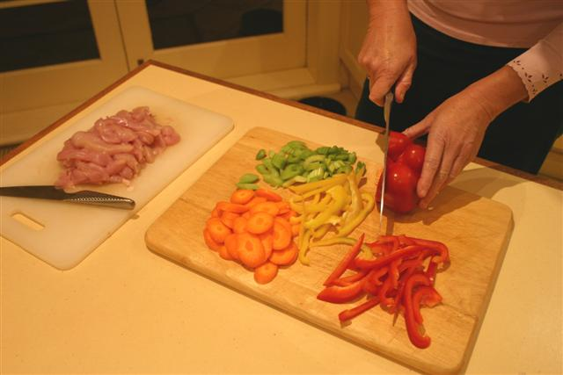
Hygienic Status of Salads Displayed at Cold Buffets in Abu Dhabi Hotels
Aim of The study
The study has been conducted to assess the microbiological status of the salads displayed at the salad cold bars at different Abu Dhabi 4 and 5 stars hotels.

Slide 16
Hygienic Status of Salads Displayed at Cold Buffets in Abu Dhabi Hotels
How useful the outcome of this study
The outcome of this study has been used to recommend some control measures to make better the hygienic status of salads displayed at the salad cold bars at different Abu Dhabi 4 and 5 stars hotels.

Slide 17
Hygienic Status of Salads Displayed at Cold Buffets in Abu Dhabi Hotels
Materials and method
Different Salad types( total 287 samples, 50 during 2006,192 during 2007and 45 during 2009) containing different types of ingredients were collected using sealed sterile bags and transported to Abu Dhabi Food Control (ADFCA) laboratories in vehicle-powered refrigerator within an average time of 45 minutes at 4 to 8 degree Celsius. The samples were prepared and cultured in suitable media (according to salad testing standard).

Slide 18
Hygienic Status of Salads Displayed at Cold Buffets in Abu Dhabi Hotels
Materials and method
In summary, the whole laboratory procedures followed the UKAS accredited food microbiological methods. After testing, the Samples were
classified as fit, unacceptable or poor quality samples according to the standard used.

Slide 19
Hygienic Status of Salads Displayed at Cold Buffets in Abu Dhabi Hotels
Results:
69(24%) of the total (287) salad samples collected were contaminated with pathogens and spoilage organisms.
E.coli 0157:H7 was reported in 2.15% of the total samples tested (table 1&2) and in 8.7% of unacceptable and in samples with poor quality' (table 3).

Slide 20
Hygienic Status of Salads Displayed at Cold Buffets in Abu Dhabi Hotels
Results:
The highest (34.8%) contamination was caused by coliform followed by non 0157:H7 E.coli (15.9%).The salad type that contained the highest contaminants (42%) was Homos, Taboula, Tahina and Fatoush followed by green and vegetable salads (36.2%). These types of salads were mostly contaminated with different types of bacteria, moulds and yeast. (Table 3)

Slide 21
Hygienic Status of Salads Displayed at Cold Buffets in Abu Dhabi Hotels
Results:
S.faecalis (10%) and Coliform (15.9%) were the most common microorganisms isolated from Homos, Taboula, Tahina and Fatoush salads .These salads were the same that contained the highest percentage of contaminant (42%) including E.coli 0175:H7 (Table 3), followed by the Leafy green, vegetable and cheese salads (36.2%)

Slide 22
Hygienic Status of Salads Displayed at Cold Buffets in Abu Dhabi Hotels
Results:
Table (1) Showing Non-Compliant Microbiological Results(23 samples) of Different Types of Salad Collected from Abu Dhabi Hotels (2006, 2007 &2009)
Year | Total samples | Reasons for Non - compliance
 |  | HTBC | L. monocy. | H CC C | E.coli 0157:H7 | Other E.coli | Yeast &moulds | H.C. Enterococci | S. aureus | Total
2006 | 50 | 0 | 1 | 0 | 4 | 2 | 1 | 0 | 0 | 8(16.0%)
2007 | 192 | 1 | 0 | 0 | 2 | 4 | 1 | 0 | 0 | 8(4.16%)
2009 | 45 | 0 | 0 | 1 | 0 | 5 | 0 | 0 | 1 | 7(15.5%)
Total | 287 | 5 | 1 | 1 | 6 | 11 | 2 | 0 | 1 | 23(8.0)%)
HTBC (High Total Bacterial Count), L.monocy (Listeria monocytogenes), HCC (High Coliform Count),

Slide 23
Hygienic Status of Salads Displayed at Cold Buffets in Abu Dhabi Hotels
Results:
Table (2) Showing the Microbiological Results of Poor Quality Salads(46 samples) Collected from Abu Dhabi Hotels (2006, 2007 &2009)
Year | Total samples | Reasons for Poor Quality
 |  | Enterococci | Yeasts, moulds &Spoilage .bacteria | H Ch C | Pseudomonas | Non 0157 :H7 E.coli | Total
2006 | 50 | 1 | 0 | 0 | 0 | 0 | 1(2%)
2007 | 192 | 4 | 21 | 14 | 2 | 2 | 43 (22.39%)
2009 | 45 | 0 | 2 | 0 | 0 | 0 | 2(4.4%)
Total | 287 | 5 | 23 | 14 | 2 | 2 | 46(16.03%)

Slide 24
table (3) Microorganisms Isolated from Different Types of Non-compliant or Poor Quality Salads (69 samples) Displayed in Hotels During 2006, 2007 and 2009
Types of salads | s. aureus | E.coli | E.coli 0157 | Pseudo | L.monocy | coliform | Enterococci | Yeast | Spoilage bacteria | Total
Cold meat, fish, chicken Salads | 1 (1.4%) | 1 (1.4%) | 3 (4.3%) | 0 | 0 | 3 (4.3%) | 1(1.4%) | 0 | 3 (4.3%) | 12 (17.4%)
Green,vegatable and cheese salads | 0 | 5 (7.2%) | 2 (2.8%) | 1 (1.4%) | 1 (1.4%) | 9 (13.0%) | 1(1.4%) | 1 (1.4%) | 5 (7.2%) | 25 (36.2%)

Slide 25
table (3) Microorganisms Isolated from Different Types of Non-compliant or Poor Quality Salads (69 samples) Displayed in Hotels During 2006, 2007 and 2009
Types of salads | S .aureus | E.coli | E.coli 0157 | Pseudo | L.monocy | coliform | Enterococci | Yeast | Spoilage bacteria | Total
Homos, taboula, tahina, fatoush | 0 | 4 (5.6%) | 1 (1.4%) | 1 (1.4%) | 0 | 11 (15.9%) | 7 (10.1%) | 5 (7.2%) | 0 | 29 (42.0%)
Corn & mayonnaise | 0 | 0 | 0 | 0 | 0 | 1 (1.4%) | 0 | 0 | 0 | 1 (1.4%)
Falafel salad | 0 | 1 (1.4%) | 0 | 0 | 0 | 0 | 0 | 0 | 0 | 1 (1.4%)
Fruit cake salad | 0 | 0 | 0 | 0 | 0 | 0 | 0 | 0 | 1 (1.4%) | 1 (1.4%)
Total | 1 (1.4%) | 11 (15.9%) | 6 (8.7%) | 2 (2.8%) | 1 (1.4%) | 24 (34.8%) | 9 (13.0%) | 6 (8.7%) | 9 (13.0%) | 69 (~100%)

Slide 26
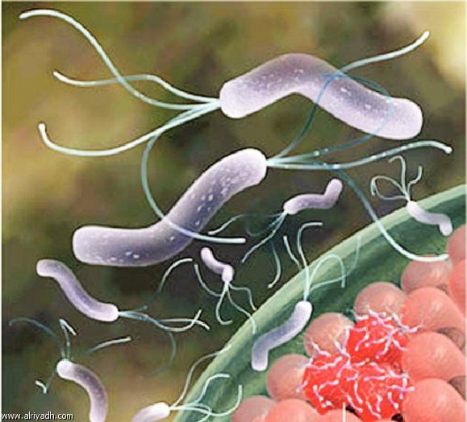
Discussion:
Many food poisoning outbreaks has been attributed to the consumption of contaminated leafy and green salads 4 even if pre-washed

Slide 27
Discussion:
Use of contaminated water, Non hygienic food handling ,primary produce from contaminated soil or from farms lacking GHP, inclusion of ingredients from suspected sources, failure to control product holding temperatures, use of contaminated equipments are some of the factors that contribute to the contamination of salads and lead to poisoning and /or spoilage of salads.

Slide 28
Discussion:
In this study the percentage of contaminated salads was high (24%) despite the fact that all hotels working in Abu Dhabi are HACCP - certified. Even in cases where suitable washing and sanitizing procedures are applied, some bacteria grow and multiply.

Slide 29
The study of Seo, K. H., and J. F. Frank ⁵ on the attachment of E. coli O157:H7 to lettuce leaf surface and bacterial viability in response to chlorine treatment showed that Pseudomonas adhered to and grew mainly on the intact leaf surface, whereas E. coli O157:H7 was entrapped 20 to 100 μm below the surface in stomata and cut edges.

Slide 30
These findings suggested that treatment with chlorine (may be, other food grade sanitizers as well) is not enough to rule out possible contamination with some of the studied organisms. The main effects of treatment with sanitizers seem to be the reduction of the organisms on the surfaces of the leaves

Slide 31
Microorganisms like E.coli 0157:H7 could be entrapped deep below the surface in stomata and cut edges and grow to cause illness especially if the temperature is not adequately controlled
The finding of the present study as regards the high bacterial contamination in salads
containing green leafy agricultural products seems to agree with most studies on salad contamination

Slide 32
In the present study, the high number of contaminated salads included almost the
same types of agriculture produce i.e. Homos, Taboula Tahina, fatoush and green salad These salads showed high percentage of contamination with E.coli, E.coli 0157:H7, Pseudomonas, L . monocytogenes, S. faecalis, spoilage bacteria and yeast .

Slide 33
One of the drawbacks of this study was the lack of medical reports of food poisoning or
food related illnesses associated with the consumption of these salads. However , our report showed no food poisoning incidence in all hotels from which these samples were collected during 2006, 2007 and 2009

Slide 34
The absence of food poisoning episodes in hotels, from which samples were collected , may be explained by that : the infective dose required to initiate symptomatic infection was not build up due to the short time for displaying the salad. Another reason may be the age of the consumers who are, mostly , of middle age and young adults with very few children and old individuals. This point may have been better illustrated if age of consumers was studied.

Slide 35
The results of this study have been used to suggest some precautions that seen adequate to minimize microbial contamination of salads displayed in Abu Dhabi 4 and 5 hotel

Slide 36
Recommendations based on findings :
Advice for hygiene officers and the food handlers working in hotels

Slide 37
Advice for hygiene officers and the food handlers working in hotels
Salads and leafy produce including unpasteurized fresh juices are items that require ultimate hygiene care because of their susceptibility to contamination with microorganisms which originate from farms….

Slide 38
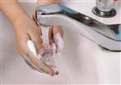
Advice for hygiene officers and the food handlers working in hotels
……contamination may take place within the hotels from food handlers, utensils, water or as cross contamination from meat, fish and poultry as well as from other sources.

Slide 39
All fresh produce shall be washed with clean potable water followed by washing in chlorinated water or any other suitable food grade sanitizer.
Sinks where fresh produce is washed shall be kept cleaned and sanitized.
Once washed, these commodities shall be kept in refrigerators at 4 degree Celsius

Slide 40
Cutting and preparation of salads shall be done on clean, sanitized cutting boards specified for these produce and continuously sanitized before and after each use.
Cutting knives shall be cleaned, sanitized and specified for salad preparation only

Slide 41
It is preferable to keep all types of spices used in preparation of salads tightly closed in refrigerators with temperature not much above 4 degree Celsius. Most spices are subjected to different manipulations including harvesting, drying, cleaning, gridding, packaging and all this manipulations are , mostly, done on open atmosphere which could add possible contaminants

Slide 42
Transportation of Salad to the bars shall be done using well covered, clean pre-sanitized utensils and containers.
Salad bars shall be cold not much above 4 degree Celsius even before it is filled with salads
Only salad bars with sneeze guard are suitable to display salads.
Only trained food handlers (on food safety and hygiene) shall handle and or prepare salads.

Slide 43
Spoons, forks and other utensils used for picking of salads shall be made of stainless steel, cleaned and replaced within not more than 2 hours of use.
Salads shall not stay on the display for more than 2 hours and for less than one hour if the salad bar temperature is above 8 degree Celsius.
One more point
Hygiene and harvesting practices at farms (locally, regionally and internationally) are issues that need to be considered for more safer fresh produce

Slide 44
Remember
Washing with chlorinated potable water does not rule out the possibility of bacterial growth especially for bacteria that survive and multiply within the stomata and on cut edges of the produce.
Juices and fluids from the cut fresh produce are suitable media for microbial growth, therefore, hygiene precautions and GHP shall be followed.

Slide 45
References :
1-Anwar S. (2007). Microbial contamination of salads in Abu Dhabi Hotels .Food safety Workshop, Sharjah, UAE 2007 Unpublished work (personal communication) .
2-Griffin, P. M. 1998. Epidemiology of Shiga toxin-producing Escherichia coli infections in humans in the United States, p. 15-22. In J. B. Kaper and A. D. O'Brien (ed.), Escherichia coli O157:H7 and other Shiga toxin-producing E. coli strains. American Society for Microbiology Press, Washington, D.C.
3-WHO-FAO Expert meeting on Microbial Hazards associated with Fresh Produce. Meeting Report 2008
4-Mary S. Palumbo, James R. Gorny, David E. Gombas, Larry R. Beuchat, ChristineM. Bruhn, Barbara Cassens, Pascal Delaquis, Jeffrey M. Farber, Linda J. Harris, Keith Ito, Michael T. Osterholm, Michelle Smith, and KatherineM.J. Swanson (2007) , Recommendations for Handling Fresh-cut Leafy Green Salads by Consumers and Retail Foodservice Operators, Food Protection Trends,2007 , Vol. 27, No. 11, Pages 892–898
5-Seo, K. H., and J. F. Frank. 1999. At­tachment of Escherichia coli O157:H7 to lettuce leaf surface and bac­terial viability in response to chlo­rine treatment as demonstrated by using confocal scanning laser microscopy. J. Food Prot. 62:3–9.4.

Slide 46
References :
6-Little CL, Gillespie! A (2008). Prepared Salads and Public Health. J. Appl. Microbiol. (2008) Dec.105 (6) 1729-43
7- Sivapalasingam, S., C. R. Friedman, L. Cohen, and R. V. Tauxe. 2004. Fresh produce: a growing cause of outbreaks of foodborne illness in the United States, 1973 through 1997. J. Food Prot. 67:2342-2353
8-Food and Drug Administration (2008), FDA Warns Consumers Nationwide Not to Eat Certain Types of Raw Red Tomatoes, for immediate release, June 7, 2008
9-Kiran Pingulkar, Anu Kamat, Dilip Bongirwar ‌, Microbiological quality of fresh leafy vegetables, salad components and ready-to-eat salads:anevidence of inhibition of Listeria monocytogenes in tomatoes, International Journal of food Science and nutrition: 2001, Vol. 52, No. 1, Pages 15-23

Slide 47
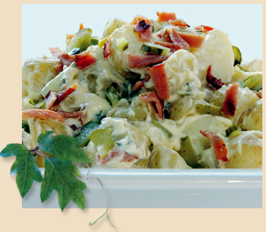
Thank you !
Abdellatif Eldaw (PhD),
Anwar Alsaad (PhD),
Hassan Al Marzouqi (BSc).

