Slide 1

QCMS Making Safe Food
Carol Ciszek
VP Quality, Food Safety and Scientific and Regulatory Affairs – Kraft Foods
DIFSC - 2011
Notes:
Sixth Dubai International Food Safety Conference

Slide 2
Kraft Foods – key facts
Approximately $48 billion in revenue
World’s #2 food company, #1 in North America
#1 in global confectionery and biscuits
Sales in 160+ countries, Operations in more than 70 countries
Approximately 140,000 employees
Donated more than one billion servings of food since 1997
Figures are for the combined Kraft Foods and Cadbury businesses

Slide 3

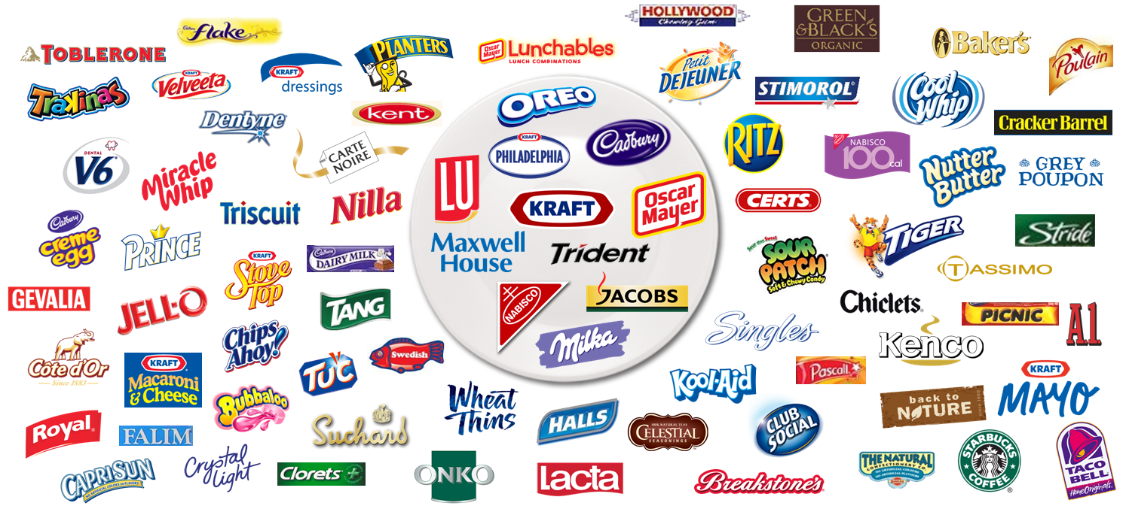
An Amazing Brand Portfolio
11 brands with more than $1 billion in revenue
70+ brands with more than $100 million in revenue
40+ brands over 100 years old
80% revenue from #1 share positions
Notes:
Kraft Foods markets many of the world’s leading food brands.
Millions of times a day, in more than 160 countries, consumers reach for their favorite Kraft Foods brands.
Our billion dollar brands include: Kraft, Cadbury, Jacobs, LU, Maxwell House, Milka, Nabisco and its Oreo brand, Oscar Mayer , Trident and Philadelphia.

Slide 4

Middle East & Africa Area
Fast Facts
Region headquarters:
Dubai & Johannesburg
Key markets:
Egypt, Nigeria, Pakistan, South Africa, Morocco
Saudi Arabia, UAE (and other Gulf Cooperation Council markets),
Some key brands:
Cadbury, Flake, Dairy Milk, Toblerone and Milka chocolates; Clorets, Stimorol and Trident gum; Halls cough drops; Carte Noire, Jacobs and Maxwell House coffees; LU, Oreo and TUC biscuits; Tang powdered beverages and Kraft cheeses
Notes:
MEA is a key market for Kraft, where we service 64 countries mainly from regional production units supported by local suppliers and distributors.

Slide 5

Our Values
We understand that actions
speak louder than words,
so at Kraft Foods:
We inspire trust.
By making food that is safe to eat
We are a food company with a relentless focus on food safety.
Notes:
Our consumers must have the confidence to use our products, and to serve them to their families, without fear of getting sick. For over a hundred years, Kraft Foods has earned that trust by making safe products. We achieve this through the consistent application of robust global standards

Slide 6

Food Safety
Is non competitive
Therefore we work with our food manufacturing peers to advance food safety.
We work closely with local governments and NGOs to drive food safety understanding.
Notes:
Dubai Municipality workshop to share practices

Slide 7

Our Integrated Prevention Based Food Safety Approach is a Point of Difference
Chemical
Microbiological
Physical
Risk Categories
Design
Procure
Convert*
Distribute
Trade
Consumer
Scope
Risk Prevention Programs
Design Safety Analysis
Specifications
HACCP
Supplier QA
Plant & Equipment Design/Capability
Contracts
Selection/
Approval
Material Monitoring
Continuous Improvement
Specifications
HACCP
Supplier QA
Traceability
Sanitation & Pest Control
Complaint Mgmt
Process Capability & Control
Traceability
Warehouse Controls
Complaints
Warehouse Control
Specification
Labelling
Consumer Response
Process Capabilities
Starts with Design and grounded in sound Preventative Programs
*Applies to internal & external plants

Slide 8
QCMS provides the framework for integrated product design.
Consumer
Design
Procure
Convert
Distribute
Trade
Consumer
Focus on what’s important
Design it in
Make it right every time
Talk about it in a meaningful way
Listen, learn, and improve

Slide 9
Design
Design
Procure
Convert
Distribute
Trade
Consumer
We design robust products with food safety in mind
Our design process includes product safety gates at key development stages
Packaging integrity is a key element
Internal global food safety team provides expertise
Notes:
Food Safety Barriers – Micro/Acidity/secondary barriers
Concept, DSA, MRA

Slide 10
Suppliers
Recent significant incidents highlight the external risks.
Chinese milk powder contaminated with melamine sickens 1,253 babies
German Dioxin egg scandal spreads across EU
LOS ANGELES (AP) — The normally quiet almond industry has suddenly found itself struggling with a food producer’s worst nightmare: a salmonella outbreak that has sickened more than two dozen people and prompted a nationwide recall.
Notes:
Therefore proactive robust programmes are established to protect Kraft‘s consumers

Slide 11

Suppliers
Design
Procure
Convert
Distribute
Trade
Consumer
Risk based supplier approval
Supplier development
Communications (specifications, expectations)
Material monitoring programme
Notes:
Pragmatic risk based selection and approval process, utilising GFSI as a platform to allow focussed resource to work with higher risk products. Developing supplier partnerships with clear communication. Updating changes through net forums and in MEA face to face workshops & training for local suppliers. MMP is a key safety net.

Slide 12

Conversion
Design
Procure
Convert
Distribute
Trade
Consumer
Our operations manage product safety based on the CODEX principles of HACCP
Founded on solid PRPs
CCP Process capability is validated against proven science
Internal Audit programme

Slide 13

Distribution & Trade
Design
Procure
Convert
Distribute
Trade
Consumer
Warehouse & Transportation expectations
Training and coaching of trade partners
Supply chain traceability
Retail product audits
Notes:
MEA has challenging supply conditions. Close co-operation with distribution & trade partners is essential to ensure Kraft products arrive at our consumers in the desired state. We have established supply chain quality across the region to focus on this, working with merchandisers so that product handling and storage contributes to the on shelf quality and with distributors to ensure that transportation and storage ensures that our products arrive fresh and intact.

Slide 14

Consumers
Design
Procure
Convert
Distribute
Trade
Consumer
Communications – product labelling
Understanding anticipated products use
Proactive use of consumer contacts
Monitoring for emerging food safety issues
Notes:
Kraft has a policy to communicate responsibly. Accurate allergen information extends consumer choice, anticipated product use helps us provide appropriate product instructions and design out risks. A global consumer contact systems allows tracking and rapid feedback to product teams on product performance in market.

Slide 15

Middle East & Africa
Is a key area for Kraft
We manufacture and source locally and globally
We apply a proactive robust approach to build partnerships to lead and support Food Safety

Slide 16



