Slide 1







Sixth DIFSC– Dubai, 28/2-1/3/2011
Achieving Food Safety in Emerging Economies: the Role of Regional and International Harmonization and Third Party Inspection Systems
Ezzeddine Boutrif
Former Director
Nutrition and Consumer Protection Division, FAO
Notes:
Thanks for the invitation etc etc
I wish to share with you today some thoughts regarding challenges and modern approaches to designing public policies that aim to integrate food security and food safety, and the work and approaches being taken by the FAO in these areas.
In my talk I will consider the following issues [next slide]

Slide 2
Outline of Presentation
What are the “Emerging Economies”?
Place of the GCC countries
Food security – a multi dimensional challenge
The inter-dependence of food security, food safety and nutrition
Integrated policies for food security – the ‘twin track’ approach – and food safety – the ‘food chain’ approach
Future food safety policy challenges and Conclusions
Notes:
Firstly I would like to briefly look at the definition of “Emerging Economies” and its use by international economic and financial institutions in the classification of countries; we will also discuss its application in relation to food security and food safety.
I will then refer to the situation of the GCC countries, and the applicability of the qualifier “Emerging Economies” to this fast growing region and its specific features in relation to food security and food safety.
I wish then to put into context the challenge of food security, the four pillars identified needed to effectively address food security, and the clear inter-linkage between food safety, nutrition and food security.
I then will share with you the approaches that FAO is taking to build food security through an “twin track” approach and, for food safety, using an integrated “food chain approach”.
And finally look at future food safety policy challenges and draw some conclusions.
I hope this will provide some food for thought and look forward to comments and discussion you may wish to raise.

Slide 3
What are the “Emerging Economies”?
Terms used: emerging economies; emerging markets; emerging market economies; rapidly developing economies; etc.
Several definitions and classifications can be found in the literature. They are loosely used and differ slightly according to the origin and the intended use.
For the purpose of this presentation, Emerging markets/Economies are defined as nations with social or business activity in the process of rapid growth and industrialization. In 2010, there are some 35 emerging markets/economies in the world, with the economies of China and India considered to be the largest.
Notes:
The term “Emerging Economies” was originally brought into fashion in the 1980s by the World Bank . It is sometimes loosely used as a replacement for emerging markets, emerging market economies; rapidly developing economies; etc…but really signifies a business phenomenon that is not fully described by or constrained to geography or economic strength. These countries are considered to be in a transitional phase between developing and developed status.
For the purpose of this presentation, Emerging markets/Economies are defined as nations with social or business activity in the process of rapid growth and industrialization. In 2010, there are some 40 emerging markets/economies in the world, with the economies of China and India considered to be the largest. These emerging economies/markets include :
Argentina , Bahrain , Brazil , Bulgaria , Chile, China, Colombia, Czech Republic ; Egypt; Estonia ; Hungary ; India ; Indonesia ; Jordan ; Kuwait ; Latvia ; Lithuania ; Malaysia ; Mauritius ; Mexico; Morocco ; Oman; Pakistan; Peru ; Philippines ; Poland ; Qatar ; Romania ; Russia ; Slovakia ; South Africa; Sri Lanka ; Thailand ; Turkey ; United Arab Emirates
From the GCC countries: Bahrain, Kuwait, Qatar and UAE and included.

Slide 4
Food Safety in Emerging Markets/Economies- Main Features
Rapid agro-business development oriented primarily for export market, or for international or national supermarket chains in large cities;
Co-existence of a dual production system: one for export /supermarket chains and the other for local market.
Food safety systems have not been developed at the same pace as agro-business → numerous incidences of rejections/bans and serious food contamination/adulteration cases (melamine, Sudan red).

Slide 5
Food Safety in Emerging Markets/Economies-Main Features (2)
Food safety development effort was mostly directed towards the regulatory food control, with little attention to up-stream quality assurance systems along the food chain;
Domestic food supply destined to low-income population received little attention from food safety authorities, with negative consequences on consumers’ health.

Slide 6
The GCC Countries – Specific Features
High income countries, with strong consumer purchasing power
Limited agricultural resources – over 80% of food supply is imported
Food safety authorities must ensure that the food supply is safe and of the required quality (no dumping)
They must also ensure national food security.

Slide 7
Policy challenges to implement food safety in GCC Countries
Harmonization of food safety regulations regionally and internationally;
Provision of scientific justification to more stringent standards;
Implementation of common entry points;
Ensuring the implementation of the food chain approach on imported foods – equivalence and third party certification;
Addressing the specific needs of the informal food sector .

Slide 8
Challenges to Public Policy Development
Good policy development requires assessing and balancing economic, social and environmental impacts to find the “best” outcome
Conflicting interests are inevitable – all parties impacted by new policies need to be engaged and consulted
Integrated policies are increasingly being demanded by governments and through international agreements
Integrated policy development is difficult and slow – it requires diverse inputs and skills, transparency and inclusiveness over different dimensions
Notes:
8
Designing public policy is, at the best of times, a challenging task as public policy makers need to balance a range of objective data and subjective factors, and determine the benefits and costs that new requirements, laws or regulations will bring.
Modern policy development approaches demand that the impact the policy will have on the economy, society and environment are assessed to ensure outcomes are effective, efficient and sustainable. These impacts span across dimensions and can be difficult to determine and balance
Conflicting interests are also inevitable particularly in wide ranging policy issues, so it is essential that parties impacted or who have a stake in the policy are consulted to ensure policies will be implementable and effective.
The ultimate decision making regarding new policy is in the hands of politicians - who not only need to assess the policy on its merits, but consider political risks; a factor that can at times undermine the intent of the policy.
Public policy is difficult when only one issue is to be addressed – however policy makers are increasingly required to develop policies that integrate socio-economic and environmental factors simultaneously.
Integrated policy development can therefore be a slow process and progress can be inhibited at a number of points.
One only needs to look at slowness of policy development at both the national and international level on climate change to realize the difficulties faced by policy developers and politicians when seeking to develop integrated policies – and the criticism that such slow progress attracts. However, integrated approaches are being increasingly demanded including through international agreements.
Developing and integrating food security and food safety policy has also not been without its problems – however their interdependence is increasingly being realized and addressed as a single issue.
Before I discuss how these policies integrate, let me first describe the dimension of the food security problem.

Slide 9
Global Food Insecurity
Location and duration of food emergencies 2010
Despite growth in food production global food security has not been achieved
The number of chronically hungry people has increased steadily from the 1990s and is now close to 1 billion
Reasons behind food insecurity are complex – no one policy can address all the factors at play: rather a systematic integrated approach is required
Notes:
Almost a billion people are now suffering from hunger. Even before the food and economic crises, hunger was on the rise.
In some regions, the negative trend has been steady over a longer time period.
In southern and eastern Africa, the population of food-insecure people has more or less doubled over the last 25 years while per-capita cropped area has declined by 33%.
Poor people reduce their dietary diversity and spending on essential items such as education and health care when trying to cope with the burden of consecutive food and economic crises.
The reasons behind this high level of food insecurity are complex:
Population increases and demographic shifts
Area of agricultural land is decreasing in developed countries, increasing in developing countries
limited finance and human resources
volatility in food availability and prices (climate related and/or input cost or market driven)
Investments in agriculture is decreasing, so is foreign aid.
Competition over resources will likely be increasing (in particular energy, urban expansion)
Market and trade access issues can limit either capital income or food availability
While multi-faceted, these constraints require a common – and internationally accepted – approach if true policy integration is to be developed.
What policy approaches therefore need to be applied to ensure food security and how do food safety and nutrition play an integral part?

Slide 10
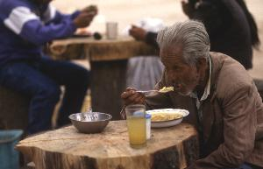
Integrating Food Security and Food Safety Policy
Food security: all people, at all times, have physical, social and economic access to sufficient, safe and nutritious food to meet their dietary needs and food preferences for an active and healthy life. [World Food Summit, 2009]
The four pillars of food security are availability, access, utilization and stability.
  Both food safety and nutrition are now seen as integral to food security
  But how does food safety contribute to food security?
Notes:
10
The concept of food security was developed over 30 years ago (driven by severe famines of the period) from the view that access to adequate food supplies was a prerequisite to public health.
This concept has evolved and now [through the World Food Summit 2009] to now recognise that food security is a multidimensional issue that requires a number of integrated policy.
The World Food Summit recognizes that food security rests on 4 integral functional pillars that focus on promotion and recovery of sustainable livelihoods – rather than food aid.
The pillars include:
Availability – which relates to provision of sufficient quantities of appropriate, quality and safe food
Access – by individuals to adequate resources to acquire appropriate food
Utilization – which highlights that adequate diets depend on clean water, sanitation and health care
Stability – which is provided through ongoing access to and availability of adequate, safe and nutritious food: including in the face of climate or market shocks.
It is important to note that both safety and nutrition are now integrated into the concept of food security.
Indeed it is surprising that safety and nutrition have taken so long to be recognized as fundamental links to food security given their own strong inter-linkage.
This interlinkage can readily be understood from the fact that poor food production or hygienic practices, at any point on the food chain, can result in food losses (compromising food quantity and nutrition) and result in food borne diseases that can compromise public health, productivity and trade.
Food safety and nutrition policies are therefore a critical element of food security policy – an integral and systemic approach is therefore essential if food security goals are to be realized.
So what policy approaches are being applied to ensure an integration especially across the food safety and security spectrum?

Slide 11
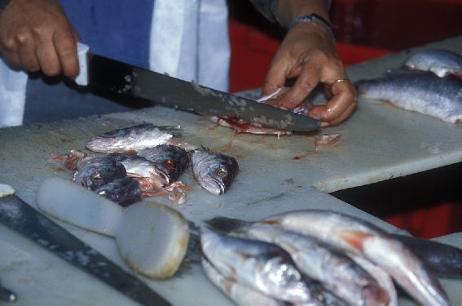
Contribution of food safety to food security
Prevention and reduction of foodborne illness among vulnerable populations, increasing productivity and livelihoods
Reducing food losses (pre and post harvest), increasing available food
Increasing market access, increasing purchasing power

Slide 12
A “Twin Track” approach to food security
Rural Development /Productivity Enhancement: ensure policies and programmes to sustainably boost food supply and establish resilient food systems that deliver safe and quality food
Direct and immediate access to food: through both direct food transfer, social safety nets, provision of resources, public work programmes, and nutrition intervention programmes
The “four pillars” are integral to this approach
Notes:
In support of efforts to achieve the MDGs, FAO with the support of IFAD and WFP, launched the “twin track” policy approach for combating hunger and poverty and addressing food insecurity.
“Twin-track approach” consists of:
strengthening the productivity of farmers and build resilient systems – this includes using an integrated approach to enhancing agricultural production, supporting research and technology, promoting diversification of food production, processing and marketing; and integrating safe food practices into these systems
2. direct and immediate access to food – through direct support to vulnerable groups including through nutrition intervention programmes, food transfers, conditional and unconditional resource transfers and public work programmes.
This twin track approach is intended to be mutually reinforcing and to address long term food security through sustainable agriculture and rural development aimed at preventing or mitigating risk.
The four pillars of Availability, Access, Utilization, and Stability are addressed in each of these tracks.

Slide 13
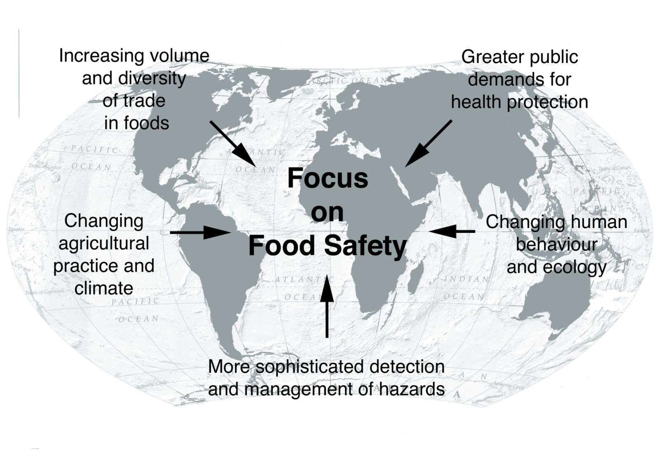
Focus on food safety
Increasing population and demand for food
Changing human/animal interactions
Changing hazards e.g. resistant microbes
Notes:
The focus on food safety within food security is however not new..........
For more than a decade there has been an increasing focus on food safety at both the public and commercial level driven by a range of factors including:
increased concentration of food production, agricultural practices and supply chain management (including retail);
globalization of the food supply and change in demand and supply;
the increased occurrence of food borne illnesses, and increases in zoonotic diseases;
greater demand by consumers for safe and quality goods; and
better understanding of food-borne hazards themselves.

Slide 14
Food chain approach
Food safety hazards may arise at different stages of the food supply
Food control – both at the public and private level – has moved to a “food chain approach”: all actors in the chain are responsible for food safety – A PREVENTATIVE APPOACH BASED ON RISK ANALYSIS RATHER THAN REACTIVE APPROACH
Notes:
The increased focus on food safety has resulted in new approaches to food safety policy and management.
Food safety hazards can arise at any point in the food supply chain.
Recognizing this - many governments, international agencies, and commercial enterprises have adopted a food chain policy approach that requires all actors who produce, transport, store, prepare and deliver food to be responsible for food safety.
It is a systems approach that integrates activities and responsibilities so that risks at all points of the chain are identified and managed.
This approach is therefore based on prevention rather than reaction and directly supports the desired outcomes of the four pillars of food security.

Slide 15



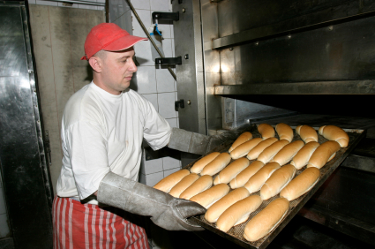
Reorientation of roles and responsibilities
Role of Governments is to be guarantors of the system
Open, transparent dialogue
Private/Public Partnership
Food producers and enterprises – develop and manage systems, and to ensure food is safe and have legal responsibility to meet food safety requirements set by the government
Notes:
15
15
The food chain approach requires responsibility for food safety being taken by all actors in the food production system: including governments to producers, processors and other entities in the food chain.
Government – act as guarantors of the system by
1. establish and manage food safety policy
2. legal and administrative frameworks
3. designating agencies empowered to establish officials requirements
4. determine an appropriate level of protection.
Food industry has the first line of responsibility – to ensure food safety, but also has other tasks regarding food quality, responsible labelling,
The food chain approach is the most effective way to maximise consumer protection, demonstrate due diligence, ensure measures are applied at the most outcome-effective point in the food chain, from pre-production practices to the point of sale or distribution to consumers.
Also note the changes this approach places on food inspectorate and inspection services. Food handlers must be able to demonstrate to inspectors that conformity with official standards has been achieved and maintained for all products processed or handled by them.
The food chain approach has been endorsed under the General Principles of Hygiene of the Codex Alimentarius Commission and thus forms an international benchmark for food safety internationally.
The importance of Codex itself must also be highlighted as a means of ensuring that common food safety policies are implemented internationally.

Slide 16
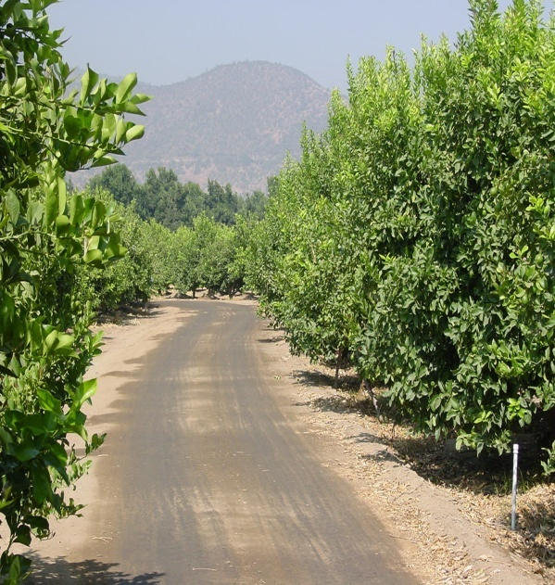
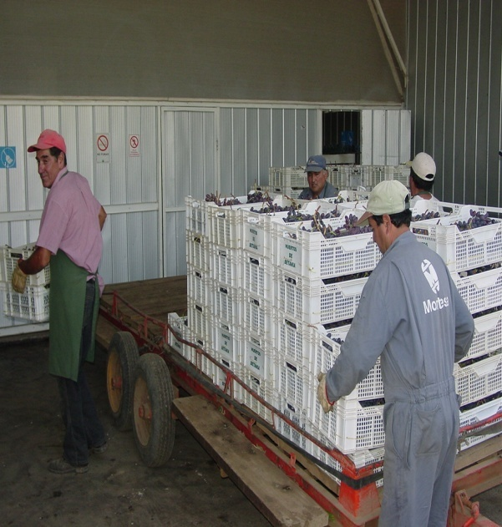
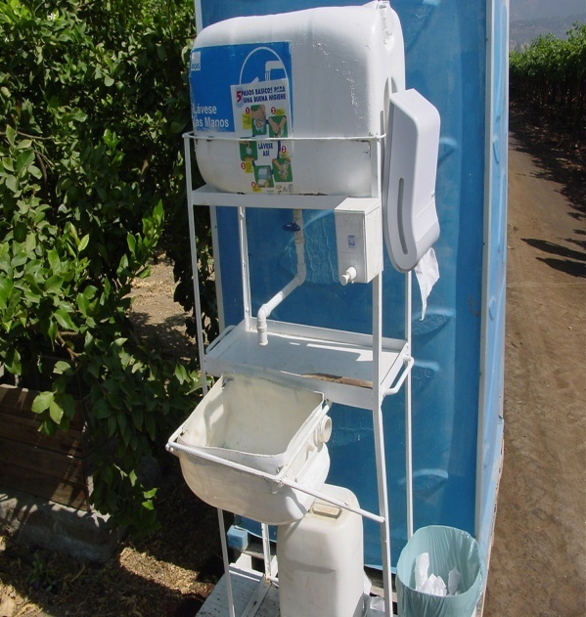
Good practices in the food production chain
GAP
GMP
GHP
...... and the Hazard Analysis Critical Control Point system (HACCP) at relevant points in the chain ...... optimizes quality and safety of food products throughout the food chain. It is an integral approach to food safety
Notes:
As there is less emphasis on end product testing and more on preventive measures, the systematic adoption of GAPs, GHPS, GMPS, and HACCP based approaches are an integral part of the food chain approach.

Slide 17
The role of Codex in international food safety policy
The primary international instrument to promote international harmonization of national food safety and quality standards and facilitate food trade
All measures must be science-based
Referred under the WTO SPS agreement
Codex standards
benchmark standards for national food control and in trade disputes on food safety/quality
Notes:
The importance of Codex should be highlighted in driving international consistency in integration in food safety policy.
Developed by consensus, and referred to under the WTO SPS agreement; Codex standards are required to be science based.
They act as benchmarks for national food control – thereby driving international harmonization of food safety standards – and provide policy discipline in SPS trade disputes under the WTO.
While Codex standards act as benchmarks and guides for national governments – they do not in themselves drive coherent or integrated national food safety policies.
This relies on capacity building efforts – that are underpinned by Codex – to support the development of consistent and integrated food safety systems at the global and national level.

Slide 18
Value of meeting international food safety standards to food security
World Bank research estimates that adopting international (Codex) standards for:
aflatoxin (B1) would increase African nut and grain exports by some US$670 million per year and expand global cereal and nut trade by US$38.8 billion
pesticide residue limits in bananas would raise African banana exports by about US$410 million a year
veterinary drug residues would boost South Africa’s beef exports by US$160 million a year

Slide 19
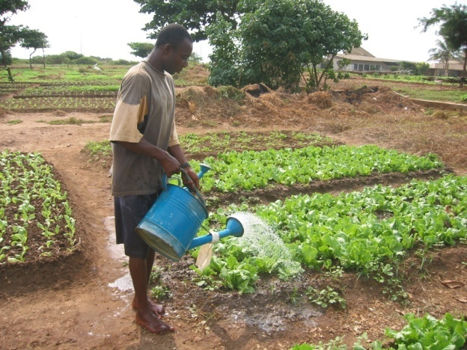
Challenges to meeting food safety
implementing food safety measures in a world of
  increasing food insecurity
  recession and financial crisis
  increasingly variable climatic conditions
importance of communicating and illustrating the value of food safety
retaining food safety as an integral part of the food security agenda

Slide 20

Concerns with meeting food safety requirements
Limitations of developing countries and those susceptible to food insecurity to implement effective food safety systems
Cost of implementation of food safety measures and compliance with standards
Diversity of food safety standards
  public vs private standards
  certification costs
  different requirements for different markets
  possible increase in cost of food thereby making it less affordable to poor consumers

Slide 21
Food safety in times of food shortage – finding the balance
When food is in short supply, can policy makers accept lower food safety standards to protect food security?
Can simple measures be taken at point of use to improve food safety?
Need to take into account the risks and the long term effects of under-nutrition in the risk analysis process (acute vs chronic effects of food safety hazards)

Slide 22
Capacity building as the driver of food safety policy integration
Many developing countries lack adequate capacity to develop integral policies for food security and safety
Food safety is still under-acknowledged by decision makers and given lower priority by major donors; though this is changing
Food safety capacity building efforts must aim to enhance individual and institutional capacities to enable countries to:
  develop integrated policies and programmes to enhance production of safe, quality food;
  meaningfully participate and apply Codex standards;
  support and enhance the agro-processing sector; and
  facilitate international food trade and improved market access
Notes:
Capacity building at both the institutional and infrastructural level is key to highlighting the importance of food safety to food security.
Capacity limitations occur both in recognizing the importance of food safety to food security and socio economic well being, or in implementing the tools and systems required to operate integrated food control systems.
Importantly, decision makers and donors alike may fail to recognize the linkages between food safety, nutrition and security and consequently under invest in the necessary policies and systems: this is changing however as international food safety incidents, and trade in food – especially from developing countries – increases.
Note that this can also be the case for food producers who may exhibit a biased perception about the high costs of compliance in return for limited benefits.
To address these constraints to implementing integrated food safety policies, a mix of approaches and tools is needed. This includes developing generic tools and guidelines to assist countries implement good safety practices, together with in country capacity building projects.

Slide 23

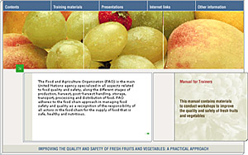

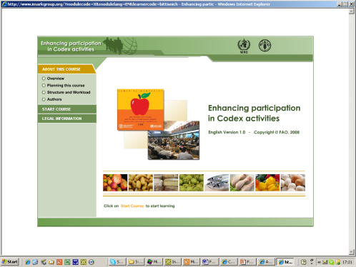
Guidance/Tools
On-line/CD training manual for FFV GAP
On-line course in GHP for coffee
FAO food safety website: http://www.fao.org/ag/agn
Codex web site: www.codexalimentarius.net
Food safety portal: http://www.ipfsaph.org/En/default.jsp
Notes:
FAO FS guidance tools have been developed in response to international demand for guidance of FS CB and range from:
text based guidelines covering both broad issues in improving food control capacity (e.g Guidelines for assessing CB needs); applying risk based approaches; and specific guidance on good practices – some are very specific to regions. So there FAO has developed a broad range and depth of materials.
on line/CD tools for example coffee GHP and FFV GAP [both of these are hot links on the slide and you can go to them directly]
range of tools to assist information sharing – e.g. international portal of food safety, animal and plant health (linked to OIE and IPPC)
Codex web site has an array of tools on how to enhance participation in Codex activities including an e-learning website
THESE TOOLS ARE DEVELOPED WITH INTERNATIONAL EXPERT INVOLVEMENT; ARE PEER REVIEWED; AND ROAD TESTED IN ORDER TO VALIDATE THEY ACCORD WITH NEED, ARE IN LINE WITH INTERNATIONAL NORMS AND GOOD PRACTICE; AND IMPORTANTLY ARE USEFUL

Slide 24
Conclusions
Global food security is a multi-dimensional problem and requires integrated policy responses
Food security, safety, and nutrition are inter-dependent
An integrated food chain approach enhances the linkage between food safety, nutrition and food security
The “twin track” approach to food security – addresses both acute and long term problems: food safety and nutrition are integral to this approach
Capacity Development frameworks will better integrate and guide food safety capacity building efforts
Food safety is dynamic – public policies need to be flexible to address new risks and adopt integrated preventative approaches.
Notes:
24

Slide 25
Thank you!
Questions?

