Slide 1
SFDA Local Regulations and Standards
Dr. Salah AlMaiman
Executive Director - Technical Regulations and Standards
Saudi Food and Drug Authority
Food Sector
Kingdom of Saudi Arabia
DIFSC
Dubai - March, 1st 2011

Slide 2
Overview
SFDA Local Regulation and Standards
SFDA Objectives
SFDA Regulations & Standards
SFDA Procedures related to claims
Recommendations

Slide 3
SFDA Local Regulation and Standards
SFDA Objectives
SFDA Regulations & Standards
SFDA Procedures related to claims
Recommendations

Slide 4
SFDA Main Objectives
1. Ensuring safety and wholesomeness of food and safety of feed.
2. Ensuring safety, efficacy, and availability of drug for human and animals.
3. Ensuring safety of biological, chemicals, Cosmetics, and pesticides.
4. Ensuring the safety of medical devices.
5. Performing researches and studies in related fields.
6. Establishing a good and positive communication and cooperation with all stakeholders locally and internationally.
7. Establishing databases for food and drug either imported or locally manufactured to help in risk assessment and traceability.

Slide 5
SFDA - Food Sector
Vision
To establish an effectively functional control body concerned with enhancing the safety and quality of food from farm to table.
Mission
To apply a regulatory system based on scientific principles and characterized by integrity and transparency which achieves, high levels of food safety and quality with the participation of all stakeholders.

Slide 6
Food Sector Scope of Work
Legislative:
Development and adoption of regulations & standards related to food safety and quality as well as feed & pesticide safety.
Inspection:
Inspection of imports, exports and locally produced food, feed and pesticides for compliance with approved standards.
Laboratories:
To operate modernized food control laboratories to strengthen their role in food control system.

Slide 7
Food Sector Scope/cont.
Monitoring:
To develop national monitoring programs for contaminants including pesticide residues and environmental contaminants in food and feed.
Awareness:
To Raise awareness on food safety issues among consumers and stakeholders in Saudi Arabia.
Research & Development:
To conduct studies and researches that contribute to strengthening consumer confidence in the safety and quality of food.

Slide 8
SFDA Local Regulation and Standards
SFDA Objectives
SFDA Regulations & Standards
SFDA Procedures related to claims
Recommendations

Slide 9
Regulations and standards drafted by SFDA
Standard setting related to food, feed and pesticides will be transferred from SASO to SFDA in the near future.
Saudi food low (Act ).(in its final approval stage)
Saudi Feed law.
Various new standards have been drafted by SFDA including those related to claims.

Slide 10
Drafting Saudi Food law: Resources Considered
When preparing Saudi Food Law the following resources were considered:
Existing national Control laws and regulations.
Generic Food Law prepared by FAO.
Benchmarking with international and regional food laws such as that of EU, USFDA, Australia, and Japan.
In Addition to technical assistance from international experts and organizations such as World Bank, UNDP, WHO, FAO,..etc.

Slide 11
General Features of Saudi Food Law
Harmonized with related international laws and regulations.
Meet the Kingdom commitments toward WTO.
Adopting safety of the whole food chain concept to ensure traceability.
Risk based.
Adopt Preventive control concept.
It was presented to all concerned parties.

Slide 12
Claims

Slide 13
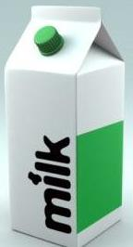
Examples of Claims
claim
Reduces the sense of hunger
Helps to moderate signs of anxiety in mildly stress-sensitive adults
Reduces arterial stiffness

Slide 14
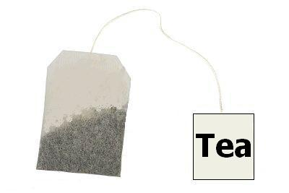
Examples of Claims
claim
Activates body's defence
Black tea helps you to focus attention.
Useful for patients with diabetes
Reduce risk of cancer

Slide 15
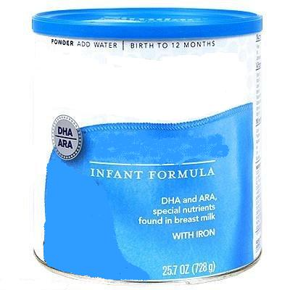
Examples of Claims
claim
Stimulates the immune system of children during growth.
Promotes a healthy body weight during childhood and adolescence.
Dairy foods promote dental health in children.
Chocolate milk helps you grow

Slide 16
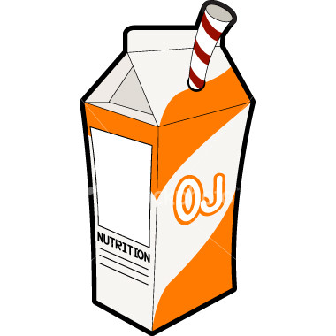
Examples of Claims
Claim
Cranberry juice helps reduce the risk of urinary tract infection

Slide 17
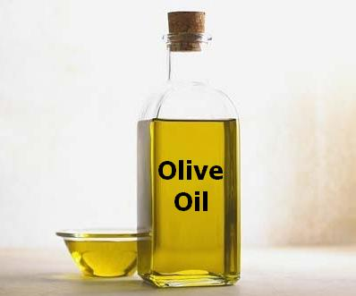
Examples of Claims
claim
Protect your heart
Help growth and development

Slide 18
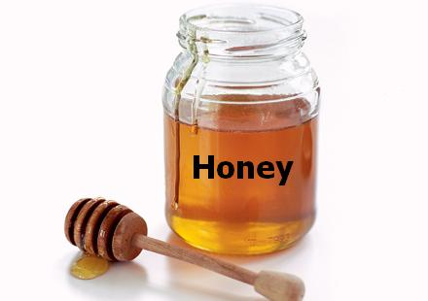
Examples of Claims
claim
Support the immune system
Promote a healthy heart
Reduce blood lipids

Slide 19
CURRENT: GSO and SASO standards related to claims
GSO (1366) G REQUIREMENTS FOR HANDLING OF FOODS FOR SPECIAL MEDICAL PURPOSES.
GSO (654) / 1996 GENERAL REQUIREMENTS FOR PREPACKAGED FOODS FOR SPECIAL DIETARY USES.
GSO (1058) / 2002 FOODS FOR USE IN WEIGHT CONTROL DIETS.
GSO (1021) / 2000 GLUTEN — FREE FOODS.
GSO (1367) /2002 FOOD WITH LOW SODIUM CONTENT

Slide 20
GSO (9)/2007 LABELLING OF PREPACKAGED FOODSTUFFS
Article 4/2 "A prepackaged foodstuff shall not be described or presented on any label or in any labeling in a manner that is false, deceptive; or is likely to entail an erroneous impression regarding its or characteristics in any respect”

Slide 21
7. GSO 2106/2010 INFANTS FORMULA AND FORMULA FOR SPECIAL MEDICAL PURPOSES INTENDED FOR INFANTS:
In article 10 : “These requirements include a prohibition on the use of nutrition and health claims for foods for infants and young children except where specifically provided for in relevant Codex Standards or national legislation”

Slide 22
GUIDELINES FOR USE OF NUTRITION AND HEALTH CLAIMS (Codex)
Nutrition and health claims shall not be permitted for foods for infants and young children except where specifically provided for in relevant Codex standards or national legislation.
(CAC/GL 23-2009).

Slide 23
Regulations and Standards Drafted by SFDA
1. DRAFT REGULATION ON NUTRITION AND HEALTH CLAIMS
Applies to nutrition and health claims made in commercial communications, whether in the labeling, presentation or advertising of foods to be delivered as such to the final consumer. It shall also apply in respect of foods intended for supply to restaurants, hospitals, schools, canteens and similar mass caterers.
In article 6 : Scientific substantiation for claims
Nutrition and health claims shall be based on and substantiated by generally accepted scientific data.
A food business operator making a nutrition or health claim shall justify the use of the claim.
SFDA may request a food business operator or a person placing a product on the market to produce all relevant elements and data establishing compliance with this Regulation.

Slide 24
:Article 11
Restrictions on the use of certain health claims
The following health claims shall not be allowed:
a) claims which suggest that health could be affected by not consuming the food;
(b) claims which make reference to the rate or amount of weight loss;
(c) claims which make reference to recommendations of individual doctors or health professionals

Slide 25
2. DRAFT REGULATION RELATED TO FOOD SUPPLEMENTS.
Addresses food supplements marketed as foodstuffs and presented as such and delivered to consumer only in a pre-packaged form and does not apply to medicinal products as defined by Saudi Arabian “Medicinal Product Law”.

Slide 26
3. DRAFT REGULATION ON NOVEL FOOD.
Applies to the placing on the market of foods and food ingredients which have not been used for human consumption to a significant degree within the KSA such as irradiated, genetically modified food.

Slide 27
SFDA Local Regulation and Standards
SFDA Objectives
SFDA Regulations & Standards
SFDA Procedures related to claims
Recommendations

Slide 28
SFDA Procedure
Product With Claim
Food With Claim
Food Sector
Medicine Claim With Added Active Drug
Registration
Scientific Evaluation Needed
Primary claim evaluation
Claim Compared to GSO, SASO and other approved Standards.
Consulting With International Bodies Such As CODEX, EFSA, FDA and Others
Conduct Scientific Studies ( Planning)
On the time being (Technical
Committee)
In the future (Risk
Assessment )

Slide 29
Claims- SFDA Procedure
SFDA ( Food Sector) is now dealing with claims as follow:
1. Primary Claim evaluation:
Cases are evaluated by compliance unit that investigates the claim and compare it to GSO, SASO and other approved standards.(accepted or rejected).
2. Claims needs scientific evaluation (scientific committee - Risk Assessment dept.):
Evaluate claims by referring to literatures published on that specific matter.
Refer to different international bodies such as Codex Alimentarius, EFSA and US FDA as well as other related bodies.
When ready and fully operational, this department will conduct its own full scientific evaluation.

Slide 30
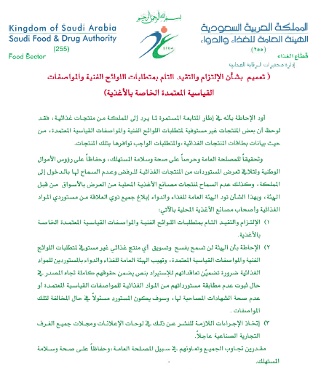
SFDA Procedure
Notification sent to chambers of commerce and posted on SFDA site
Notification
Concerning the
Committee and
compliance of
Requirements
of food
Specialized
Technical
Regulations

Slide 31
SFDA Local Regulation and Standards
SFDA Objectives
SFDA Regulations & Standards
SFDA Procedures related to claims
Recommendations

Slide 32
Recommendations
More specific health/nutrition claim standards needed.
Regional or international Accessible health claim database.
Regional or international workshops on health claim.
Harmonization of claims procedures on the GCC level.

Slide 33
Je vous remercie de votre attention
Dziękuję za uwagę
Thank you for your attention
感谢您的关注！
Vielen Dank für Ihre Aufmerksamkeit
شكـــــراً لانتبــاهكم
Dziękuję za uwagę
ご清聴ありがとうございました
感谢您的关注！
Tak for jeres opmærksomhed
Thank you for your attention

