Slide 1
Global Regulations on
Nutrition and Health Claims -
Why Harmonisation Matters
International Workshop on
Responsible Consumer Information on Nutrition and Health Claims
DIFSC March 1st 2011
Eva Hurt
Corporate Regulatory & Scientific Affairs
Nestlé

Slide 2
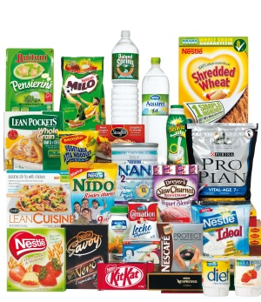
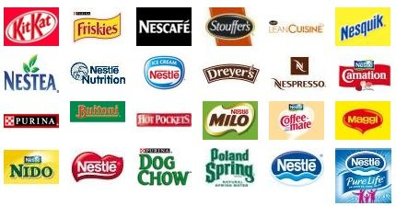
Nestlé – A Truly Global Company
Our Billionaire Brands
A product for every moment of every day, from morning to night and from birth to old age
Every single day we sell around 1 billion products

Slide 3
Nestlé Research & Development
Global scale & local relevance
29 R&D Centres
320 Application groups
5,200 People

Slide 4
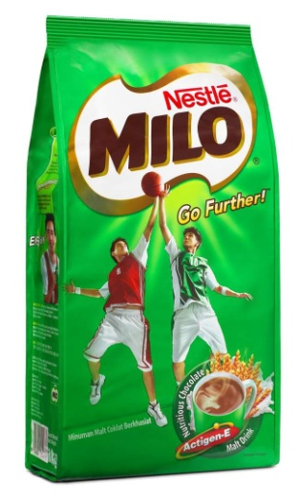

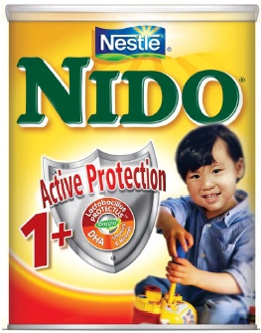



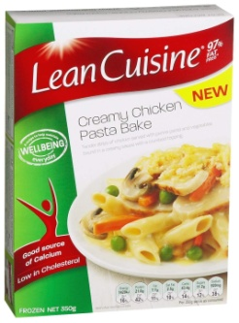
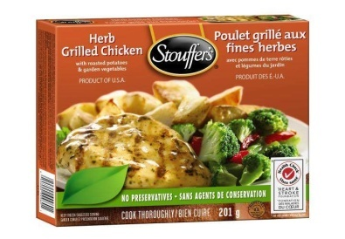
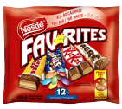
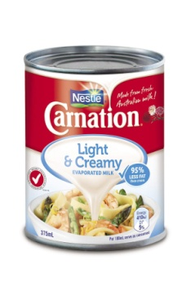
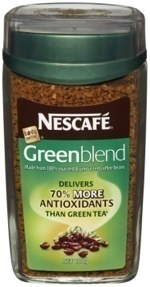
From Nestlé Innovation to Health Claim
Optimal energy release
Enriched with Calcium
Active
Protection
40-80 Calories per bar
Helps lower cholesterol
Wellbeing
everyday
Knowledge of local consumers and local regulations is key*
*Claims for illustrative purposes only

Slide 5
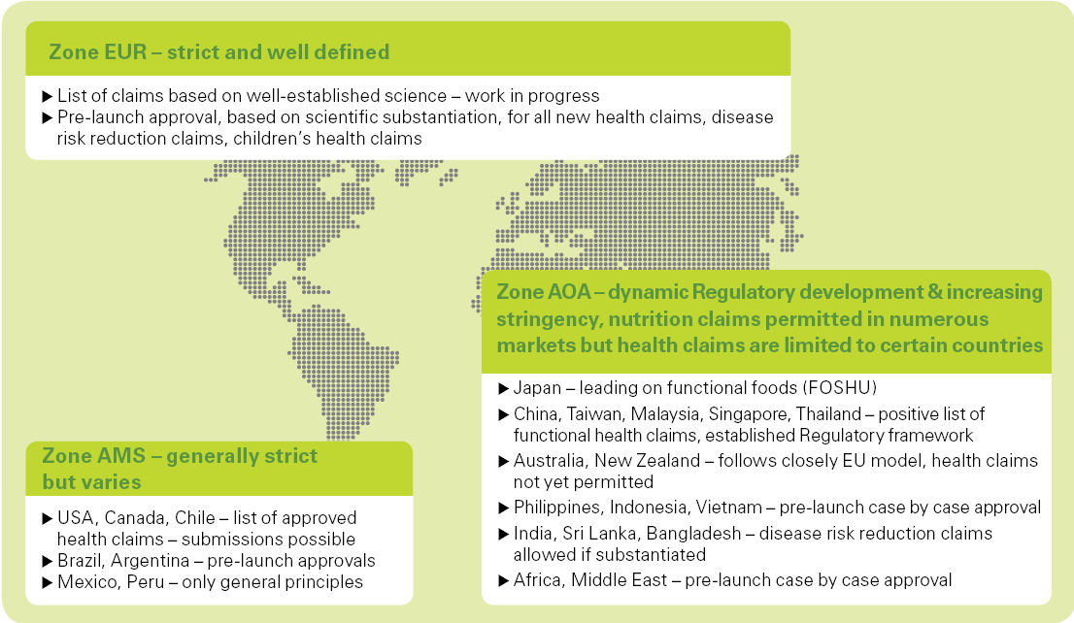
Health Claims Situation - Global

Slide 6
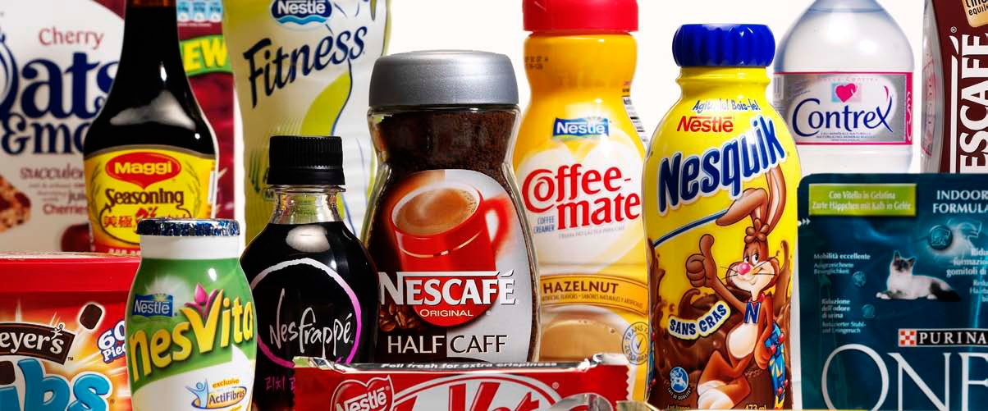
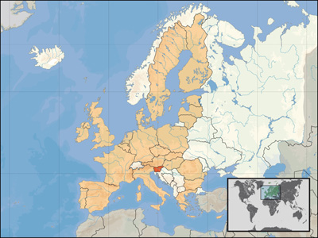
EU Regulation on Health Claims
Harmonised requirements for nutrition and health claims on food products across the 27 countries of the EU
  Third countries fully apply general principles (CH, Norway)
  1 approved health claim - 500 million consumers
  Maximisation and protection of R&D investment (CHF 2.0 bio spend on R&D)

Slide 7


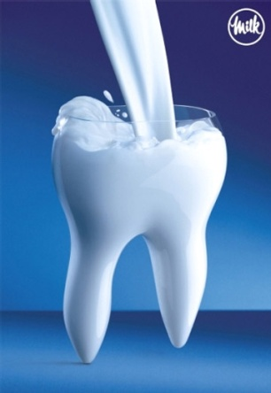
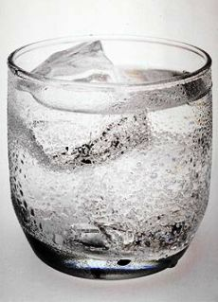
EU Regulation on Health Claims
Nestlé Position
Nestlé welcomes :
All Health Claims are approved prior to use in EU
Use of nutrient profiles as condition for making claims provided they are science based and do not discourage product innovation.
Proprietary data protection
New applications possible at any time making
the system one of the most flexible in the global context

Slide 8
Actual Challenges of the Regulation
The “unfinished” Regulation in EU –
Need to obtain positive outcome on
  Adoption of Community list of permitted health claims (Art 13)
  Final interpretation of data protection provisions (Art 21)
  Adoption of workable Nutrient Profiles (Art 4)
  Amendment of Annex Nutrition Claims
    Inclusion of claims that encourage product reformulation
    Simpler rules on comparative claims
  Guidance on use of authorised claims
    Flexibility of wording of adopted claims
    Conditions of use
The “future” Regulation – What’s next? Where do we (want to) go from here?

Slide 9
The Real Challenge for Nestlé -
Health Claims on a Global Scale
The EU health claim system is based on a procedure open to new health claims, which are granted based on a scientific evaluation of the highest standard
EU system is likely to influence countries with no specific health claims Regulations in place (Australia-NZ, South Africa, others) today
We have observed that authorities use EFSA Opinions and use these to restrict claims in their countries without having corresponding authorisation procedures in place.
We have observed that some regions follow US-FDA Regulations, others follow the EU model for Claims.

Slide 10
Key Elements for Global Health Claims Regulations
Classification of health claims according to Codex Alimentarius
Proportionality of science and communication – do not communicate beyond the facts but allow to communicate the facts
Proper scientific evaluation and transparent process
  Risk assessment separated from risk management
  Totality of evidence needs to be taken into account
  No fixed number of trials
  Recognition of science from other parts of the world

Slide 11
What’s next? Nutrient Profiles
Nestlé welcomes nutrient profiles in the framework of the EU Health Claims Regulation
Increasingly, on a global level (WHO) and in the EU, the debate widens to include nutrient profiles for other purposes than health claims (e.g. taxation, advertising, fortification).
Industry should not support unilateral application of existing nutrient profiles for purposes other than health claims without careful consideration of their consumer benefit and regulatory context.

Slide 12
Why Harmonisation Matters
A few examples :
On a given product, Mexico and Argentina share one multilingual label – in principle.
However, Mexico’s Nutrition Labelling Regulation does not include fibre in total Energy count
Therefore two sets of legislation are leading to two energy values for the same product: how can we explain that to the consumer?
Reference information : |  |  | Label text: Spanish
Nutrient | per 100 g | Per serving | Composición media | Por 100 g | Por porción
Energy | 2270 kJ | 567 kJ | Energía, kJ | 2251 Argentina 2230 Mexico | 561 556
Protein | 7.5 g | 1.9 g | Proteínas, g | 7,5 | 1,9
… |  |  |  | …
Fibre | 2.4 g | 0.6 g | Fibra dietética g | 2,4 | 0,60
Sodium | 0.076g | 0.019 g | Sodio, mg | 76 | 19

Slide 13
Why Harmonisation Matters
Different definitions of ‘yogurt’ in Asia lead to lengthy approval processes in some countries delaying multi-market launches
Mandatory nutrition labelling is introduced around the world with slightly different rules in each countries,
  e.g. Malaysia, Singapore and Thailand, although geographically close, do not share the same list of mandatory nutrients
Lack of harmonized tolerances for nutrition labelling leads to different nutrition tables for one and the same recipe
  25 recipes for ASEAN countries for same product from the same factory due to different nutrient declaration tolerances.
  4 labels for 5 countries (TH, HK, PH, MY, & IN) for same recipe
    1 additional product registration can take 6-12months
    1 additional label costs approx. 100.000€
More and more fragmentation in regulations
Harmonisation of regulatory landscape

Slide 14
What’s next ? Health Claims
The “future” Regulation – Where do we want to go from here? ‘EU-Qualified health claims’? ‘Prevention claims’?
Harmonised regulation facilitates health claims leverage across countries with similar needs and product categories
We would welcome harmonisation of nutrition labelling and health claims rules beyond EU, e.g. in Asia, Latin America, Africa and the Middle East
Scientifc evaluation of the highest standard is a unique opportunity to create credible claims that will make a real difference and give consumers the reliable and necessary information about food and its benefits that they long for.

Slide 15


... captures the very essence
of Nestlé and the promise
we commit ourselves to
everyday, everywhere
as the leading Nutrition, Health
and Wellness Company

