Slide 1
Global Food Safety Initiative - Harmonising Food Safety Standards
Catherine François
Director Food Safety Programmes, Consumer Goods Forum

Slide 2
Driving continuous improvement in food safety to strengthen consumer confidence worldwide

Slide 3
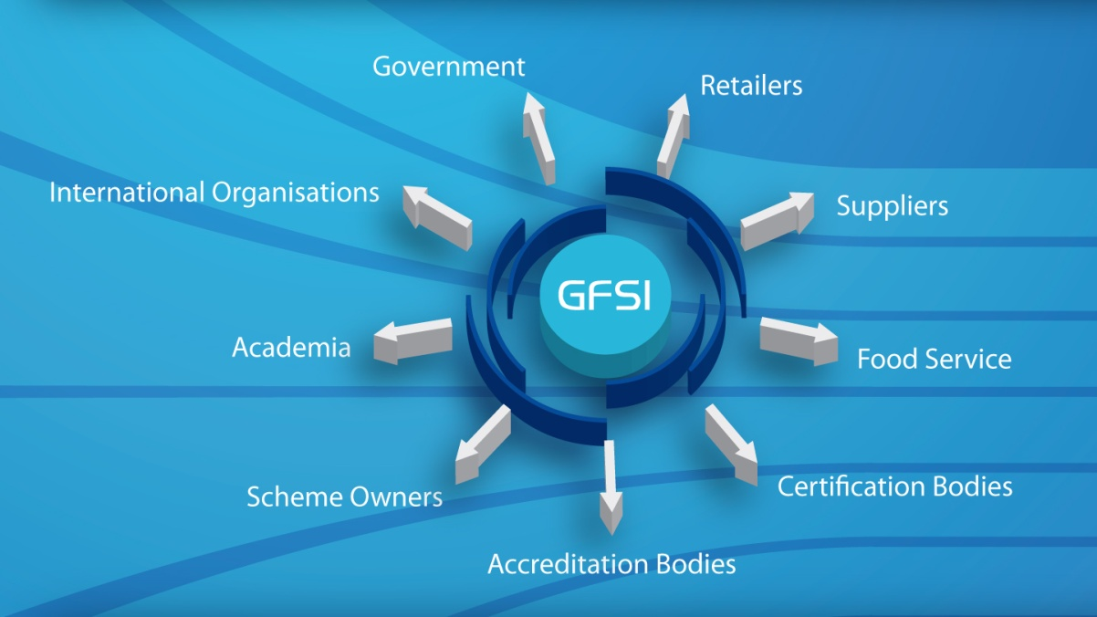
GFSI – A Shared Responsibility
In order to meet consumer expectations, a global solution is key.
GFSI is a multi-stakeholder approach involving the whole supply chain

Slide 4
GFSI managed by The Consumer Goods Forum (formerly CIES)
An independent global parity-based Consumer Goods network
Over 650 Members
Paris, HQ
Washington D.C.
Tokyo
Notes:
The Forum is a body equally representing retailers and manufacturers in the food and non-food sectors, whose combined sales are worth
2.1 trillion Euros.
Our members are the CEOs and senior decision makers in their respective companies.

Slide 5
The Consumer Goods Forum Top of Mind Survey
 | Ranking 2011 | Ranking 2010 | Ranking 2009
Corporate Responsibility | 1 | 2 | 3
Food Safety | 2 | 4 | 2
Economy and Consumer Demand | 3 | 1 | 1
Consumer Health & Nutrition | 4 | 7 | 7
Retailer Supplier Relations | 5 | 5 | 5
Notes:
A survey conducted by The Consumer Goods Forum across approximately 400 retailers and manufacturing CEOs indicated that food safety remains a high priority among this leadership group. Where ever the threat to food safety originates, a wider-reaching global supply chain exposes our food supply to enhanced risk and much of the responsibility falls to those who ultimately produce and sell the food. As the distance from farm to fork grows wider, it becomes harder for companies who source globally to control every point in the supply chain.

Slide 6
Notes:
Same lack of geographic pattern
Again possible they correlate with media coverage of food safety issues and recalls, especially in down markets
Our position it’s also the changing attitudes of consumers when it comes to food preferences and personal values

Slide 7
In 2000…..
Food safety crises led to a decline in trust
Profileration of individual retailer schemes
Burden to suppliers and producers due to frequent audits
Lack of efficiency and high costs in the food supply chain
Notes:
Back in 2000, food safety was also top of mind with consumers due to several high-profile recalls, quarantines, and negative publicity about our industry. The retailers and manufacturing CEOs agreed that consumer trust needed to be strengthened and maintained, while making the supply chain safer, through the harmonisation of food safety standards and driving cost efficiency, which is why GFSI was created.

Slide 8
Why GFSI ?
GFSI Mission
Driving continuous improvement in food safety to strengthen consumer confidence worldwide
GFSI Objectives
GFSI
Reduce food safety risks
Manage cost
Develop competencies and capacity building
Knowledge exchange and networking
Notes:
OBJECTIVES :
Reduce food safety risks by delivering equivalence and convergence between effective food safety management systems
Manage cost in the global food system by eliminating redundancy and improving operational efficiency
Develop competencies and capacity building in food safety to create consistent and effective global food systems
Provide a unique international stakeholder platform for collaboration, knowledge exchange and networking

Slide 9
GFSI Strategic Priorities 2011 - 2015
Building Confidence in Certification
Forging Links with other Organisations
Communication

Slide 10
Building Confidence in Certification Through a Robust Guidance Document
A multi-stakeholder document that specifies the process by which food safety schemes may gain recognition and gives guidance to schemes seeking compliance. It also specifies the requirements to be put in place for a food safety scheme seeking recognition by GFSI and the key elements for production of safe food.
Part I - The Benchmarking Process
Part II - Requirements for the Management of Schemes
Part III – Scheme Scope and Key Elements
6th Edition - Issued in January 2011

Slide 11
Convergence Means Confidence
Benchmarking work was originally carried out on four food safety schemes (BRC, IFS, Dutch HACCP and SQF) to reach a point of convergence.
All schemes were completely aligned with the GFSI Guidance Document Version 5 requirements.
This meant increased confidence in the schemes and comparable audit results.
Notes:
One of the objectives of the Global Food Safety Initiative is convergence between food safety standards.
Presently, benchmarking work has been completed on 10 food safety management schemes. These schemes have been formally benchmarked and recognized by the GFSI Board. These schemes are completely aligned with the GFSI Guidance Document, Version 5 requirements.
This results in increased retailer confidence in these schemes and comparable audit results.

Slide 12
GFSI Breakthrough – June 2007
The following companies came to a common
acceptance of GFSI benchmarked standards, and
now many other companies have followed suit
Notes:
In June 2007, the following companies announced their common acceptance of GFSI benchmarked standards at post farm gate level, meaning once a facility is certified by any of the benchmark schemes, the results will be recognized uniformly.
This was a significant moment for the GFSI, given that the buying power this group represents is enormous, representing approximately 740 billion US dollars across 325,000 stores worldwide.

Slide 13
Benchmarking – What does this mean? « Once certified, accepted everywhere »

Slide 14
Some companies now accepting GSFI recognised schemes
Notes:
14

Slide 15
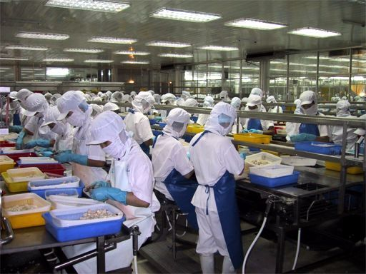
Case Study – U.S. Food Service and GFSI
In 2005, U.S. Foodservice only accepted audits from companies that could demonstrate:
Audit check list that has been revised to include latest food safety risks
Auditors with strong competencies in the industries audited
Strong standardization programs among auditors
No conflict of interests between consulting and auditing
In 2006, U.S. Food Service discovered that the GFSI benchmarked schemes would address the majority of concerns and a stakeholder system would address the rest.

Slide 16
Feedback on GFSI Certification
Notes:
December 2010 Survey Results - Survey was distributed to 1300 supplier facilities, 471 responded
Of Those NOT working towards Certification, why not? (Top 3 reasons)
50%- No Time
20%- No Resources/ Personnel
30%- Other
10% No benefit to GFSI
7%- Cost
7% Do NOT understand GFSI
7% No value vs. Cost
This brought us to the internal question: Internal Question: Do we want Suppliers that don’t have the time or resources to do food safety & quality?
Of Those Working towards Certification, what are you not yet certified? What are the barriers to getting started? (Top 3 reasons)
While there are some barriers a good portion of the Suppliers didn’t have any problems
27% NO barriers
25% Time
21% Understanding GFSI
15% Resources
7% Cost

Slide 17
Feedback on GFSI Certification
Notes:
The Good News IS: Majority feel that GFSI Recognized Certifications Improved Safety and Quality in Their Operations
Top 3 Most Significant benefits to date:
69 % Improved Food Safety
61 % Improved Food Quality
44% Reduced number of 3rd Audits
25% No Benefits Yet

Slide 18
Benefits to Date for U.S. Foodservice
Globalized program across all categories & suppliers
More consistent interpretations – raising the bottom
Better documentation on HACCP, Food Safety and Food Quality plans
On-site systems verification by competent staff
Grievance mechanism against non-performing auditors and/or audit companies/CBs, Standard Owner and Accreditation Agencies
Decreased need for our pre-approval and approval audits
More focused interventions/easier identification of gaps & focus for our staff

Slide 19
Why Suppliers Like GFSI…..!!
“Lidestri Foods Inc.”
Having a large number of customers, one of the biggest challenges becomes the many different food safety and quality programs that need to be implemented and managed. GFSI has helped us standardize these programs within our own organization as well as across our customer base.
Mark Scoville - Corporate Quality Assurance Manager
“The Carriage House Companies”, along with its' parent Ralcorp Holdings, are strong proponents of the Global Food Safety Initiative and the growing support in North America. We feel that by successfully meeting the BRC standards, we have enhanced our quality and food safety systems to a new level, have provided our employees with a better understanding of the HACCP Principles and have developed a continual focus for our plants to be Audit Ready, Everyday !”
Joe Woloszyn, Director of Quality and Product Safety
“As a distributor of fresh produce, Mastronardi Produce felt that the requirements for SQF 2000 best met our business objectives and closely paralleled our already existing food-safety program.
Most all of senior management has remarked on how this has made their jobs easier….Less re-work easily translates into more profitability. We have less employee turnover due to a more engaged workforce. Also our budget for audit expenses has dramatically decreased.
Joe Darden, Vice President Of Food Safety

Slide 20
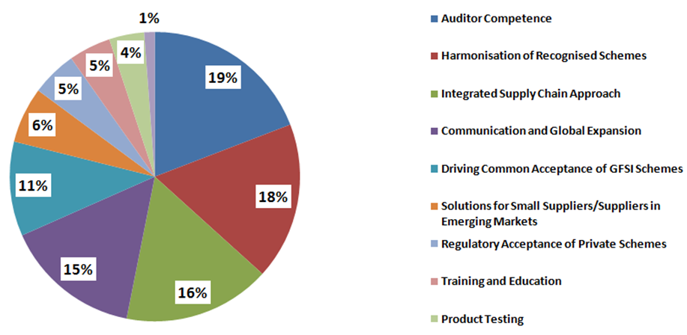
Stakeholder Meeting Output 2011 : Top Critical Focus Areas for GFSI

Slide 21
Requirements of society.
9.000.000.000 Consumers
in 2050

Slide 22
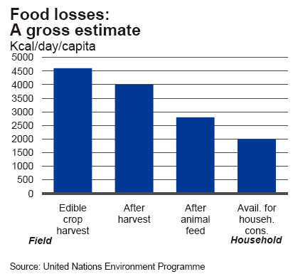
Further challenges for Food Safety
Food demand will increase by 70%
Food and animal feed production to compete with biofuels:
Higher costs for food production
Climate change
High losses from food production to household (50%):
Rotting / Vermin
Inefficient supply chains
Lack of cold chain control
Poor local infrastructure
Left overs
Animal diseases

Slide 23
GFSI Adding Value …
Less duplication
Driving consistency in the content of the standards
Healthy competition between existing schemes, driving continuous improvement in the delivery of the standards with checks and balances where required
More cost efficiency in the supply chain and fewer audits for suppliers
Comparable audit approach and results
Flexible approach to all suppliers globally
Confidence in sourcing and safer food for the consumer
Notes:
In closing, the GFSI adds value in many ways

Slide 24
For more information:
Websites
www.mygfsi.com
www.tcgffoodsafety.com
Email
gfsinfo@theconsumergoodsforum.com

