Slide 1
Foodborne Disease Outbreak Tabletop Exercise
Dubai, UAE
February 2014

Slide 2
Objectives
Understand the specific and intersecting role of laboratory and epidemiology
During cluster detection
During cluster/outbreak investigation
During outbreak deceleration and resolution
Understand the key considerations for communication between laboratory and epidemiology during outbreak investigations

Slide 3
Overview
Scenario with five parts
Short slide presentation for each section followed by discussion
Time | Section
20 mins | Introduction
25 mins | Part 1 (Detection)
25 mins | Part 2 (Acceleration)
25 mins | Part 3 (Deceleration/Resolution)
25 mins | Wrap up

Slide 4
Introduction

Slide 5
Foodborne Disease Outbreak Investigations
Goals:
Immediate control of outbreak and prevention of illnesses
Provide opportunities to identify gaps in food safety systems
Effective investigations key to reducing burden of foodborne disease
Identify food vehicles and factors which lead to outbreaks

Slide 6
Foodborne Diseases: A Changing Landscape
More food is centrally produced, so when something goes wrong, people get sick over a wide area
More food is sold fully cooked, so consumer just has to warm it
More food is eaten in restaurants, so more people have a hand in preparing our food
We import more of our food supply, so we depend on the food safety systems in other countries
Healthy animals can carry germs that make us sick
New technologies for producing, processing, and preparing foods
These data are for training purposes only and do not represent factual events
6

Slide 7
Steps in investigating an outbreak
Detect the cluster and assemble a team
Gather descriptive information
a. determine etiology
b. describe the outbreak by time, place, and person
c. write a case definition
d. conduct surveillance for more cases
Generate hypotheses
Test hypotheses
a. design a study
b. analyze the study
Determine how and where contamination occurred
Prevent more illnesses
Communicate

Slide 8
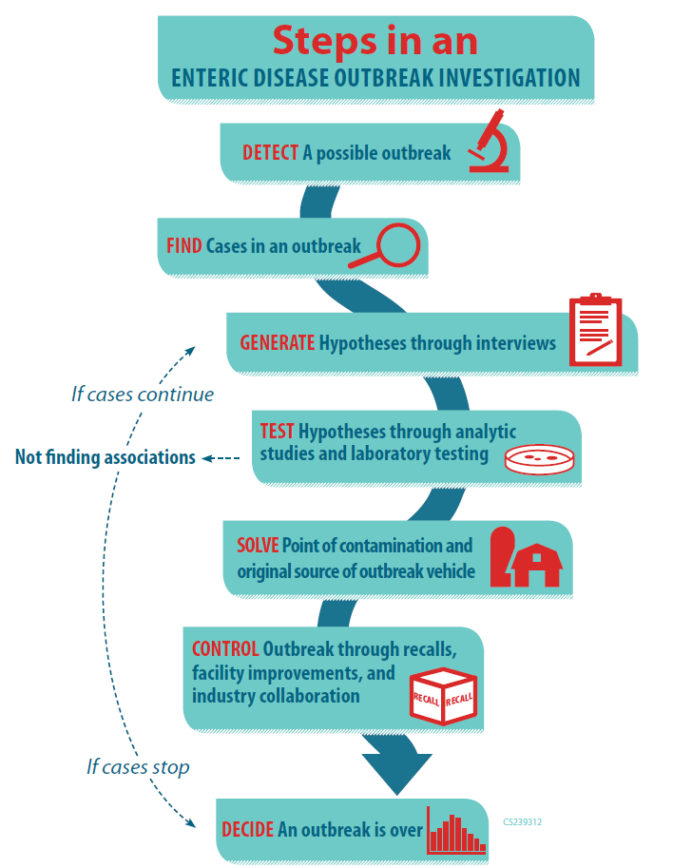

Slide 9
Cluster vs. Outbreak
Cluster = the occurrence of more than the expected number of people diagnosed with a certain disease within a specific group, geographic area, or period of time
Outbreak = a cluster of cases linked by a common exposure/event
Not all clusters are outbreaks

Slide 10
Lessons Learned in Investigating Multistate Foodborne Disease Outbreaks
Case patient demographics (age, sex, ethnicity) and geographic/ temporal distribution provide critical clues about the source
Clusters of cases at restaurants, events, food shopping venues are key
Help narrow the focus
Facilitate traceback to find commonality across clusters identified
It is not just asking ill people what they ate, but also understanding how food is prepared at the menu/ingredient level
Industry groups can provide information to help shape hypotheses

Slide 11
E. coli O157
Shiga-toxin producing E. coli (STEC)
Colonizes intestinal tract of ruminants
Diarrheal illness
Can be severe in children and elderly
Hemolytic-uremic syndrome (HUS) (a type of kidney failure)
Incubation time: The time from eating the contaminated food to the beginning of symptoms is typically 3-4 days
Commonly implicated vehicles: ground beef, leafy greens, and unpasteurized dairy
Notes:
E. coli O157 is a Shiga-toxin producing E. coli, or STEC, that colonizes the intestinal tract of ruminant animals, such as cattle. In humans, infection causes a diarrheal illness, which can be severe, especially in children or the elderly. Hemolytic uremic syndrome, or HUS, can occur and can result in kidney failure. Ground beef, leafy greens, and unpasteurized dairy products are commonly implicated vehicles in outbreaks.
11

Slide 12
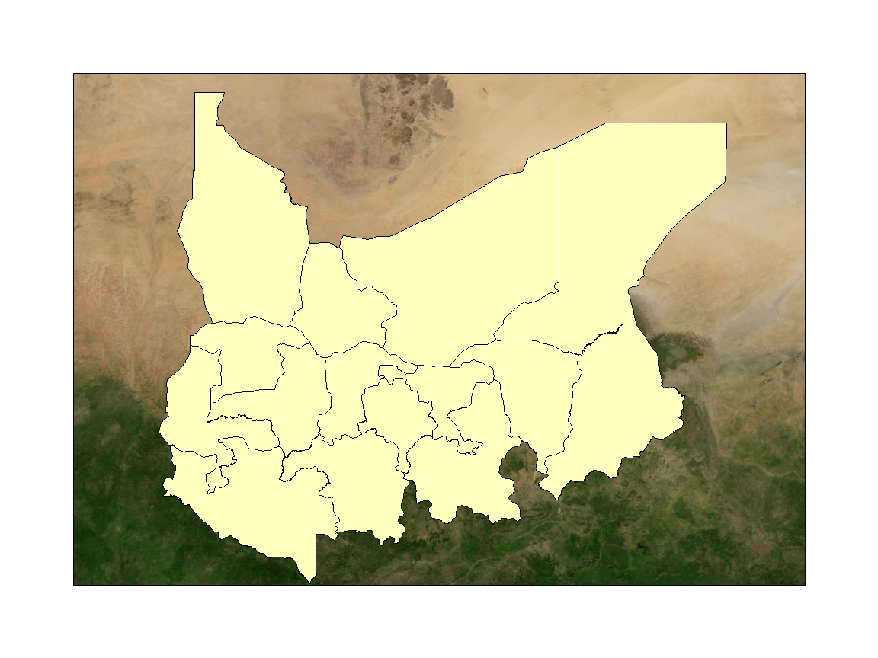
Khatib
Population size: 63 million
Capital city: Khatima, population 1 million
Ministry of Health headquartered in Khatima
Breakdown of municipal structure
Province
Community
Country X
Sina

Slide 13
Laboratory Capacity for E. coli O157 Testing in Khatib
Provincial laboratories and major hospitals institutes have capability to test stools submitted for the presence of Shiga toxin-producing Escherichia coli (STEC).
National Health can conduct DNA "fingerprinting" with pulsed-field gel electrophoresis (PFGE)

Slide 14
Part 1: Detection

Slide 15
Outbreak Detection
19 April 2014: Block Health officer in Sanand block was informed by an local health worker in Andej village of cluster of 6 children with bloody diarrhea
2 children have already died
Rapid response team consisting of district level health officials as well as clinicians and experts from the local Medical College have been dispatched to the field on the same day.

Slide 16
Preliminary Case Patient Demographic/Clinical Info (n=6)
Illness onsets during 5 April to 20 April
Median age = 7 years; Age range: 6 to 8 years
67% (4/6) are female
5 hospitalized
3 with Hemolytic Uremic Syndrome (HUS)
2 deaths
Preliminary laboratory testing from 2 cases with HUS indicates E. coli O157 infection

Slide 17
Preliminary Case Definition
Illness with laboratory confirmed E. coli 0157 OR Hemolytic-uremic syndrome (HUS) OR blood diarrhea among a resident Khatib since 1 April 2014

Slide 18
Notification of Health Providers
An alert is sent to local hospitals, clinics, and health workers in Khatib to report any suspect cases of illness

Slide 19
17 cases from 7 provinces, as of 19 April
Andej
Village

Slide 20
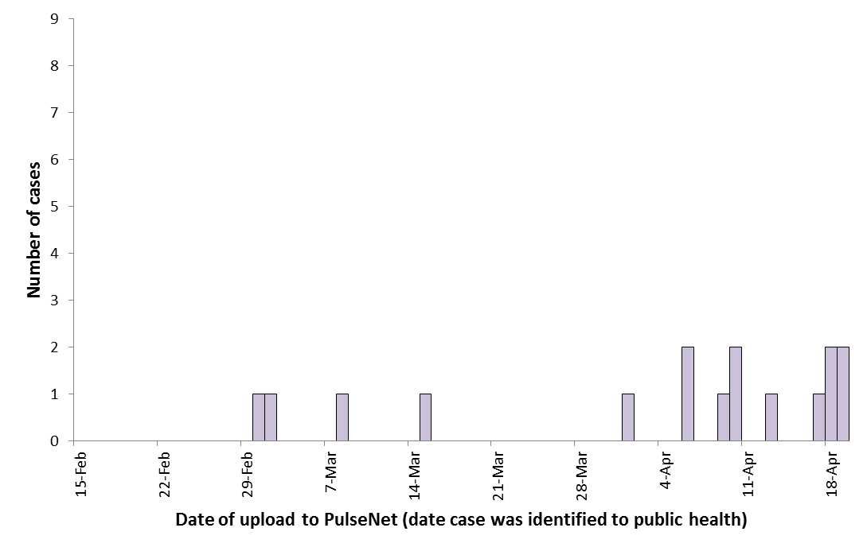
Cases by Date of Report - 15 Feb to 19 April 2014 (n=17)
Case Patient Demographic/Clinical Info
Median age = 22 years
Age range: 2 to 65 years
< 5 years = 13%
6 to 17 years = 30%
18 to 50 years = 43%
50+ years = 4%
Female = 71%
10 hospitalized
3 with Hemolytic Uremic Syndrome (HUS)
Two deaths
Date of report

Slide 21
Panel Discussion – I
Perspectives and next steps as of 19 April 2014?
Is this an outbreak?
Laboratory / Epidemiology
Is case definition appropriate?
What other case-finding methods should we consider?
How frequent/what are the logistics of how information exchanged between lab and epi?
How helpful would it be to request additional lab testing?
What is helpful for lab to know to better aid epi investigation? Vice versa?
Communication:
Public health notification?
Local
National
International
Does the public need to be informed
If so, what/how?

Slide 22
Part 2: Acceleration

Slide 23
Next Steps: Hypothesis Generation
Rapid response team requested food/exposure history from patients parents/care givers via “supplemental” E. coli O157 questionnaire that includes a 5 day food history plus specific questions on:
Unpasteurized milk and dairy
Leafy greens (spinach, lettuce), sprouts
Animal contact
Shopping & eating locations
Attendance at events
Travel history
A notice sent to other Districts to complete supplemental questionnaire on any illnesses meeting the case definition
Completed supplemental questionnaire requested by fax to District Health Officer which provides to National Level Health Authority

Slide 24
Summary Clinical/Demographic Information as of 9 May 2014
56 cases in 14 provinces
21 hospitalizations, 3 with hemolytic uremic syndrome (HUS); two reported deaths
Unusual age distribution
Heavily skewed toward 15-49 (75% of cases)
More females (~70%) than males
Illness onset range: 27 February – 20 April

Slide 25
Lab Information as of 9 May
19 cases have confirmed E coli O157:H7 Infection
DNA "fingerprinting" with pulsed-field gel electrophoresis (PFGE) performed at the National Reference Laboratory, found:
17 (89%) had same rare pattern, EXHX01.0026 / EXHA26.0005
2 (11%) other patterns
All isolates with EXHX01.0026 / EXHA26.0005 pattern are positive for stx2 only (a marker for more sever disease)

Slide 26
Case Interview Information as of 9 May
A total of 25 questionnaires received
Cases report eating:
Eggs (92% 23/25), nuts (88% 22/25), lamb (88% 22/25), yogurt (88% 22/25), chickpeas (84% 21/25), tomatoes (76% 19/25), eggplant (64% 16/25), cucumber (64% 16/25), milk (76% 19/25), oranges (56% 14/25)
No single brand or type predominates for any of these foods
No other food eaten in unusual frequency
Cases eat food bought from many different markets – none in common
No history of travel or attendance at a common event

Slide 27
Case Interview Information as of 9 May
Four unrelated cases (from different families) reported eating a meal at the same Anganwadi (local community center)
Meal dates on 2 April and 3 April
No other cases report common food exposure

Slide 28
A Cluster in Another Province
On 10 May, Razi Province reports a sudden cluster of cases of HUS presenting at local hospitals
No previously reported cases
Does not neighbor any provinces with reported cases
Total of 18 hospitalized cases with bloody diarrhea, 4 with HUS
Preliminary laboratory testing from 2 cases with HUS indicates E. coli O157 infection
Median age is 19 years, 75% are male
Illness onsets range: 7 April to 16 April

Slide 29
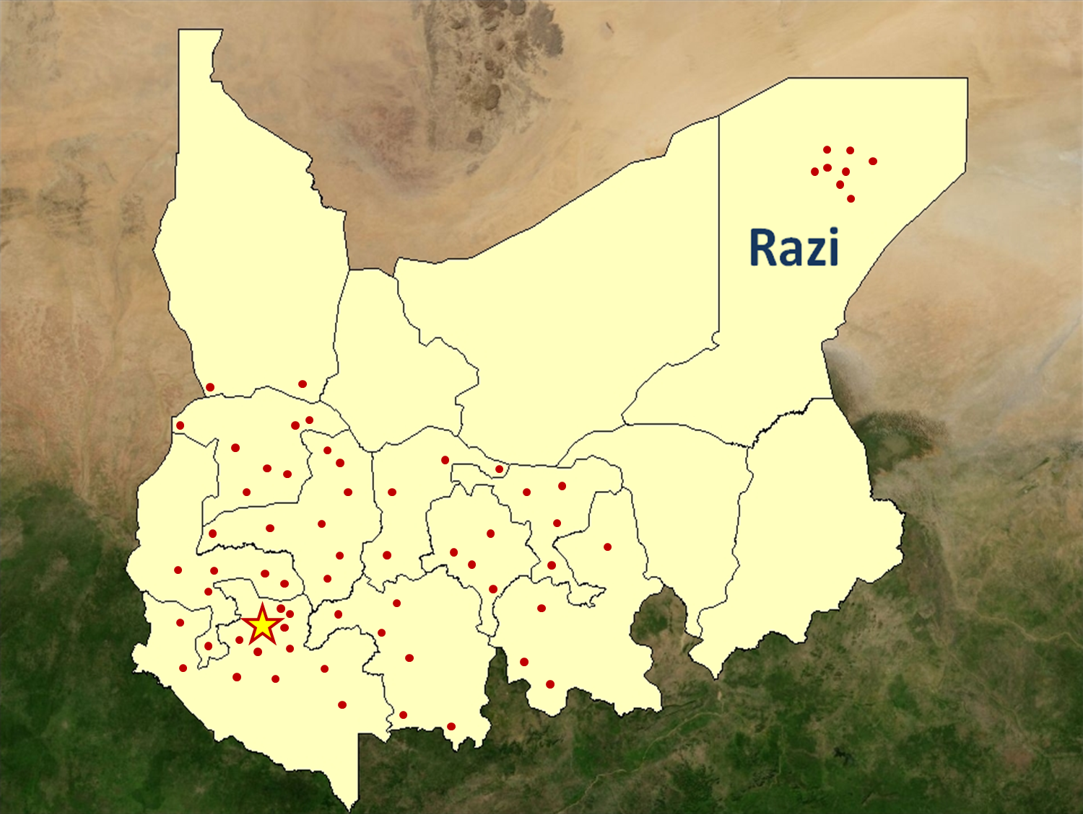
64 cases in 11 provinces, as of 10 May

Slide 30
Panel Discussion IIa
Is this an outbreak?
Is the HUS cluster in Razi Province part of the larger investigation?
What information do you want to know from lab?
What information do you want to know from epi?
Next steps, right now?
Lab
Epi

Slide 31
Part 2: Acceleration Part 2

Slide 32
Revised Case Definition
Illness with laboratory confirmed E. coli 0157 OR Hemolytic-uremic syndrome (HUS) since 15 Feb 2014

Slide 33
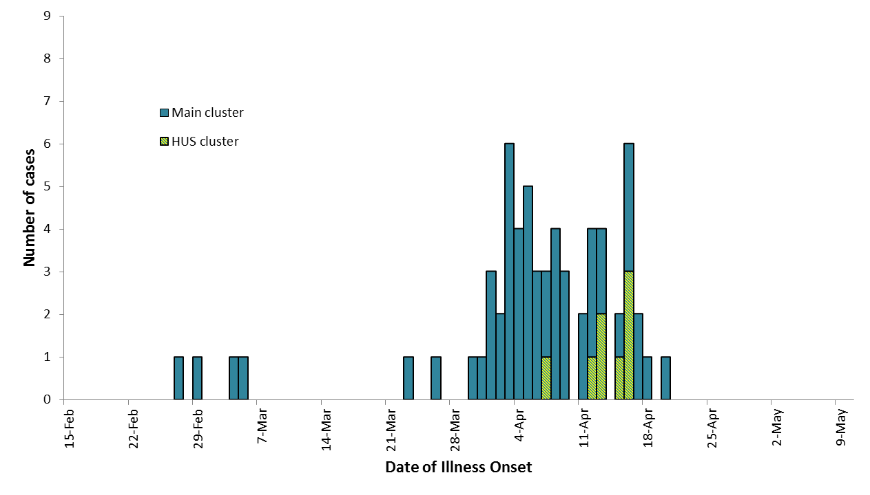
Infections with E. coli O157:H7 by Date of Onset,
15 Feb to 10 May 2014 (n=64)
Cluster Identified (April 19)

Slide 34
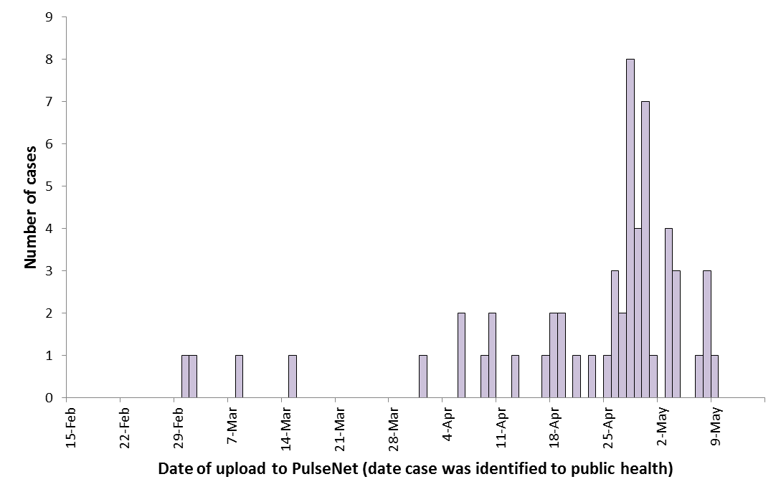
Infections with E. coli O157:H7 by Date of Report, 15 Feb to 15 May 2011 (n=56)
Cluster Identified (April 19)

Slide 35
Case Food Consumption Information as of 15 May (n=40 of 64)
Exposures reported by >50% of cases
Nuts: 82%
No single type of nut predominates
Chickpeas: 84%
no single type predominates
Yogurt: 86%
Four unrelated cases eating at the same Anganwadi were asked about the meal they ate there
All had a meal consisting of rice, dal, cucumber salad, and raita

Slide 36
HUS cluster in Razi
Health officials interviewed 6 of 8 hospitalized cases
3 reported eating at 2 different sandwich shops serving kofta and shawarma
Shop A: veal/lamb kofta with all toppings
Shop B: one chicken shawarma with all toppings; one lamb kofta, but never eats any of the vegetable toppings

Slide 37
Lab results for HUS cluster
PFGE results indicate that patient isolates from the HUS cluster match the main outbreak pattern (EXHX01.0026 / EXHA26.0005)
Toxin profile also matches (stx2 only)

Slide 38
Panel Discussion IIb
Is this an outbreak?
What is the case definition?
What does the shape of the epi curve tell us about the hypothesis (if anything)?
What type of epidemiologic follow-up?
Analytic studies
Comparison studies (what)
Can engaging industry be helpful? How?
Food testing
What do we test, if anything?
Communication
Lab/Epi
Public health notification?
Local
National
International
Does the public need to be informed
If so, what/how?

Slide 39
Part 3: Resolution/Deceleration

Slide 40
Case definition
Confirmed
A person with E. coli O157 infection with illness onset from February 15, 2012 to present, and
with isolate matching PFGE XbaI pattern EXHX01.0026
Suspect
A person with either HUS or diarrheal illness confirmed as Shiga toxin-positive based on laboratory testing (PFGE pending or not available)

Slide 41
Menu-level Comparisons
A total of 7 cases in Razi report eating sandwich wraps from 2 different shops
Shop A: 2 cases report eating veal/lamb kofta with all toppings; 2 cases report eating chicken shawarma with all toppings
meal dates between 6 April and 10 April
Shop B: two cases report eating chicken shawarma with all toppings; one lamb kofta, but never eats any of the vegetable toppings
meal dates between 4 April and 7 April
A total of 9 cases in Andej Village reported eating a meal at the Anganwadi (local community center)
All had a meal consisting of rice, dal, cucumber salad, and raita
Meal dates either of 2 April or 3 April

Slide 42
Ingredient-level Comparisons
Recipes for each dish served at the sandwich shops and Anganwadi obtained
Different proteins used in the meals eaten by ill people
Common: yogurt sauce on shawarma and raita at Anganwadi)

Slide 43
A Hypothesis!
Could contaminated yogurt be the source of this outbreak?

Slide 44
A Hypothesis!
Could contaminated yogurt be the source of this outbreak?
What are the ingredient in yogurt sauces served in the sandwich shops and the raita served in the Aganwadi?

Slide 45
Yogurt Sauce Ingredients
Aganwadi (raita)
Yogurt, brand A
Cumin
Cucumber, shredded
Salt
Shop A
Yogurt, brand A
Cucumber, diced
Garlic, fresh
Salt
Shop B
Yogurt, brand A
Mayonnaise
Cumin
Cucumber, grated
Garlic, grated
Salt
Sugar
Pepper

Slide 46
Raita/Yogurt Sauce Ingredients
Anganwadi
Yogurt, brand A
Cilantro
Cucumber, shredded
Cumin
Onion
Salt
Shop A
Yogurt, brand A
Cucumber, diced
Garlic, fresh
Salt
Shop B
Yogurt, brand A
Mayonnaise
Cumin
Cucumber, grated
Garlic, grated
Salt
Sugar
Pepper

Slide 47
Engaging Industry
Yogurt
Brand A yogurt makes up 92% of the market share
Cucumbers
Cucumbers grown in 2 southern provinces this time of year
2 large farms (Farm Alpha and Farm Zeta)
Sell commercial volume cucumbers; farms do not sell cucumbers to retail grocers
4% of cucumber crop was exported to 3 neighboring countries
Farm Alpha closed since 1 March due to workers’ strike

Slide 48
Food testing
Based on ingredient-level comparison, lab undertakes targeted food testing of
Brand A yogurt
Cucumbers from Farm Zeta

Slide 49
Food Testing Results
Two weeks later, 30 May
Cucumbers
PFGE outbreak strain (EXHX01.0026 / EXHA26.0005)
Toxin profile: stx2
Yogurt
STEC (+); PFGE different from outbreak strain
Toxin profile: stx1 and stx2

Slide 50
Panel Discussion III
Is this an outbreak?
Significance of the food testing results?
What if cucumbers were negative?
STEC(+) yogurt → action point?
Is the outbreak over?
Communication:
Does the public need to be informed
If so, what/how?
Public health notification to local, international agencies
If so, what/how?
Debriefing the investigation team:
Logistics, evaluation, lessons learned, next time

Slide 51
Investigation of Farm Zeta
A large dairy farm was directly adjacent to the cucumber-growing area.
Testing of water from the sewage lagoon identified E. coli O157:H7 with a PFGE pattern indistinguishable from the outbreak strain (EXHX01.0026 / EXHA26.0005)
There was evidence of water pooling in a low-lying part of the cucumber field close to the dairy farm.
The farmer reported several episodes of unusually heavy rains in the weeks before the first cases were reported and then during the period when cucumbers were harvested from this field (late March and early April).
A recommendation was made to the farmer to not use harvest areas prone to flooding

Slide 52
What is the conclusion of this outbreak?
Large, multi-prefecture outbreak of E. coli O157
64 cases in 11 provinces
39 (61%) hospitalized; 2 deaths
Illnesses were most likely caused by consumption of contaminated cucumbers served at restaurants/outside the home
Cucumbers were grown by Farm Zeta

Slide 53
64 cases in 11 provinces, as of 30 May

Slide 54
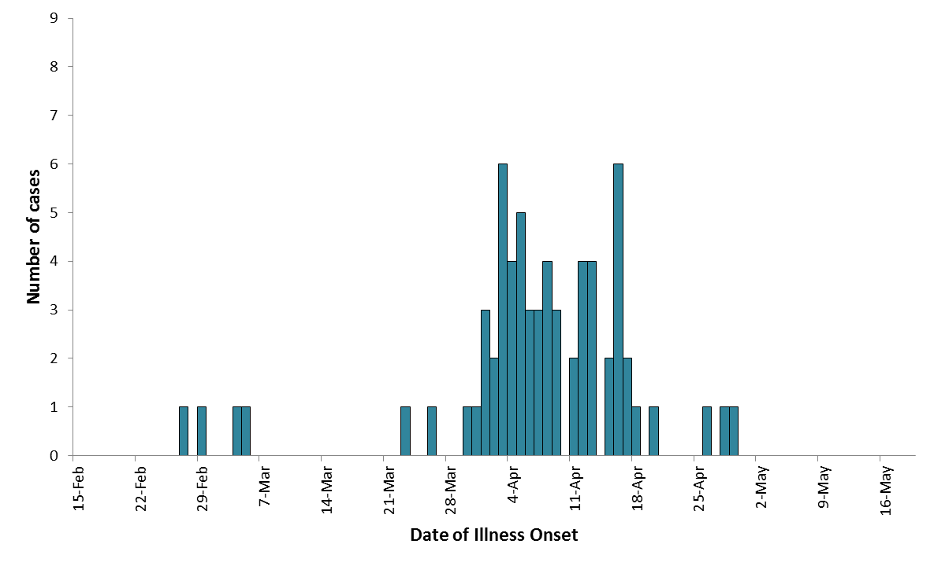
Final epi curve of cases by date of illness onset,
15 Feb to 19 May 2011 (n=64)

Slide 55
Wrap up
PFGE aided in confirming and defining the scope of an outbreak
Industry aided understanding market share and product distribution
Routine communication with lab and epi group critical to success of the outbreak
How do we sustain lab/epi communication and collaboration?
What activities can you implement right now to strengthen lab-epi communication and collaboration?

