Slide 1
Examples of Existing modelling tools for tracking Microbial hazards in food chain
Moez SANAA & Ewen TODD

Slide 2
QRA MODELS
“PRODUCTION-TO-CONSUMPTION”
Dynamic models for predictive microbiology including Growth & Survival
Specific to the food matrix
Consumption patterns
Panels, Health status
Raw
Materials
Transport
Process/ Food packaging
Transport
Retail
Consumer
RISK
Starting material
Management of the primary production
Pre-harvest activities
Primary production models
Thermal transfer models
Cross-contamination
and
Recontamination
models
Quantitative analysis of raw material quality data / farm release models
statistical analysis procedures
Notes:
Première diapo sur les compétences
Click1 : Approche intégrée de la fourche à la fourchette
Click2 : Avec application de modèles dynamiques de croissance et de survie avec prise en compte de la dynmaique des caractéristiques du produit tout au long du process
Click3 : Integration des différents « schémas » de consommations, prise en compte des caractéristiques de la populations,…
Click4 : Développement de procédure de traitements statistiques des données sur la qualité de la matière première : = QADD pour Quantitative analysis of dairy data
Click1 : Intégration d’un module tenant compte des contaminations croisées et re-contaminations : a de l’importance dans BIOTRACER (inadvertent or intentional contamination ») ➔ cf diapo suivante qui présente ce module

Slide 3
MODEL GENERAL PRINCIPLES example Milk production
Raw Milk contamination
  Growth during transport and storage
  During processing: reduction/survival/Growth
Contamination during processing
  Recontamination
    Transfer of organisms from plant environment to cheeses
  Cross contamination
    transfer of microorganisms from one cheese to another caused by direct or indirect contact
  Bacteria fate
    Products/Environment
    Growth/stress
Detection / Response: detect and respond to “incidents”
Notes:
Progrès en matière de sécurité microbiologique des aliments depuis 10 ans
Multiplication des analyses environnement / produits
Identification des sources de contamination (typage)
Renforcement du niveau de maîtrise hygiénique
Conséquences
Baisse du niveau de contamination
Détection difficile des contaminations
Analyse statistique des données d’échantillonnage non concluantes
Questions
Quel niveau de contamination réel dans l’environnement ?
Quel impact sur les produits ?
Quelle efficacité des mesures de maîtrise ?
Respect des FSOs ?

Slide 4
COMPARTMENTAL MODEL
Cheese processing room
Ripening
room 1
Ripening
room 2
Packaging
room
Passageway
Ripening
room 3
Smearing machine room
Ripening
room 4
Presence of bacteria colonies in different compartments : milk (cells/Liter), Products (colonies/Product), Environment (colonies), Machines (colonies)
State of compartment C at time t: C_{t}= (a_{i}, b_{i}), i = 1 to n
    a_{i} = size of the colony i (cells) b_{i} = Latency specific to colony i n = number of colonies

Slide 5
COMPARTMENTAL MODEL
STEP S+1
STEP S
Lot K1
Lot K2
Cheese
Cheese
Machine
Environment S+1
Environment S
Transfer of colonies
Intra-lot and inter-lot contaminations
Intra-step and Inter-steps contaminations

Slide 6
MODEL THE TRANSFER OF COLONIES
Machine
p_{mc}
Cheese
p_{cm}
p_{me}
Environment
Notes:
Ici dire que la variabilité provient de la concentration initiale en BL2: 9; 9.2; 9.8

Slide 7
Fate of the micro-organism in foodstuffs (predictive microbiology models)
Impact of food technology
Moez SANAA

Slide 8
Outline
Primary growth models
  Classical models
  Microbial interactions
Secondary growth models
  Cardinal models
  Growth/no Growth boundary
  Lag times models
Model validation

Slide 9
Growth phases
Environment conditions are considered constant
ln(x)
Death
ln x_{max}
exponantial
Lag
(latency)
Stationary
μ
ln x₀
Time

Slide 10
10
10
9
exponential
Gompertz
9
8
8
log₁₀ x₀ = 5.86
log₁₀ x_{max} = 9.54
lag = 50.3 h
μ_{max} = 0.043 h⁻¹
7
log₁₀ x₀ = 5.90
lag = 39.9 h
μ_{max} = 0.037 h⁻¹
7
6
6
5
5
0
100
200
300
400
0
100
200
300
400
10
10
9
logistic
9
Baranyi
8
log₁₀ x₀ = 5.60
log₁₀ x_{max} = 9.42
lag = 38.1 h
μ_{max} = 0.042 h⁻¹
8
log₁₀ x₀ = 5.85
log₁₀ x_{max} = 9.32
lag = 47.5 h
μ_{max} = 0.040 h⁻¹
7
7
6
6
5
5
0
100
200
300
400
0
100
200
300
400
10
9
Rosso
log₁₀ ufc.ml⁻¹
8
log₁₀ x₀ = 5.90
log₁₀ x_{max} = 9.35
lag = 39.7 h
μ_{max} = 0.037 h⁻¹
7
6
5
temps (h)
0
100
200
300
400

Slide 11
Factors that affect growth
Biotic environment
  Competition for nutrients, production of specific inhibitors (bacteriocins), alteration of the environment
Abiotic environment
  Temperature, oxygen levels, specific preservatives (e.g. nitrite, organic acids, smoke components), space limitation, diffusion of nutriments, etc.
Strain differences

Slide 12
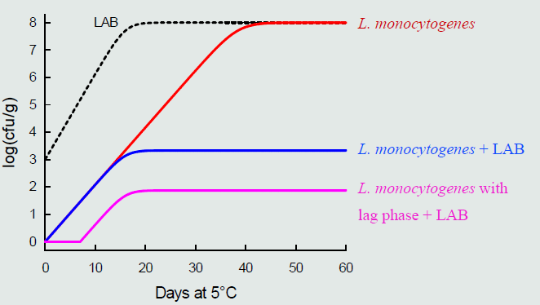
Microbial interaction
Giménex & Dalgaard 2004, Mejlholm & Dalgaard 2007

Slide 13
Comparing two constant environment conditions
ln x
ln x_{max}
x_{max} = x_{max1} = x_{max2}
x₀ = x₀₁ = x₀₂
μ₁
pH₁ = pH₂
aW₁ = aW₂
T_{opt}= 37°C, T_{min}= 2°C
T₁ = 25°C, T₂ = 15°C
μ₂
ln x₀
lag₁
lag₂
Time (h)

Slide 14
Secondary Growth models
Environmental Factors
"CARDINAL Model"
1.4
pH = 7
pH = 6
pH= 5.5
pH = 5
T = 37°C
T = 25°C
T = 15°C
T = 10°C
1.2
1
0.8
0.6
μ_{max} (h⁻¹)
0.4
0.2
0
0
10
20
30
40
50
4
6
8
10
température (°C)
pH

Slide 15
Secondary Growth models
Cardinal temperature model

Slide 16
Full cardinal model

Slide 17
Cardinal model assumptions
Optimal growth is a characteristic of microbial strain specific to food matrix
Cardinal parameters are strain specific
  Could be assessed using broth media
Strain variability could be captured by varying cardinal parameters

Slide 18
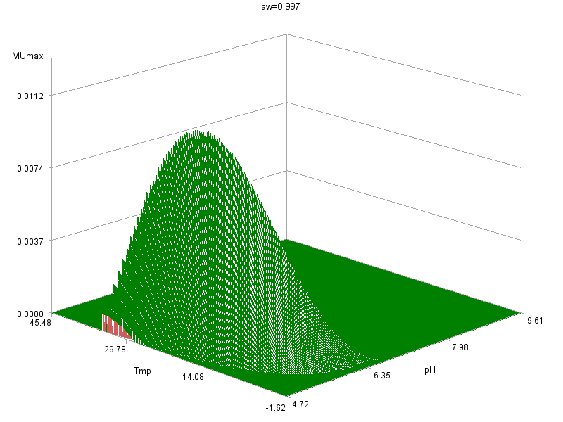
Aw = 0.997
T°C
pH

Slide 19
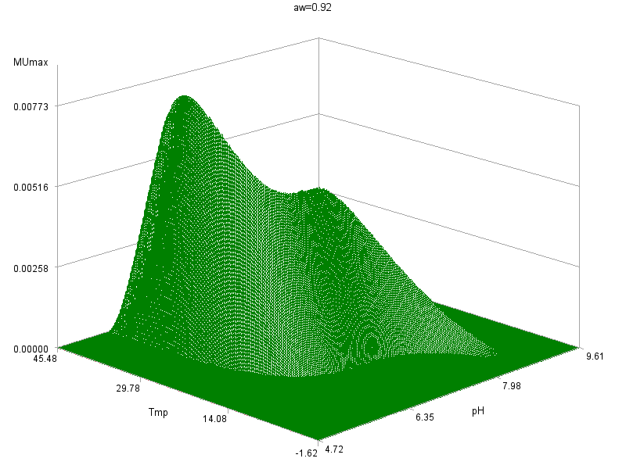
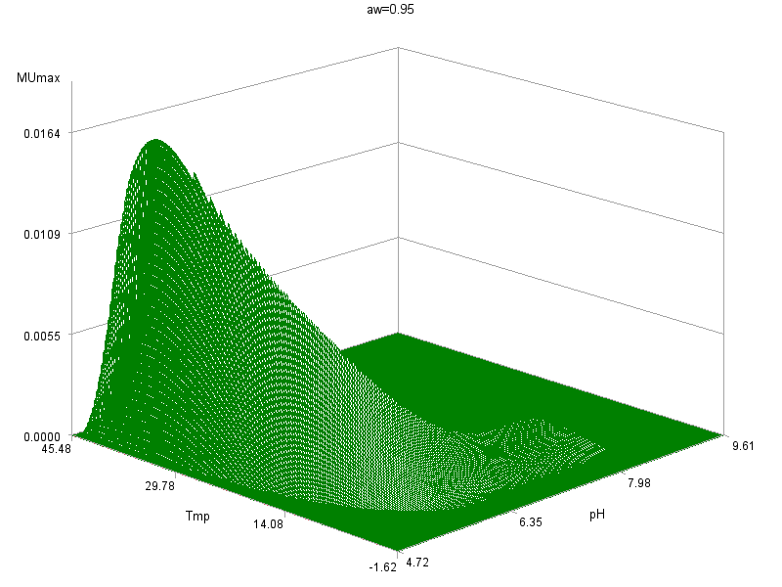
Ex: Listeria monocytogenes
Aw = 0.93
µ = µ_{opt} . ϕ(T°, pH, aw)
Aw = 0.95
T°C
pH
T°C
pH

Slide 20
Growth Boundary
Augustin et al 2005
X : are environment factors (pH, T, aw…)
C : are inhibitor factors concentration such as organic acids

Slide 21
Lag time models
Lag time for a microorganism depend on
  Environment parameter
  Physiological stage of the microorganism
Relative lag time (RLT)
  RLT=lag time/generation time
  RLT=lag time x Ln2/Growth rate

Slide 22
Population vs Cellular lag time
Growth rate of populations and single cells do not differ
Lag time for populations (> 10-100 cfu/g) are shorter and less variable than for single cells
Lag time of single cells (corresponding to contamination of some foods) can be predicted from population based data of similar physiological condition
  lag time x μmax = 3.9 ± 2.5 (single cells)
  Ln(Mean lagpopulation) = 0.907 x Ln(Mean lag single cell) – 0.311
Single cell lag is about two times the population lag

Slide 23
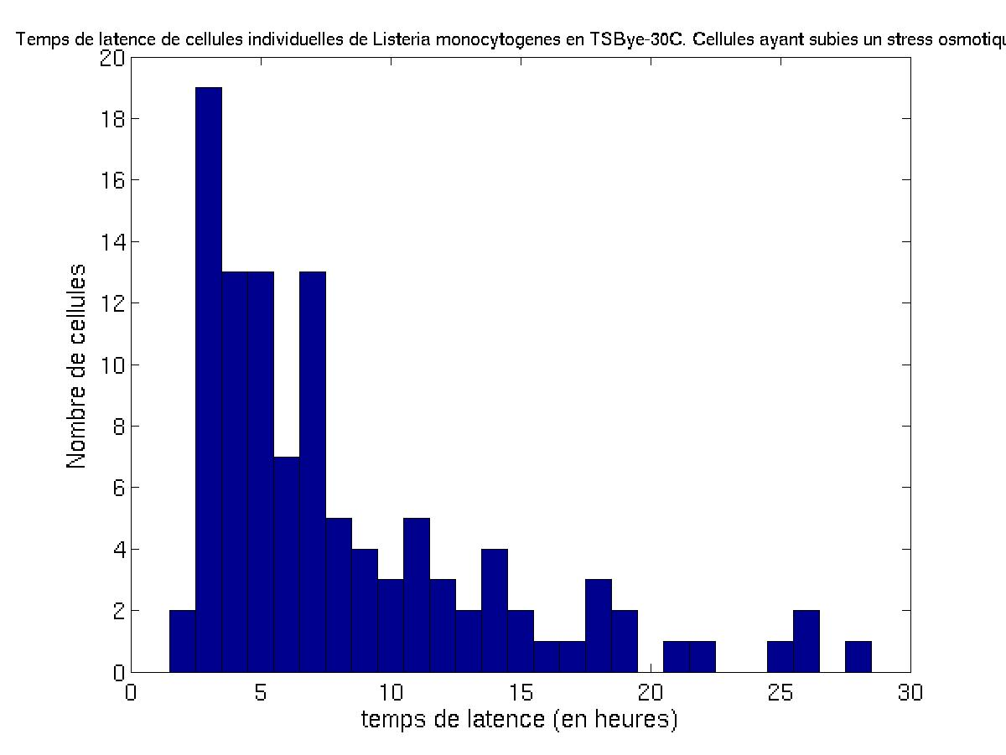
Distribution of cell lag: osmotic stress (NaCl 25% fo 24 h )
Cellular lag time variability

Slide 24
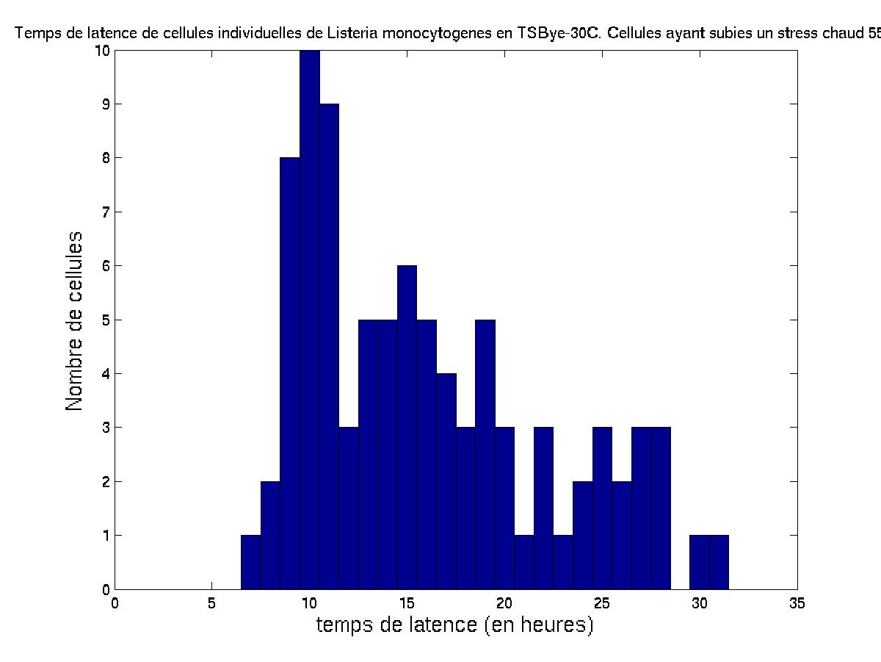
Distribution of cell lag: heat stress (55°C for 4 min)
Cellular lag time variability

Slide 25
Evaluation and Validation
Secondary models can be evaluated by comparing measured and predict values of kinetics parameters
In real world the environment conditions vary during time, the experiment should be deigned to allow the combination of secondary and primary model
  Measurement of the organism concentrations
  And all the relevant physical and chemical parameters during time

Slide 26
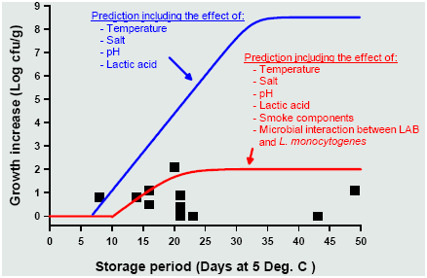
Simplification?
The model should take into the account for the food complexity!
Example Listeria monocytogenes in smoked fish
Ross & Dalgaard 2004, Mejlholm & Dalgaard 2007

Slide 27
Microbial growth modeling
Processing conditions
Product characteristics
Storage conditions
Spoilage micro-organisms
Pathogenic micro-organisms
Shelflife
Critical concentration of spoilage micro-organisms
Safe shel-life
Critiacal concentration of pathogenic micro-organisms
Storage time

Slide 28
Modeling bacterial survival or inactivation kinetics

Slide 29
Bacterial survival or inactivation kinetics
“Survival curve”
Same
  Micro-organism
  Medium
  Temperature
Graph of the number of survivors according to time

Slide 30
Survival curve, inactivation kinetics
t₁
t₂
t, time
D
log₁₀N₁
log₁₀N₂
log₁₀N

Slide 31
Equation
D
t, time
if N₂= N₁/10,
  log₁₀(N₁/N₂)= 1,
  t₁ – t₂ = time to divide the population by 10 = D
slope = -1/D
D = decimal reduction time
N
N - 1
log₁₀N

Slide 32
Other writing
log₁₀(N) = log₁₀(N₀) - t/D
N = N₀ • 10^{-t/D}
E = t/D = log₁₀(N₀/N) = « efficiency »
= number of decimal reductions
= number of log reductions
= log kill

Slide 33
An interesting consequence
N = N₀ • 10^{-E}
Consider a lot of units of volume V, the expected number of survivors per unit is given by:
N . V= N₀ • V . 10^{-E}
If N . V ≥ 1, then the unit is not sterile
If N . V < 1, then the unit is sterile

Slide 34
Shoulder
a
time
log₁₀N₀
log₁₀N

Slide 35
Shoulder
Multi target theory
  e.g. clumps
Multi hit theory
Activation taking precedence over inactivation mechanism
Cells loosing their resistance
  e.g. neutral spores in acid suspension medium
  e.g. inactivation of catalase

Slide 36
Tailing off
Tailing off
a
time
log₁₀N₀
log₁₀N

Slide 37
Tailing off
Mixed populations
Clumping
Activation of a secondary spore germination pathway
Protective effect of the suspension medium
  e.g. acid spores in neutral medium

Slide 38
S-shaped curves
Ababouch, L. et al., J. Appl. Bacteriol. 1987 62:503-11

Slide 39
Generalized equation for efficiency
a
time
a
time
log₁₀N₀
log₁₀N

Slide 40
Concavity upward
L'Haridon, R. & Cerf, O.
Revue de l'Institut Pasteur
de Lyon 1978 11: 445-456.

Slide 41
Non linear survival curves
2/3 of experimental studies
Many other equations can be used

Slide 42
Influence of temperature
Bigelow
log₁₀D
n
n - 1
T, temperature
z

Slide 43
Temperature changes
temperature
Equal Δti
time

Slide 44
Modeling industrial treatments
Each Δt_{i} achieves a number of decimal reductions
E_{i} = (Δt_{i} – a)/D_{Ti}
The total treatment achieves a total number of decimal reductions

Slide 45
Modeling industrial treatments
Pasteurizing value
The F value for a process is the number of minutes required to kill a known population of microorganisms in a given food under specified condition
Sterilizing value

Slide 46

Example

