Slide 1
Sampling and testing strategies
Microbial Risk Assessment and Mitigation Workshop:
towards a Quantitative HACCP Approach
Dubai February 23, 2012
Moez SANAA

Slide 2






Norms framework
Food
industry
bodies
Codex Alimentarius
CCPR
CCMAS
TC#
Codex Committee on Pesticide Residue
Codex Committee on Methods of Analysis
and Sampling
Book entitled: “Sampling for Microbiological Analysis: Principles and Specific Applications”
TC69
Application of statistical methods
SC1
Vocabulary and terms
Applications of statistical methods
in process management
Acceptance sampling
Measurement methods and results
SC4
SC5
SC6

Slide 3
ISO 2859
-
0:1995
Sampling procedures for inspection by
attributes
--
Part 0:
Introduction to the ISO 2859 attribute sampling system
ISO 2859
-
1:1999
Sampling procedures for inspection by attri
butes
--
Part 1:
Sampling schemes indexed by acceptance quality limit
(AQL) for lot
-
by
-
lot inspection
ISO 2859
-
1:1999/Cor 1:2001
Sampling procedures for inspection by attributes
--
Part 2:
ISO 2859
-
2:1985
Sampling plans indexed by limiting quality (LQ) for isolated
lot i
nspection
ISO 2859
-
3:1991
Sampling procedures for inspection by attributes
--
Part 3:
Skip
-
lot sampling procedures
ISO 2859
-
4:2002
Sampling procedures for inspection by attributes
--
Part 4:
Procedures for assessment of declared quality levels
ISO 3951:1989
Sampling procedures and charts for inspection by variables
for percent nonconforming
ISO 8422:1991
Sequential sampling plans for inspection by attributes
ISO 8422:1991/Cor 1:1993
Sequential sampling plans for inspection by variables for
ISO 8423:1991
percent nonconforming (known stan
dard deviation)
ISO 8423:1991/Cor 1:1993
Guide for the selection of an acceptance sampling system,
ISO/TR 8550:1994
scheme or plan for inspection of discrete items in lots
ISO 10725:2000
Acceptance sampling plans and procedures for the
inspection of bulk materials
ISO 11648
-
1:2003
Statistical aspects of sampling from bulk materials
--
Part
1: General principles
ISO 11648
-
2:2001
Statistical aspects of sampling from bulk materials
--
Part
2: Sampling of particulate materials

Slide 4
Codex Norms dealing with sampling
CODEX STAN 233
Sampling Plans for Prepackaged Foods (AQL 6.5)
CODEX STAN 234
Recommended Methods of Analysis and Sampling
CAC/MISC 7
Methods of analysis and sampling for fruit juices and related
products
CAC/GL 33
Methods of Sampling for Pesticide Residues for the
Determination of Compliance with MRLs
CCMAS
Guidelines on sampling
Draft version

Slide 5
Types of sampling plans for testing in foods
Safety or quality of foods assessment
Two types of sampling plans
  attributes sampling plans
    Qualitative data (absence-presence)
    Grouped Quantitative data (e.g. < 10/g cfu, 10-100 cfu/g, > 100 cfu/g)
  Variables sampling plans
    Non grouped Qualitative data
Paradox: Despite their wide use and adoption, sampling plans are not fully understood
  Especially with regard to their statistical background
  And in relation to other risk management approaches such as HACCP and Food safety objectives

Slide 6
Decision tools?
- Optimal sampling plan?
- Interpretation of the outcomes?
Official Control and surveillance activities
Techniques
Decision tools
Food Business Operators
Techniques
Decision tools
Need of techniques and tools to achieve FBO objectives and Public health objectives

Slide 7

Two-Class Attributes Sampling
n
Sampling
laboratory analysis
Number of positive
(or concentration > m) sampled units
k
Reject
If k > c
Accept
If k  c
N

Slide 8
Three-Class Samples
Quantitative analytical results
  Sample results above M are unacceptable
  Sample results between m and M are marginally acceptable
  Sample results below m are acceptable

Slide 9
Attributes sampling plans for assessment of mean microbiological concentration
m

Slide 10
Variable sampling plans
Used when the underlying distribution of microbial concentrations within lots is known, or can be assumed

Slide 11
Variable sampling plans
If we assume that the variable or its logarithm follow a normal distribution:
mean µ
standard deviation σ
Upper tolerance limit: T_{u}. The proportion of non conform units:
Lower tolerance limit: T_{l}. The proportion of non conform units:
In case of two limits:

Slide 12
Variable sampling plans
where k is dependent on the given values for n, p_{l/u}, and α.

Slide 13
Microbiological sampling plans and food safety objectives or performance objectives
Example FSO: 100 cfu/g
  assume a control point from which neither activation nor growth is expected
  Concentration within lot follow a log-Normal distribution
    std=0.8
  A two class plan for grouped quantitative analytic results with n=10 and c=0 has 95% chance to reject a lot with mean=1.48 Log CFU/g (30 cfu/g) and std=0.8
  This type of lots has 5% chance to be accepted and about 26% of their units exceeding the FSO!!
  Level that would be accepted with 95% → mean= -0.05 Log cfu/g (0.88 cfu/g)
  If all the lots produced are at this level of quality (0.88 cfu/g) the FSO will represent the upper limit of concentrations in terms of 99.9 percentile of their frequency distribution…

Slide 14
Sampling tools
Non risk based Sampling
Risk Based sampling
Sampling plans:
  Regulatory compliance
  Trade agreement
  To describe food processing (surveillance – Alert – decide for corrective or more stringent control or preventive measures)
  Collect data for more quantitative approaches
Risk attribution analysis → allocate sampling (Hazard/food combinations, hazard/processing step ….)
Quantitative risk assessment models
Simulate the impact of different scenarios and sampling plans

Slide 15
Homogeneous vs. heterogeneous contamination
When considering presence/absence of pathogen per unit generally distribution of the bacteria load is assumed uniform.
In statistical term: use of Poisson distribution
What is the robustness of sampling plans using this assumption?

Slide 16
X combinaisons of n N and b
Batch i
N_{i} : total load in cfu
n_{i} : number of units per batch
b_{i} : Homogeneity factor
Iterations
n_{i} ground beef unit
N_{s} (s=1 à n_{i}) number UFC per unit
n samples
Qualitative Analytical Results
Decision
Accept/reject

Slide 17
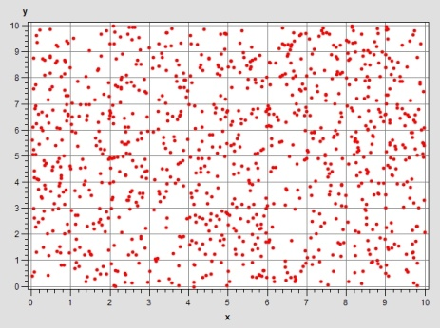
Illustration of uniform partition: homogeneous distribution

Slide 18
How to distribute the N ufc

Slide 19
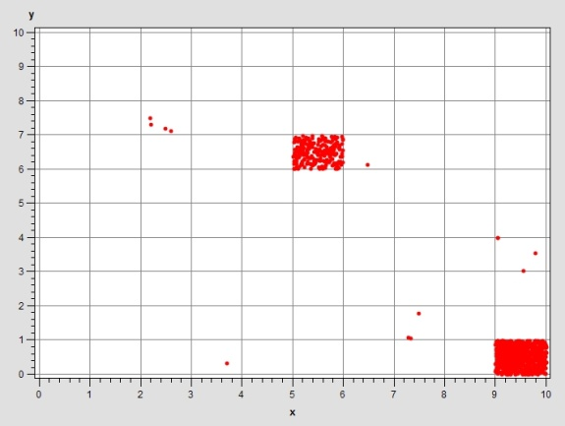
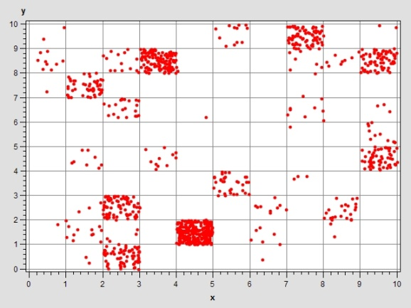
Illustration of Non uniform partition: heterogenous distribution

Slide 20
How to simulate the absence of homogeneity?
Several solutions and techniques are possible:
  e.g., Negative binomial, beta-binomial, Poisson log-Normal….)
Example: BETA-BINOMIALE:
  BETA : describe the probability (p_{i}) of one single cfu to contaminate unit i of a batch of n units: Beta(b,b(n-1))
    pi depend on the parameter b and the unit rank
  Given a unit i and pi and the remained cfu Ni, the binomial distribution will give the number of distributed cfu :
    Binomial (pi, Ni)

Slide 21
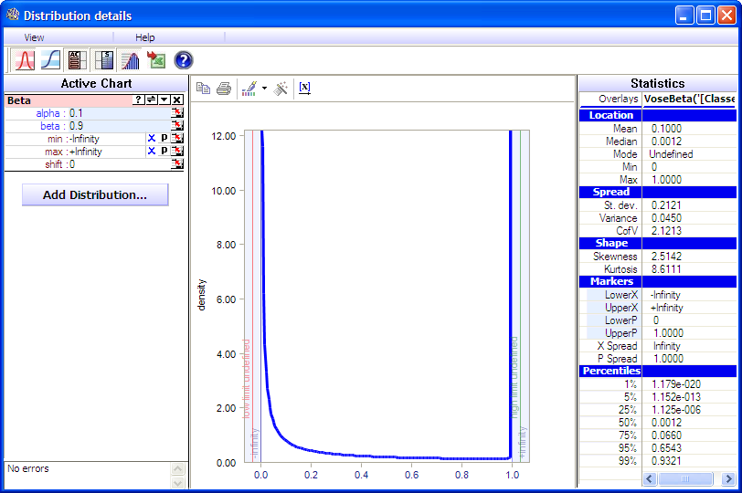
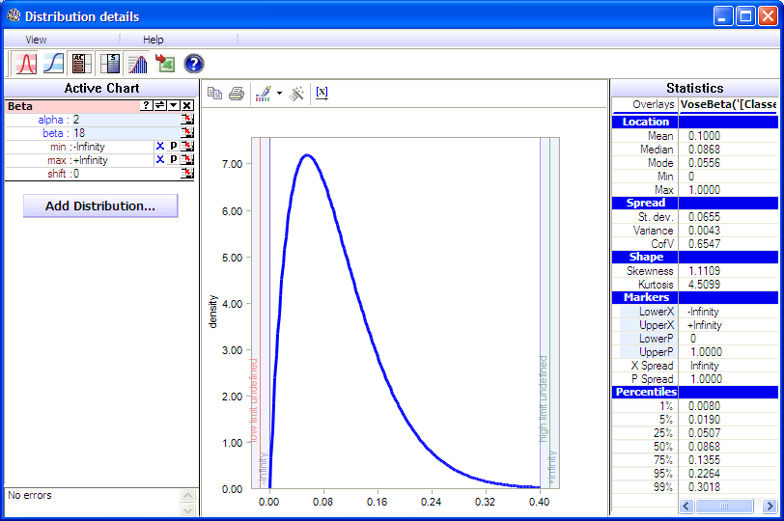
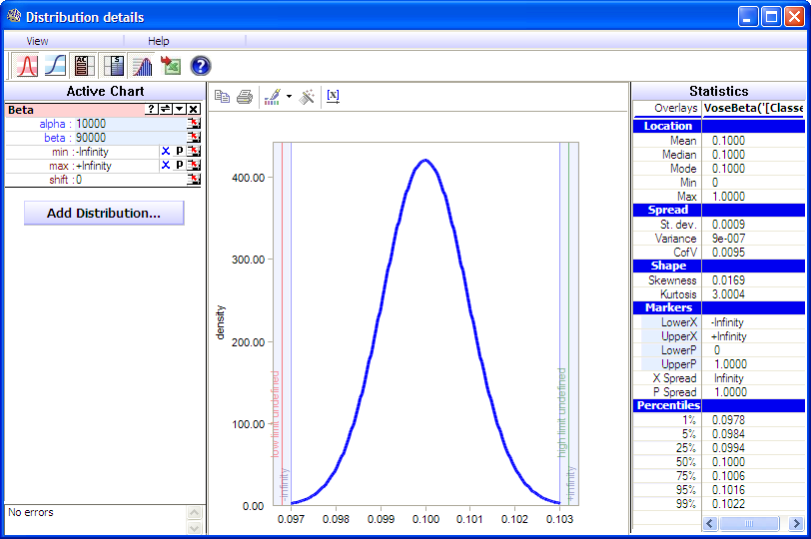
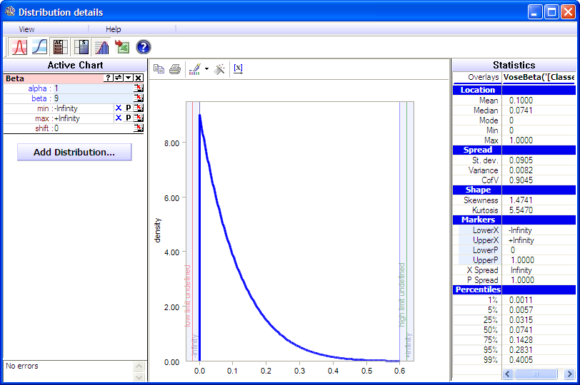
b=2
b=0,1
b=10000
b=1

Slide 23
Example of the distribution of the contamination between the units of a sample of 60 units (illustration)
1
2
3
4
5
6
7
8
9
10
a
“Hot Spot”
b
c
d
“Sporadic/Background”
e
f

Slide 24
Time dependant Release of cfu (hypothetical example)
100
<5
<5
40
30
<10
Cfu release
40% of the contaminated products are contaminated surround the third hour of the production
0
1
3
Hour of production

Slide 25
 | Total microbial load = 1 000 ufc de STEC
Number of units per batch | Mass of individual sampled units | b=0.1 | b=0.5 | b=1 | b=2 | b=3 | b=infinity
400 | 5 | 43 | 32 | 31 | 30 | 30 | 29
 | 10 | 27 | 17 | 16 | 15 | 15 | 14
 | 20 | 18 | 10 | 8 | 8 | 7 | 7
 | 25 | 16 | 8 | 7 | 6 | 6 | 5
2 400 | 5 | 194 | 182 | 181 | 180 | 180 | 177
 | 10 | 104 | 92 | 91 | 90 | 90 | 90
 | 20 | 58 | 47 | 46 | 45 | 45 | 44
 | 25 | 49 | 38 | 37 | 36 | 36 | 35
8 000 | 5 | 613 | 602 | 600 | 599 | 599 | 511
 | 10 | 314 | 302 | 301 | 300 | 300 | 278
 | 20 | 164 | 152 | 151 | 150 | 150 | 151
 | 25 | 134 | 122 | 121 | 120 | 120 | 120
 | Total microbial load = 10 000 UFC de STEC
Number of units per batch | Mass of individual sampled units | b=0.1 | b=0.5 | b=1 | b=2 | b=3 | b=infinity
400 | 5 | 12 | 5 | 4 | 3 | 3 | 2
 | 10 | 9 | 3 | 2 | 2 | 1 | 1
 | 20 | 8 | 2 | 1 | 1 | 1 | 0
 | 25 | 7 | 2 | 1 | 1 | 1 | 0
2 400 | 5 | 30 | 20 | 19 | 18 | 18 | 17
 | 10 | 20 | 11 | 10 | 9 | 9 | 8
 | 20 | 14 | 7 | 5 | 5 | 4 | 4
 | 25 | 13 | 6 | 4 | 4 | 4 | 3
8 000 | 5 | 73 | 62 | 61 | 60 | 60 | 60
 | 10 | 43 | 32 | 31 | 30 | 30 | 30
 | 20 | 27 | 17 | 16 | 15 | 15 | 14
 | 25 | 23 | 14 | 13 | 12 | 12 | 11

