Slide 1
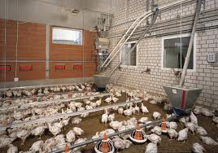
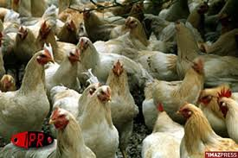
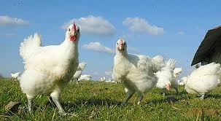
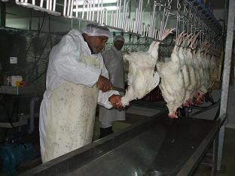
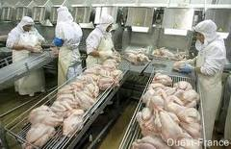

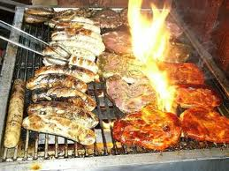
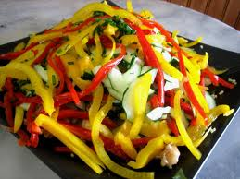
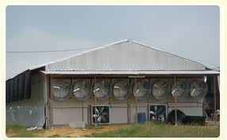
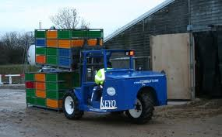
Campylobacter in broilers meat production: control options and performance objectives (or targets) at different stages of the food chain
Moez SANAA

Slide 2
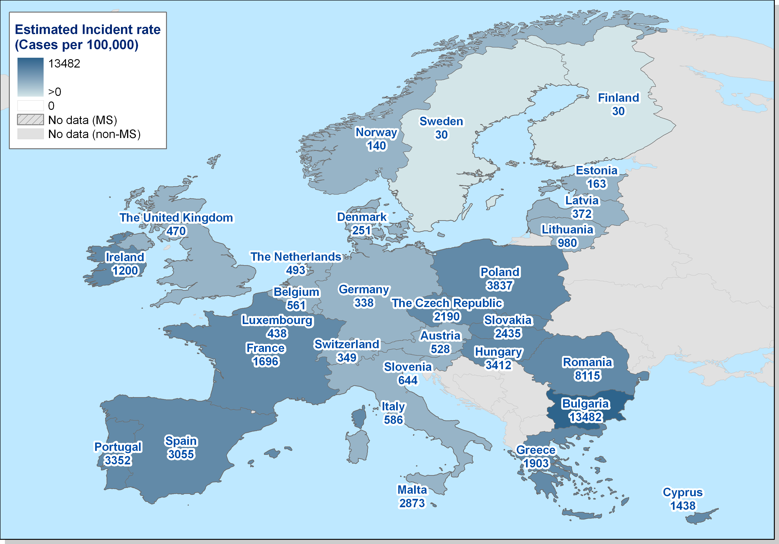
Estimated true incidence rate (per 100,000) of human campylobacteriosis in the EU-27

Slide 3
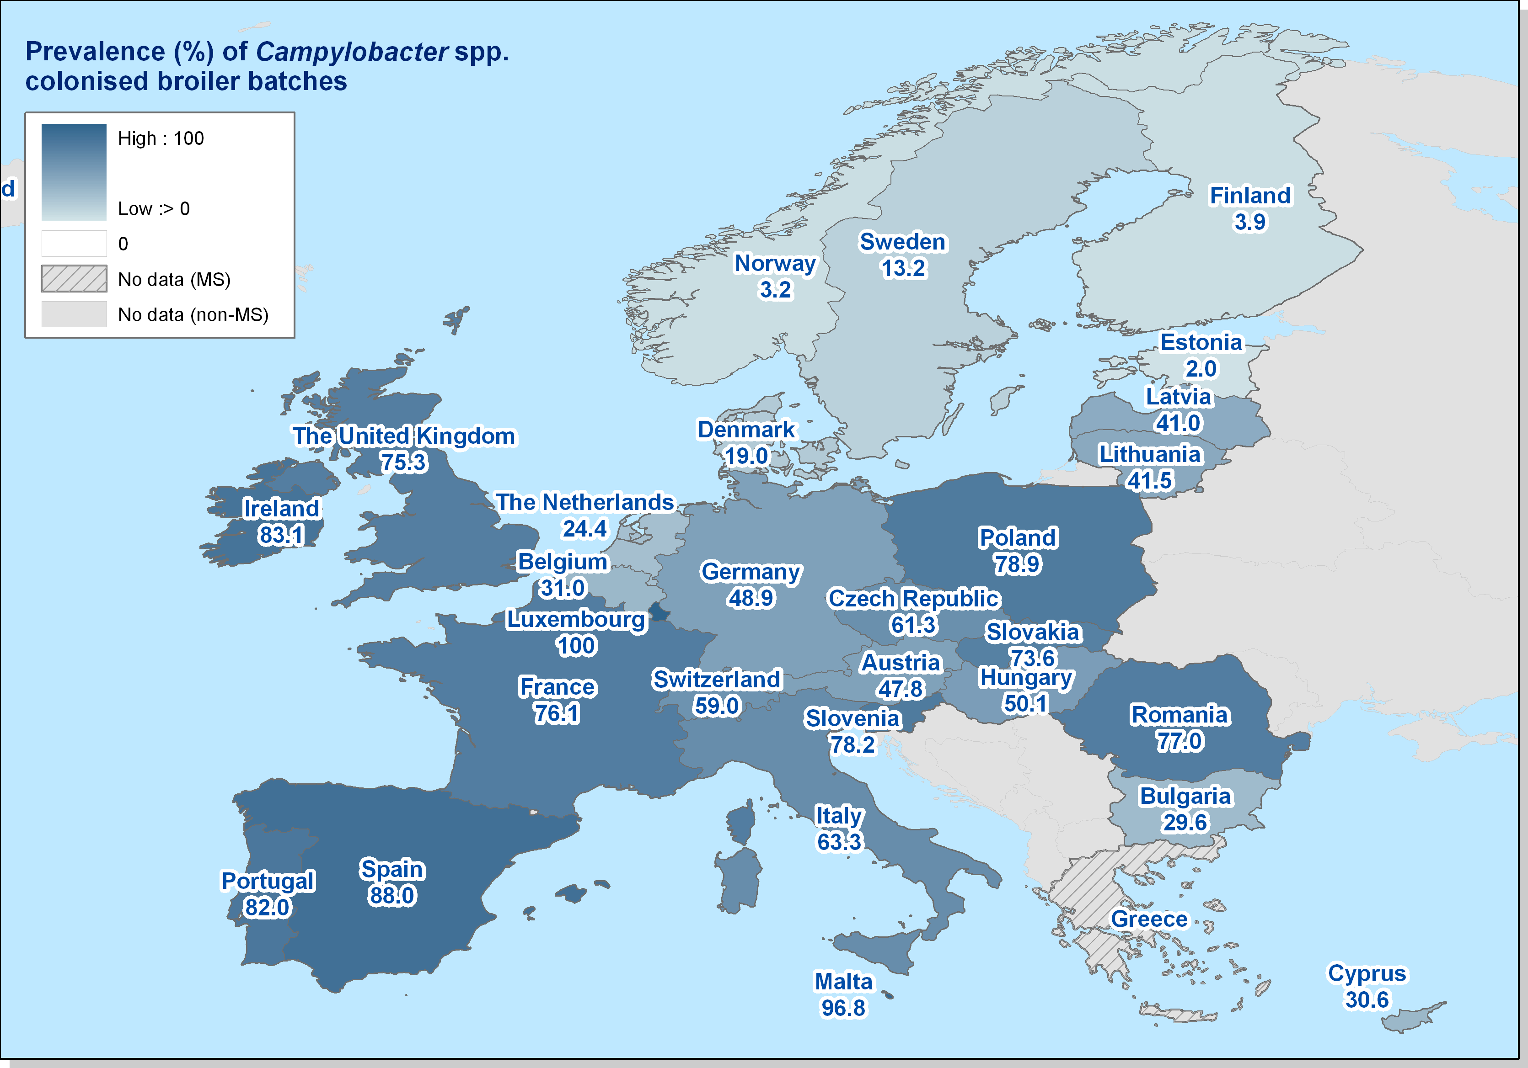
Prevalence of Campylobacter-colonized broiler batches in the EU, 2008 (EFSA, 2010a)

Slide 4
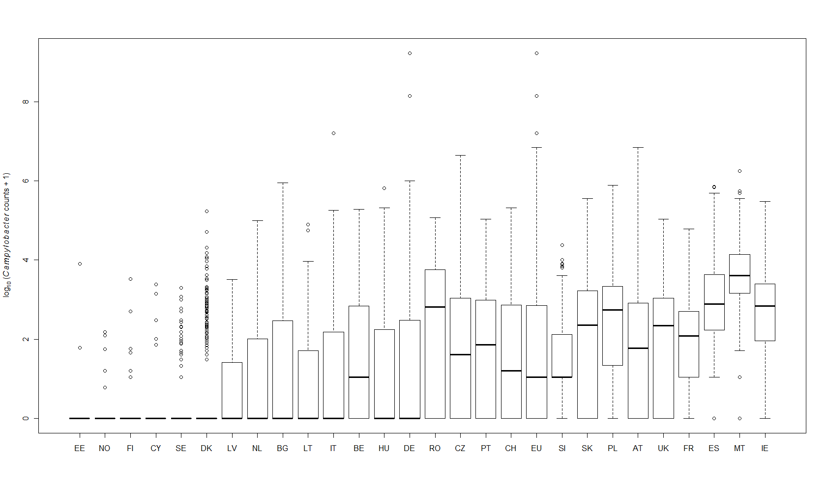
Boxplot of the log₁₀ (Campylobacter counts on broiler carcasses + 1), by country and in the EU*, 2008 (EFSA, 2010a)

Slide 5
control methods that has been considered at broiler chain
  Prevent Campylobacter entering broiler houses at primary production (using approaches primarily based on biosecurity including hygienic measures during thinning, and possibly by reducing slaughter age);
  Increase resistance of broiler chickens to colonization (using approaches such as additives (organic acids, phytocompounds) to drinking water and/or feed, vaccination, and/or selective breeding);
  Reduce the concentration of Campylobacter in chicken intestines before slaughtering (for example by treatment with bacteriophages or bacteriocins)
  Enhance hygienic measures during slaughter (for example improved design of equipment, slaughter practices, prevention of faecal leakage, training of personnel in hygiene implementation,
  Apply decontamination of carcasses (using chemical or physical treatments); and
  Educate food handlers in hygienic practices (professional catering and domestic household setting, primarily aimed at prevention of cross-contamination during handling of broiler meat).

Slide 6
Interventions in primary production | Efficacy for Campylobacter reduction at the point of application | References
Hygiene/biosecurity | At 21 days: from 20.0% to 7.7% between-flock prevalence (BFP) | Gibbens et al., 2001
 | At 28 days: from 32.0% to 12.0% BFP
 | At 35 days: from 44.0% to 30.8% BFP
 | At 42 days: from 70.8% to 38.5% BFP
 | Implemented in model as the beta coefficient that corresponds to a hazard ratio of 0.40, (0.15, 1.09) p=0.06
Fly screens | At 21 days: from 11.4% to 5.8% BFP | Hald et al., 2007
 | At 28 days: from 28.6 to 5.8% BFP
 | At 35 days: from 45.5% to 7.7% BFP
 | Implemented in model as a slaughter age-weighted k-factor of 0.47 (21 days of slaughter age), 0.15 (28 days of slaughter age) and 0.10 (35 days of slaughter age)
Discontinued thinning | BFP estimate OR = 1.74, implemented in model as regression coefficient (0.5521) | EFSA, 2010a
Slaughter age | BFP estimate OR = 1.98 per 10 days increase, implemented in model as regression coefficient (0.06742) | EFSA, 2010a
Vaccination | 2 log₁₀ reduction in caecal contents | de Zoete et al., 2007
Bacteriocins | 5.1-5.9 log₁₀ reduction in caecal contents | Svetoch et al., 2008
Bacteriophages | 3 log₁₀ reduction in caecal contents | Wagenaar et al., 2005
Drinking water treatment with organic acids | 0.5-2 log₁₀ reduction in caecal contents | Chaveerach et al., 2004
Feed additives | No effect to complete inhibition | Hilmarsson et al., 2006 Solis de los Santos et al., 2010 Skanseng et al., 2010

Slide 7
Interventions during transport and before slaughter
Feed withdrawal | Various results and various outcomes
Crate treatment | 7.5 log₁₀ per crate compartment; 5.5 log per crate surface; 40-60% reduction of crate positivity | Berrang et al., 2004a Allen et al., 2008a Slader et al., 2002
Interventions at slaughter
Prevention of leakage of intestinal contents | 0.9 log₁₀ CFU reduction on carcass | Boysen and Rosenquist, 2009
Detection/re-processing of highly (faecally)-contaminated carcasses | 1.75 log₁₀ CFU on carcass | Kemp et al., 2001
Cloacal plugging | 0.53-1.7 log₁₀ CFU reduction | Musgrove et al., 1997 Berrang et al., 2001 Buhr et al., 2003
Scheduled slaughter (positive batches are scheduled to a risk reducing procedure such as freezing or heat treatment) | Depends on risk reducing procedure | Hofshagen et al., 2008. EFSA, 2010a
Logistic slaughter (the slaughter of negative batches before the positive) | Very little effect. | Havelaar et al., 2007

Slide 8
Interventions post slaughter
Chemical decontamination of carcasses
Lactic acid (2%) | 0.47 log₁₀ reduction (through inside-outside bird washer (IOBW) | Bolder, 2007
 | 0.74 log₁₀ reduction (inoculated skin) | Riedel et al., 2009
Acidified sodium chlorite (1200 mg/l) | 1.26 -1.75 log₁₀ reduction (sprayed after IOBW) | Bashor et al., 2004
 | 1.75 log₁₀ reduction (sprayed after IOBW) | Kemp et al., 2001
 | 0.5 log₁₀ cycles (in IOBW) | Bolder, 2007
 | 0.5 -1 log₁₀ when sprayed at 1000 ppm | Corry et al., 2008
Chlorine dioxide | 0.49 log₁₀ reduction (4.25 ppm in IOBW) | Bolder, 2007
(50-100 mg/l) | 0.99 -1.21 log₁₀ reduction (50 or 100 ppm, dip – inoculated) | Hong et al., 2008
Trisodium phosphate | 1.03 log₁₀ reduction (spray) | Bashor et al., 2004
(10-12%, pH 12) | 1.2 log₁₀ reduction (dipping at 50°C) | Slavik et al., 1994
 | No effect of dipping at 20°C | Whyte et al., 2001b
 | 0.5 log₁₀ when sprayed at 12% | Corry et al., 2008
Acidified electrolysed oxidising water (immersion) | 1.07 log₁₀ reduction | Kim et al., 2005
Peracetic (peroxyacetic) acid | 43% reduction of positive carcases | Bauermeister et al., 2008a

Slide 9
Physical decontamination of carcasses
Freezing for few days |  | 0.91 -1.44 log₁₀ reduction | Sandberg et al., 2005 Georgsson et al., 2006a Rosenquist et al., 2006
Freezing for 3 weeks |  | 1.77 - 2.18 log₁₀ reduction | Sandberg et al., 2005 Georgsson et al., 2006a
Hot water immersion |  | 1.25 log₁₀ reduction | Corry et al., 2006
Irradiation |  | 6 log₁₀ reduction | Farkas, 1998 or expert opinion
Cooking |  | 6 log₁₀ reduction | Whyte et al., 2006
Crust-freezing |  | 0.42 log₁₀ reduction | Boysen and Rosenquist, 2009
Steam |  | 0.46 log₁₀ reduction | Whyte et al., 2003
Steam ultrasound |  | 1.3-2.51 log₁₀ reduction | Boysen and Rosenquist, 2009

Slide 10
Modular approach
Farming system
Primary Production
Module
Prevalence of infected birds
Slaughterhouse
Module
Mode of preparation and consumption
Distribution of Campylobacter concentration
Transfer rates of Campylobacter
Consumer
Module
Exposure assessment
Dose response model
Risk

Slide 11
Intervention implementation
Primary production
Slaughter
Processing
Retail & preparation
Exposure
Risk
P
C
EU baseline survey (2008)
Future
interventions
Future risk
Counter – factual state
No interventions
Future P, C
Primary production
Slaughter
Processing
Retail & preparation
Exposure
Risk
Risk reduction
Current P, C
And interventions
Primary production
Slaughter
Processing
Retail & preparation
Exposure
Risk
Current risk

Slide 12
transfer rates during preparation
f_{wh}
Washing
t_{hs}
Salad
T₁
t_{wh}
Hand
f_{nwh}
No W
t_{hs}
Salad
T₂
t_{ch}
f_{wb}
Washing
t_{bs}
Salad
T₃
t_{wb}
Chicken
t_{cb}
Cutting Board
f_{nwb}
No w
t_{bs}
Salad
T₄
f_{ob}
Change
t_{bs}
Salad
T₅
t_{ob}
t_{ck}
f_{wk}
Washing
t_{ks}
Salad
T₆
t_{wk}
Knife
f_{nwk}
No W
t_{ks}
Salad
T₇
f_{ok}
Chnage
t_{ks}
Salad
T₈
t_{ok}

Slide 13
Montville (2001), Nauta (2007), Mylius (2007), Van Asselt (2008)
f_{wh}=0.80
Washing
t_{hs}=10^{-1.0531}
Salad
T₁
t_{wh}=0.019
Hand
f_{nwh}=0.20
No W
t_{hs}=10^{-1.0531}
Salad
T₂
t_{ch}= 10^{-1.5135}
f_{wb}=0.62
Washing
t_{bs}=0.343
Salad
T₃
t_{wb}=0.52
Chicken
Cutting Board
f_{nwb}=0.05
No w
t_{bs}=0.343
Salad
T₄
t_{cb}=10^{-1.5298}
f_{ob}=0.33
Change
t_{bs}=0.343
Salad
T₅
t_{ob}=0
t_{ck}=0.0775
f_{wk}=0.62
Washing
t_{ks}=0.0258
Salad
T₆
t_{wk}=0.0091
Knife
f_{nwk}=0.05
No W
t_{ks}=0.0258
Salad
T₇
f_{ok}=0.33
Change
t_{ks}=0.0258
Salad
T₈
t_{ok}=0

Slide 14
Distribution of global transfer rate

Slide 15
Selection of countries for modeling based on EU baseline survey data
*C2 has a relatively high proportion of outdoor flocks
 | Country 1 (C1) | Country 2 (C2)* | Country 3 (C3) | Country 4 (C4)
Prevalence of Campylobacter-colonized batches | Low | medium | medium | high
Level of carcass contamination | Low | high | medium | medium

Slide 16
Summary of model inputs (most likely values) used to evaluate intervention scenarios
Current Intervention | C1 | C2 | C3 | C4
Farm
Indoor farms as % of total | 100 | 71 | 100 | 94
Mean age at slaughter¹ | 32 | 41 | 38 | 40
Thinning as % of all batches¹ | 3 | 82 | 25 | 65
Between-flock prevalence³ | 3 (0-8) | 30 (24-31) | 19 (6-38) | 76 (67-86)
Hygiene/biosecurity¹ | 96 | 73 | 78 | 24
Bacteriophages | 0 | 0 | 0 | 0
Bacteriocins | 0 | 0 | 0 | 0
Vaccination | 0 | 0 | 0 | 0
Fly screens | 0 | 0 | 0 | 0
Water treatment with organic acids² | 0 | 30 | 0 | 0
Transport
Any intervention | 0 | 0 | 0 | 0
Slaughter
Campylobacter count⁴ on neck/breast skin after chilling (log₁₀ CFU/g) | 0.94 (0.29) | 2.72 (0.85) | 2.21 (1.2) | 2.36 (1.34)
Logistic slaughter | 0 | 0 | 0 | 0
Scheduled slaughter | 0 | 0 | 0 | 0
Detection of highly contaminated carcasses | 50 | 50 | 50 | 50
Prevention of faecal leakage | 0 | 0 | 0 | 0
Decontamination | 0 | 0 | 0 | 0
Freezing | 0 | 0 | 0 | 0
Reporting factor human cases | 42.5% | 4.2% | 30.0% | 11.4%

Slide 17
Effect of 1, 2, 3 and 6 log₁₀ reduction of Campylobacter in caecal contents of broilers, both for indoor and outdoor flocks
Red. caecal counts |  | 1 log₁₀ | 2 log₁₀ | 3 log₁₀ | 6 log₁₀
Red. carcass |  | 1 | 2 | 3 | 6
Country | C1 | 83.2% | 97.5% | 99.7% | 100.0%
 | C2 | 66.6% | 91.9% | 98.6% | 100.0%
 | C3 | 67.0% | 91.7% | 98.4% | 100.0%
 | C4 | 65.5% | 91.0% | 98.3% | 100.0%

Slide 18
Effect of decontaminations in slaughter-house on the relative reduction in human cases in the four study countries
Treatment | Effect (log₁₀ reduction) | Reduction in public health risk
Irradiation/cooking | 6.00 | 100%
Short time freezing: Georgsson et al. (2006), Rosenquist et al. (2006), Sandberg et al. (2005), | 0.91 - 1.44 | 62 – 93%
Long time freezing: Sandberg et al. (2005), Georgsson et al. (2006) | 1.77 - 2.18 | 87 – 98%
Lactic acid: Bolder (2007) | 0.47 | 37 – 56%
Hot water: Corry et al. (2006) | 1.25 | 75 – 89%
Acidified sodium chlorite: Bashor et al. (2004), Kemp (2001), | 1.26 – 1.75 | 75 – 96%
Trisodium phosphate: Bashor et al. (2004) | 1.03 | 67 – 84%

Slide 19
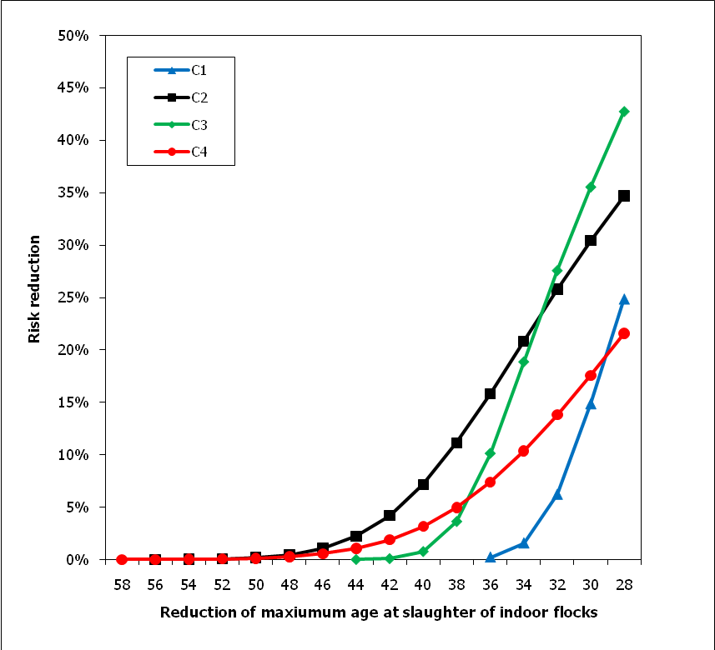
Effect of reducing the slaughter of indoor flocks on the relative reduction in human cases (at country level) for consumers of broiler meat from flocks coming from different production systems

Slide 20
Risk reduction using decontamination treatments in the four study countries

Slide 21
Risk reduction from scheduled slaughter in C1
Intervention | Risk reduction with scheduling based on the effect of decontamination at slaughter
 | Treatment of all flocks | Scheduling with detection (sampling 4 days before slaughter) | Scheduling with culture detection (sampling 7 days before slaughter)
Irradiation | 100% | 75% | 48%
Long term freezing | 98% | 74% | 7%
Short term freezing | 83% | 62% | 40%
Lactic acid | 56% | 42% | 27%

Slide 22
The impact of the implementation of Microbiological criteria
MS | μ_{est} | Sd_{est} | prevalence
AT | 2.18 | 1.38 | 80.6%
BE | 2.72 | 0.93 | 52.1%
BG | 2.87 | 1.04 | 45.0%
CZ | 2.35 | 1.58 | 69.9%
DK | 2.11 | 1.28 | 31.1%
FI | 0.32 | 1.59 | 5.7%
FR | 2.13 | 1.01 | 87.7%
DE | 1.87 | 1.66 | 62.0%
HU | 2.19 | 1.19 | 56.1%
IE | 2.72 | 1.01 | 98.0%
IT | 2.72 | 1.01 | 52.2%
LV | 2.02 | 0.78 | 33.6%
LT | 1.96 | 0.93 | 46.0%
MT | 1.96 | 0.93 | 94.8%
PL | 2.87 | 0.97 | 80.9%
PT | 2.50 | 1.05 | 74.1%
RO | 2.50 | 1.05 | 63.6%
SK | 2.68 | 1.06 | 74.6%
SI | 1.72 | 0.78 | 80.6%
ES | 2.86 | 1.18 | 100.0%
SE | 1.48 | 1.01 | 13.4%
NL | 2.34 | 1.14 | 37.8%
UK | 2.27 | 1.33 | 87.3%
NO | 0.95 | 0.51 | 5.1%
CH | 4.10 | 1.41 | 70.6%

Slide 23
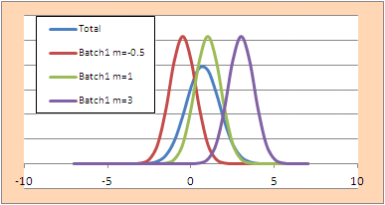
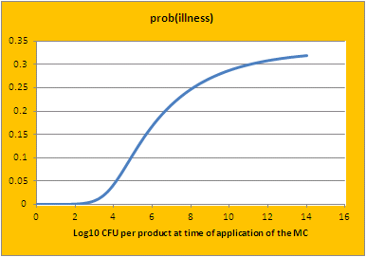
raw material
Step 1
Step i....
end of production
retail
consumption
risk
Upstream
module
Microbial critireon
m, M
n, c
Downstream
module

Slide 24
Microbial criteria
Sampling plan
  n : number of sampled units per batch
  m : limit of tolerance cfu/g
  c: accepted number of units within the sampled units that exceed m
If the lot is rejected we assume that the lot is destroyed or treated with 100% success.

Slide 25
Variability of the contamination

Slide 26
Between and within lot variability

Slide 27
Simulation model inputs
The sampling frame specification: n, c, m, M
n= the number of sampling units from the lot (1, 3, 5 and 10)
c = the maximum allowance number of sample units that exceed the microbiological criterion (0, 1, 2)
m = the maximum number or level of relevant bacteria (CFU/gm or ml) (Threshold value: 100, 500, 1000, 5000 and 10000)
M = the maximum number to separate marginally acceptable/unacceptable quality food (Maximum permitted microbial level, here M=m)

Slide 28
Simulation model inputs
Intra-lot contamination is assumed log normal,
  log₁₀(c_{ijk}) ~Normal(µ_{ij} , _{iw})
  C_{ijk} : kth carcass in lot j in MS i.
  µ_{ij} : mean of contamination in lot j in MS i, assumed normally distributed
  µ_{ij} ~Normal (µ_{i} , _{iB}) where is estimated from EU base line study.
  _{iw} : within lot standard deviation in MS i assumed constant from one lot to another
  The model assumes that the standard deviation of the log concentrations estimated for each MS is equal to:

Slide 29
Probability of rejection
Given a lot with the characteristics µ_{ij} and _{iw} the probability to be rejected is equal to
  the probability to observe more then c samples with an estimated concentration higher then m.
  The analytic solution of this probability is difficult to address.
  We use a Monte-Carlo approach to asses this probability:

Slide 30
Impact of rejecting lots on the risk per serving
The risk reduction (RR): Risk without inspection-risk when an inspection is implemented and all positive flocks are removed/ Risk without inspection.

Slide 31
Comparison of the assessed mean risks per serving for broiler meat produced in the different EU MSs plus Norway and Switzerland as follows from the EU baseline survey data and the minimum residual risks with implementation of the MC with m= 1000, n=5, c=1. Values of the mean risk are on a linear scale, but they are not given as they have to be read relative to each other. The MRRR value used elsewhere equals the value of the minimum residual risk divided by the current risk

Slide 32
The assessed mean risks per serving for the broiler meat produced in the different EU MSs as follows from the EU baseline survey data and the percentage of batches not complying with the MC (BNMC) with implementation of the MC with m= 1000, n=5, c=1. Note that the latter should be read from the secondary y axis

Slide 33
scatter plot of percentage of batches not complying with the criterion (BNMC) and the minimum relative residual risk (MRRR) after implementation of the MC
with m= 1000, n=5, c=1
with m=1000, n=3, c=0

