Slide 1
Protecting Our Products and Consumers in a Global Economy A Presentation at the 6th Dubai International Food Safety Conference February 27 – March 1, 2011 Dubai, United Arab Emirates
Dr. Paul A. Hall, RM (NRCM)
President

Slide 2
Producing Safe Food is Our Top Priority!
Consumer protection and trust
Consumers must be able to trust the brands they buy and the food they eat
Food safety is absolutely critical to that trust
Business survival/self-interest
Our brands are our most important asset
History is replete with brands and businesses being destroyed because of a lapse in food safety
Industry responsibility
Moral obligation to produce food as safe as practical
Industry pledge not to make safety a competitive issue

Slide 3
Why is Food Safety our Top Priority?
It is a smart investment in doing food safety right
The changing global food safety landscape demands more diligence, flexibility, and speed than ever before.
The cost impact of not doing food safety right is higher than it’s ever been.
The benefits of doing food safety right contributes directly to the bottom line – and not just in cost avoidance.
Consumer and regulatory scrutiny are at an all time high.
World class companies that win in the marketplace have world class food safety principles.

Slide 4
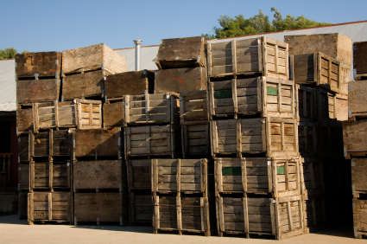
Our Global Food Supply
Food is a heavily traded commodity
Global agricultural trade in 2009 was valued at $1.01 trillion (WTO, 2011)
Food imports into the U.S. has averaged >10% annual growth over the past 5 years
Projected to climb to over $80B in 2011
>9M entries of imported food into the U.S. passing through >300 entry points each year
The United Arab Emirates imports approximately 80% of their food with China, India, and the United States being the top three sourcing countries

Slide 5
Factors Impacting Food Safety
There are a number of factors directly impacting the safety of today’s food supply:
Globalization of our food supply
Intensive animal husbandry and agricultural practices
Centralized food processing and manufacturing
Demographic changes and consumer behavior
Changes in the microbes themselves
Climatic and environmental changes
Increased regulatory and public scrutiny

Slide 6
Factors Impacting Food Safety: Globalization of Our Food Supply
Sourcing of food ingredients and commodities outside of the U.S. has dramatically grown over the past decade
From $32.44B in 1996 to $77B in 2009 (USDA ERS)
Food imports from developing countries is skyrocketing:
Mexico/Central America $13.2B
South America $ 9.0B
China/Asia $10.9B
Africa $ 1.6B
Middle East $ 0.8B
IMPLICATION: Imported foods, especially from developing countries, are inherently riskier as food safety systems are rudimentary or non-existent

Slide 7
Factors Impacting Food Safety: Intensive Animal Husbandry and Agricultural Practices
The world’s population is projected to grow by 2025 to over 7.8B people, with the U.S. population growing to over 337 million people
An estimated 20 million acres of farmland is replaced annually due to growing populations and urbanization
Given these trends, large-scale, intensive animal production and farming practices are projected to accelerate in future years
In the U.S., intensive animal husbandry accounts for ~53% of total domestic agricultural income
As a result, about 130 times more animal waste is produced than human waste – roughly 5 tons for every U.S. citizen.
Manure has been the source of pathogens in a number of major foodborne illness outbreaks
The FAO estimates that worldwide food production will have to increase 70% by 2050
IMPLICATION: Increasing pressure from ranching and farming practices on the environment will increase the likelihood of pathogens entering the food supply

Slide 8
Factors Impacting Food Safety: Centralized Food Processing and Manufacturing
In the early 20th century and before, food processing was confined to relatively small surrounding geographic areas
Ingredients and raw materials were obtained from the local area and distribution and consumption was limited to that locale
Foodborne illness outbreaks at that time were smaller and limited in scope
Today with modern transportation and distribution systems, food processors source ingredients and raw materials from around the world as well as distribute finished products globally
Improvements in mechanization, distribution systems, and food production techniques have enabled producers to leverage scale through the centralization of food manufacturing
This trend allows for efficiency of scale, more consistent quality product, and enables the use of economically-favorable labor and locales
IMPLICATION: When a failure in food safety systems occur, more people become ill and outbreaks are dispersed over a wide geographic range and more product is involved in resulting recalls

Slide 9
Factors Impacting Food Safety: Demographic Changes and Consumer Behaviour
International migration will continue to a major factor impacting foodborne illness in the U.S.
Changing ethnicity patterns result in changing food preferences and practices that can result in food safety issues
The aging of the population is a major factor impacting food safety
The population aged 65 years and over is projected to increase by 78.6% by 2025
Infectious diseases, including foodborne diseases, are a problem for the elderly because of declining immune function
Other segments of the population that are more susceptible to foodborne disease include pregnant women, neonates, and the immunocompromised
It is estimated that 20-25% of the population is at increase risk for foodborne disease at any given time

Slide 10
Factors Impacting Food Safety: Demographic Changes and Consumer Behaviour (con’t)
Changing trends in food consumption patterns impact food safety:
Per capita Consumption (lbs/person)
1909 2005
Chicken 15.3 86.2
Red Meat 133.5 116.3
Fish/Shellfish 11.0 16.1
Fruits/Vegetables 577.6 (1970) 690.4
The consumer trends toward the consumption of organic, natural, and less processed foods has led to increased food safety challenges
Research has shown that organic food products are riskier from a microbiological safety perspective than conventional foods
Consumers engage in risky food safety practices despite health warnings and recommendations
IMPLICATION: New technologies and systems are needed to ensure the safety of today’s consumer-preferred food products. New approaches to consumer education are needed regarding safe food handling practices

Slide 11
Factors Impacting Food Safety: Changes in the Microbes Themselves
Microorganisms, including foodborne pathogens, have evolved a variety of strategies to ensure their survival
Over the past two decades, there have been a number of foodborne pathogens that have emerged with newly-acquired characteristics including:
Escherichia coli O157:H7 (tolerates high acid products)
Listeria monocytogenes (able to survive and grow at refrigerated temperatures)
Campylobacter jejuni (leading of diarrheal illness in the U.S.)
Salmonella enteriditis DT104 and other salmonellae (resistant to multiple antibiotics)
Food formulation and processing changes can induce changes in pathogens (cross-tolerance effects)
Exposure to acidic environments can confer increase heat resistance and increased tolerance to salt
IMPLICATION: Food safety systems must be designed to be robust enough to cover ever-evolving foodborne pathogens

Slide 12
Factors Impacting Food Safety: Climatic and Environmental Changes
It is well-documented that climate can have a dramatic influence on the prevalence of foodborne disease
Seasonality has been described for a number of foodborne and waterborne pathogens:
Outbreaks of E.coli O157:H7 peak during the warmest months (May – October)
Salmonella and Vibrio infections also tend to peak in the warmer months
The type of intensity of precipitation also has a dramatic effect on disease occurrence
El niño weather pattern changes have been linked to a number of foodborne and waterborne outbreaks
Contaminated groundwater has been the source of contamination of many types of food products in the past
IMPLICATION: Efforts must be made protect food products and ingredients from environmental influences

Slide 13
Factors Impacting Food Safety: Increased Regulatory and Public Scrutiny
The U.S. Centers for Disease Control and Prevention (CDC) has in place a foodborne epidemiologic surveillance network (FoodNet) that enables the rapid detection of foodborne outbreaks
The CDC also has a companion genetic detection network (PulseNet) that allows for rapid identification and genetic “fingerprinting” of foodborne isolates
These capabilities allow the government to quickly trace the source of contamination from patient to product to plant
FoodNet data from 2009 has confirmed an increase in foodborne illnesses due to Vibrio but a decline in other pathogens
Allergen and chemical contaminant concerns over the past decade
Allergens are the second leading cause of recalls in the U.S. behind microbiological pathogens
Melamine in pet food is one of the latest chemical contaminants of concern

Slide 14
Factors Impacting Food Safety: Increased Regulatory and Public Scrutiny (con’t)
Because of the ability to identify and trace the source of foodborne outbreaks there is much more activity in the regulatory arena and public awareness and scrutiny is higher than ever
Food recalls continue at an unabated rate
More regulations are being promulgated to address food safety issues
Consumer groups are increasingly active and continue to gain influence in the area of food safety
Congressional pressure is being applied to FDA/USDA to be more aggressive in addressing food safety issues (e.g. passage of the Food Safety Modernization Act in the U.S.)
Continued press coverage contributes to the erosion of consumer confidence in the safety of the food supply
Lawsuits related to foodborne illnesses continue at an unprecedented rate
Food safety has become a “hot button” from an international trade perspective (e.g. BSE, bioterrorism, chemical contaminants)
IMPLICATION: These drivers of the changing food safety landscape mean that managing food safety issues are more challenging and more is at stake than ever before

Slide 15
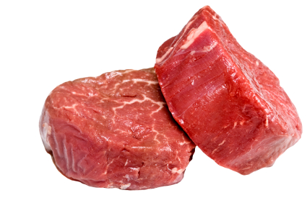
Causes of Foodborne Contamination
Food Products can become contaminated via several routes:
Naturally occurring (raw foods)
Underprocessing/improper processing
Recontamination/cross-contamination
Pathogens
Spoilage organisms
Allergens
Chemical contaminants
Intentional contamination
Economic adulteration (e.g melamine)
Bioterrorism

Slide 16
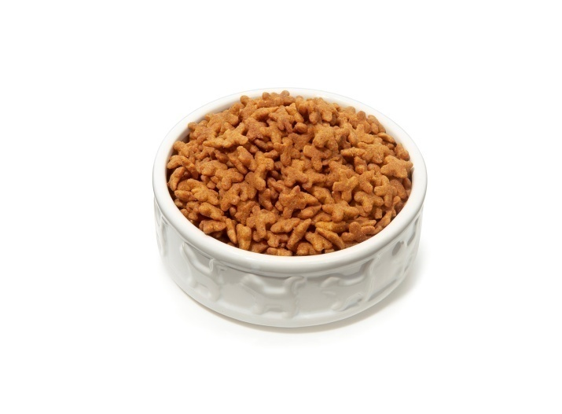
Managing the Food Safety Landscape
Progress continues to be difficult as shown by recent events that have shaken consumer confidence in the safety of the U.S. food supply
Major outbreaks continue in the U.S. resulting in a continuing stream of costly product recalls:
Pot pies (Salmonella) $20+ million
Peanut butter (Salmonella) $66+ million
Spinach (E. coli O157:H7) $25-50 million
Pet food (melamine) $40+ million
Chili sauce (botulism) $35 million

Slide 17
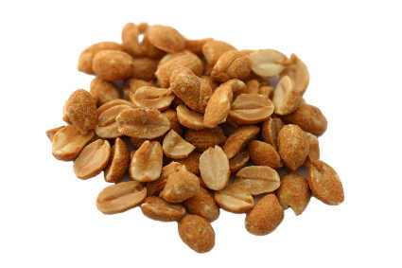
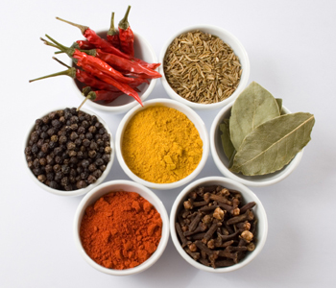
Salmonella in Low Moisture Foods
Salmonella is found in a wide variety of low moisture food products:
Chocolate/cocoa products
Desiccated coconut
Almonds
Peanuts and peanut products
Flour and grains
Dairy powders
Jerky
Dried fruits
Dehydrated vegetables
Cereal and cereal products
Spices
Dry pet foods

Slide 18
Food Producers Must Challenge Old Beliefs in Food Safety!
Example: moisture control of pathogens in foods
Control of moisture content to preserve foods has been done since antiquity
Control from the microorganism’s perspective is measured in terms of the available water (versus unavailable bound water) that can be utilized for growth and metabolism
Food microbiologists generally describe the water requirements of microbes in terms of the water activity (a_{w}) of the food
Aw also has an interactive effect with other variables such as pH, salt, heat, and preservatives
Reduced aw can induce a number of “stress response” changes in the microbe that can enhance heat resistance and prolong survival in the product

Slide 19
Approximate a_{w} Values for Growth of Selected Pathogens in Food

Slide 20
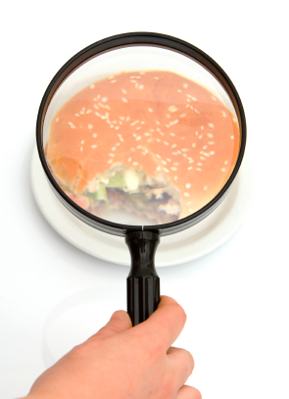
Case Study

Slide 21
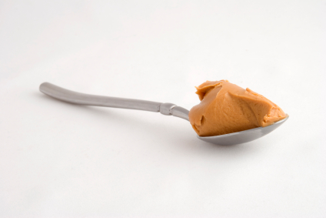
Salmonella in Peanut Butter

Slide 22
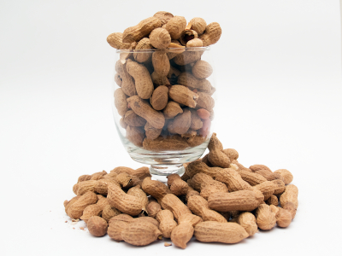
Peanut Butter Industry Facts
Peanut butter is a ~1 billion $ industry in U.S.
5 major manufacturers account for 75% of production
50% of U.S. peanut crop used for peanut butter
Peanut butter is found in 90% of homes in U.S.
Average consumer eats peanut butter 27 times/year

Slide 23
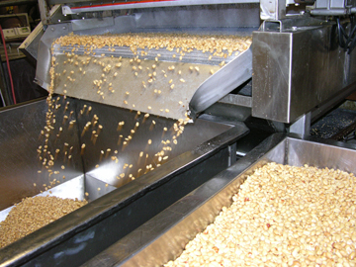
Peanut Butter Characteristics
Peanut Butter is produced from roasted shelled peanuts
Fat content ranges 49-52%
Salt is usually added at a 1-2% final concentration (lower in dietetic formulations)
Moisture content <1%, a_{w} <0.3%
Low a_{w} precludes the active growth of spoilage organisms and pathogens

Slide 24
Peanut Butter Manufacturing
Raw Shelled Nuts Roasted (Continuous or Batch 170º -180º C)
Blanched to Remove Skins
Ground and Milled
(Salt/Dextrose/Stabilizers Added)
Homogenized (optional)
Packaged

Slide 25
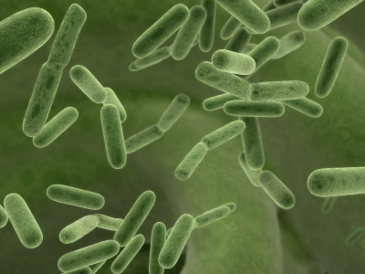
Salmonella in Peanut Butter
Raw peanuts, as with other raw agricultural commodities, are known to be contaminated with Salmonella spp
Studies have shown that the most heat resistant strain (Salmonella seftenberg) is inactivated by peanut roasting
Contamination of peanut butter with Salmonella spp. occurs via post-roasting recontamination
Prevention of recontamination depends largely upon effective separation of raw peanuts (and associated dust/fines) and the post-roast processing areas
Once peanut butter is contaminated with Salmonella spp., it will survive for prolonged periods of time

Slide 26
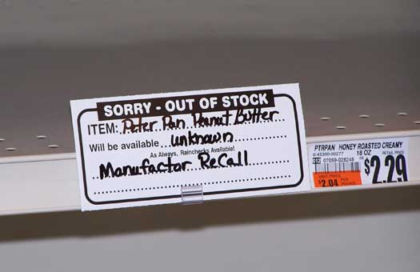
History of Salmonella in Peanut Butter
First outbreak linked to peanut butter was reported in Australia in 1996 (Salmonella Mbandaka)
Salmonella Agona outbreaks reported in 1996 in 4 countries was associated with the consumption of a peanut butter coated RTE savory snack
First outbreak in the U.S. traced to Salmonella Tennessee in peanut butter was reported in February 2007
A second major outbreak in the U.S. was traced to Salmonella Typhimurium in peanut butter in 2008 – 2009

Slide 27
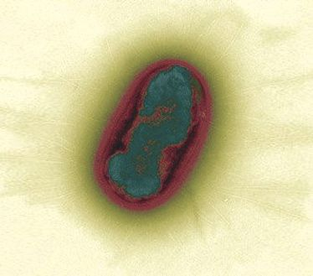
Factors Contributing to the 2007 Salmonella Recall
Inadequate separation of pre-roast/post-roast processing areas.
Dust/fines present in the post-roast areas
Roof leak and faulty sprinkler head leak introduces moisture into the environment allowing for potential growth of Salmonella Tennessee
During subsequent processing, handling, and filling, Salmonella Tennesee found its way into the product

Slide 28
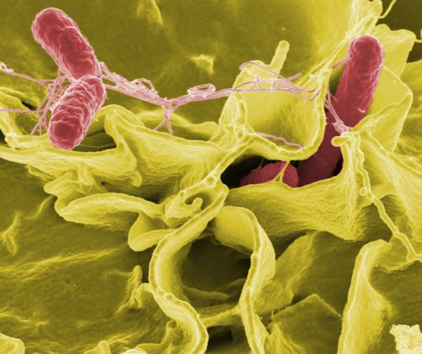
Factors Contributing to the 2007 Salmonella Recall
Typical dry cleaning procedures were not able to eliminate the pathogen from the environment
Environmental monitoring procedures were insufficient to detect the organism in the environment
Finished product testing also did not detect the organism implying sporadic contamination

Slide 29
Common Routes of Recontamination

Slide 30
Avoiding Food Safety Issues – Putting it all Together

Slide 31
Putting it all Together
The food industry must be committed to the highest possible standards of food safety throughout its operations and should take significant measures to that end:
Each food company should have an established Senior Leadership position, to bring additional focus to developing and implementing programs that continuously improve product safety and design.
Companies should consider the use of external expert food safety advisory bodies and process authorities to provide guidance on issues of food safety.
Companies should have the proper checks and balances to ensure that their suppliers and co-manufacturers are in compliance with established food safety standards.

Slide 32
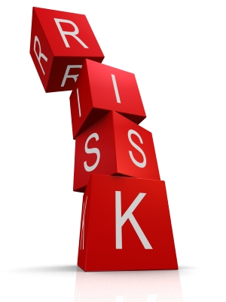
Putting it all Together
HACCP and associated pre-requisite programs should be the cornerstone of a company’s food safety program:
HACCP plans should be reassessed ideally on an annual basis or if there are any significant process changes.
HACCP plans should be developed using experienced cross-functional teams and reviewed/approved by a third-party expert authority if in-house expertise is not available.
Food Safety Assessments should be conducted to determine if the HACCP plan and pre-requisite programs are being followed and to identify gaps in the food safety system.
Food companies should require that their suppliers and co-manufacturers have implemented a valid HACCP plan and associated pre-requisite programs.

Slide 33
Putting it all Together
Food Companies must commit to making significant capital and resource investment to ensure the production of safe food:
Installation of state-of-the art equipment and process redesign.
Complete separation of raw ingredients from finished product areas.
Implementation of an aggressive environmental monitoring program for pathogens or indicators of pathogens in the plant.
Implementation of a validated allergen control plan.
Implementation of statistical sampling plan for finished product testing on all lots of finished product (where it adds value).
Use of the latest leading-edge detection technologies for all pathogen testing.

Slide 34
Putting it all Together
Sponsorship of leading-edge research for control of pathogens in food products from farm to fork.
Proactive leadership in external committees, trade organizations, and research institutions to promote food safety.
Conduct in-depth safety and quality system and capabilities assessments using cross-functional teams and independent technical experts at targeted manufacturing plants.
Assess overall recall and traceability processes across our supply chain.
Assess organizational capabilities across Operations to ensure proper resource allocation.

Slide 35
Future Needs
Need a quantum leap forward in hygienic equipment design and cleaning/sanitation of equipment for dry processes
Need to understand how novel technologies can be brought to bear to improve the safety of these products (many of which are low margin, commodity type products)
Need to understand the distribution, incidence, and levels of pathogens in raw materials such as raw peanuts so that meaningful quantitative risk assessment can be done
Need to develop industry-wide approach to sampling and testing plans, especially when a positive result occurs
Need to educate management that just because a low moisture product does not support pathogen growth, it does not mean it is a “safe product”

Slide 36
Thank you!
Questions?
www.aivfoodsafety.com
paul.hall@aivfoodsafety.com

