Slide 1
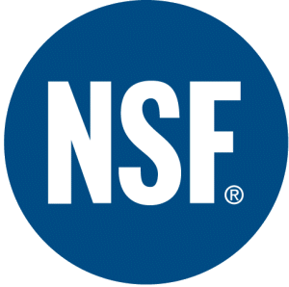
Protect Your Brand by adopting “Best Practices” for the Beverage Industry
4th Dubai International Food Safety Conference
February 26, 2009
Dubai Municipality
Notes:
Good morning.
I would first like to express my thanks to the Dubai Municipality for sponsoring this conference.
I would also like to personally thank Muhammad Khalid Saeed, Food Health Inspection Officer for the Dubai Municipality, for the invitation and handling arrangements for my attendance.
Today’s turnout is a demonstration of how serious this issue is across the globe.

Slide 2
NSF is a Health And Safety Leader
Founded in 1944, as a not-for-profit, Non-Governmental Organization (NGO).
Developer over 50 national consensus standards
Steadfast ties with key associations and government agencies
A Collaborating Centre of the World Health Organization
Service provider to over 12,000 companies in 100 countries
Standards Development/ANSI Certified, Product Certification, 3rd-Party Auditing, Laboratory Testing, HACCP Training
Notes:
I am General Manager of the Beverage Quality Program for NSF International.
We are a not for profit organization dedicated to public health safety, which naturally includes food safety. We are also a Collaborating Centre for the World Health Organization for Food Safety and Drinking Water Safety and Treatment. We have developed over 50 consensus standards involving input from all key stakeholders (industry, regulatory and consumer groups). We provide services to over 12,000 companies in 100 countries, all focusing on safeguarding the public’s health.
While our Company is based near the University of Michigan, we have offices around the world including Brussels, Delhi, Bangkok & Shanghai.

Slide 3
Presentation Objectives
What Keeps You Awake At Night?
Food and Beverage Safety
“Farm to Fork”
Global Framework
Evolving Standards
Layers built upon each other
Getting it right the first time
Best Practice
Foundation built on HACCP
Reduces risk
Sharing knowledge
Notes:
I will be sharing with you the role we play in supporting the bottled water and beverage industry.
We help managers “get it right”.
We have 25+ years of experience helping hundreds of companies world-wide to improve their standards, to reduce their risk, to build competences and to achieve and maintain the very best practice, based upon global and national regulations and Codes of Practice.
“NSF does know what keeps you awake at night!”

Slide 4
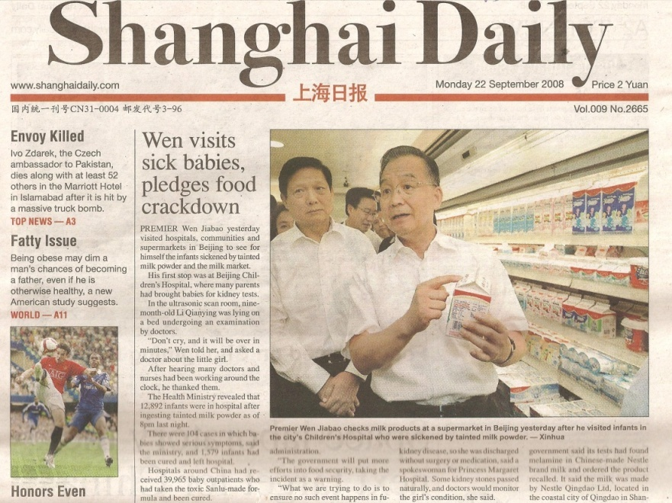
What Keeps you Awake at Night?
Food safety a big problem worldwide: WHO officials
July 17, 2007
“What’s in your drinking water?”
Source of tainted spinach finally pinpointed
Calif. Ranch likely responsible for E. coli outbreak that killed 3 people
Notes:
When I speak to executives, a major fear is that their food safety system will experience a failure and as a result people might get sick.
I come from Atlanta, Georgia. Right now we have peanuts on our mind.
If you live in the United States and are in the food industry, your worst nightmare is to wake up and find our newly elected president of the United States on television saying he is afraid for his 7 year old daughter to eat your product!
There have been other notable examples of what happens when food safety systems fail.
Worldwide Food borne Disease Major Problem
2 billion cases annually
1/3 of the global population
1.8 million deaths annually
Economic loss in the 10’s and even 100’s of billions
How could these have been prevented?

Slide 5
Masafi and NSF’s enduring association is based on the shared ideals of quality and adherence to stringent international standards. Masafi’s stated purpose is to offer premium products for better life and NSF has partnered this mission by helping us consistently deliver on our commitments to our valued consumers. NSF’s expertise has been vital to the development of world-class systems for Masafi’s business operations. We are confident and look forward to a mutually beneficial partnership with NSF in the years to come.
Notes:
We think what one of our customers, Masafi, has to say about quality said a lot …
Consistently deliver on our commitments to our valued customers …
What companies around the world have found is that working with global organizations like NSF can help bring the “Best Practice” ideas into a plant operation that can insure they can deliver on their promise.
What our experience has taught us is that most solutions to most problems that have already been thought through and proven.
Best Practice is a lot about listening and learning from others who have already been through the process. Sharing ideas so we don’t have to repeat the same mistakes.

Slide 6
Best Practices in Beverages Have Evolved From Many Sources Around The World …
Consumers
Manufacturers
Codex
Standard-setting Bodies
Universities
Academia
FDA
NGOs
EU
Governments
Industry associations
ISO
Best Science
CEIS
WHO
Internationally-recognized registrars
Notes:
The Best Practices that exist today in the Bottled Water industry reflect an evolution of quality.
We have gone from being Reactive, relying solely on Government Standards to today's environment that focus on continuous improvement.
Best Practices are continuously evolving.
They are built around the idea of …
Anticipate ……. Adjust …… then audit ….
Best Practice is a Continuum that is realizing Legally safe is not enough, that we have to focus on Process Improvement and ultimately Product specific standards.
The concern over food and beverage safety has lead to a proliferation of standards and organizations dedicated to improving quality. We have government agencies, standard-setting organizations such as ISO and BRC, SQF and IFS.
There are trade organizations around the world dedicated towards improving bottled water quality such as the US based International Bottled Water Association, the Asia and Middle East Bottled Water Association and others.
Everyone is promoting quality, but it takes “Best Practices” to insure we achieve it.

Slide 7
Today’s “Best Practice” Starts With …
HACCP:
Hazard Analysis Critical Control Point
International in Scope
Deals with all aspects of food safety and hazards
7 Guiding Principles
Mandatory in some countries (E.U.)
Voluntary in others (U.S.)
Notes:
Everything today in the world of Best Practice begins with one thing …
HACCP.
Or as a friend of mine in the UK remembers it by ….
Have A Cup Of Coffee Please
HACCP is a systematic, preventive approach to food safety that addresses physical, chemical and biological hazards by means of focusing on prevention rather than finished product inspection.
HACCP identifies potential risk so that the most critical areas, known as Critical Control Points (CCP's) can be managed to reduce or eliminate the hazards.
I think everyone in this audience is well versed in the seven key steps, or principles, that make up every HACCP plan;
Analyse hazards
Identify critical control points
Establish preventive measures with critical limits for each control point
Establish procedures to monitor CCP’s
Establish corrective actions
Establish procedures to verify the system
Establish an effective system of recording information
For Europe: It’s mandatory.
January 1, 2006 the Regulation 852/2004 of the European Parliament on the Hygiene of Foodstuffs require that: “Food business operators shall put into place, implement and maintain a permanent procedure based on the principles of hazard analysis critical control points (HACCP).”
For US: Voluntary (but likely to change after peanut problems)

Slide 8
“Best Practice” is About Optimizing Your HACCP Plan …
Enhances confidence in the safety of your beverages
Reduces failures and damaged goods
Improves cost efficiency throughout supply chain
Eliminates problems before they happen
Improves consistency of product
Provides you a competitive advantage
Lowers risk
Increases profits
Notes:
Best Practice has both immediate and long-term benefit to your operation.
It typically yields better quality which in turn increases customer satisfaction, lowers returns and increases profit.
Most important to consider is that it comes in all flavors, shapes and sizes …
…Dramatically improved Quality will increase employee and customer satisfaction, will improve share and profitability, and will enhance our reputation.
-Jack Welch (formerly with GE)

Slide 9
You Can Find “Best Practice” in any aspect of bottled water production …
Security and Water Sources
Notes:
Best Practice can be applied anywhere.
Your HACCP plan starts with what is legally required. From there you and your team will build it towards “Best Practice”.

Slide 10
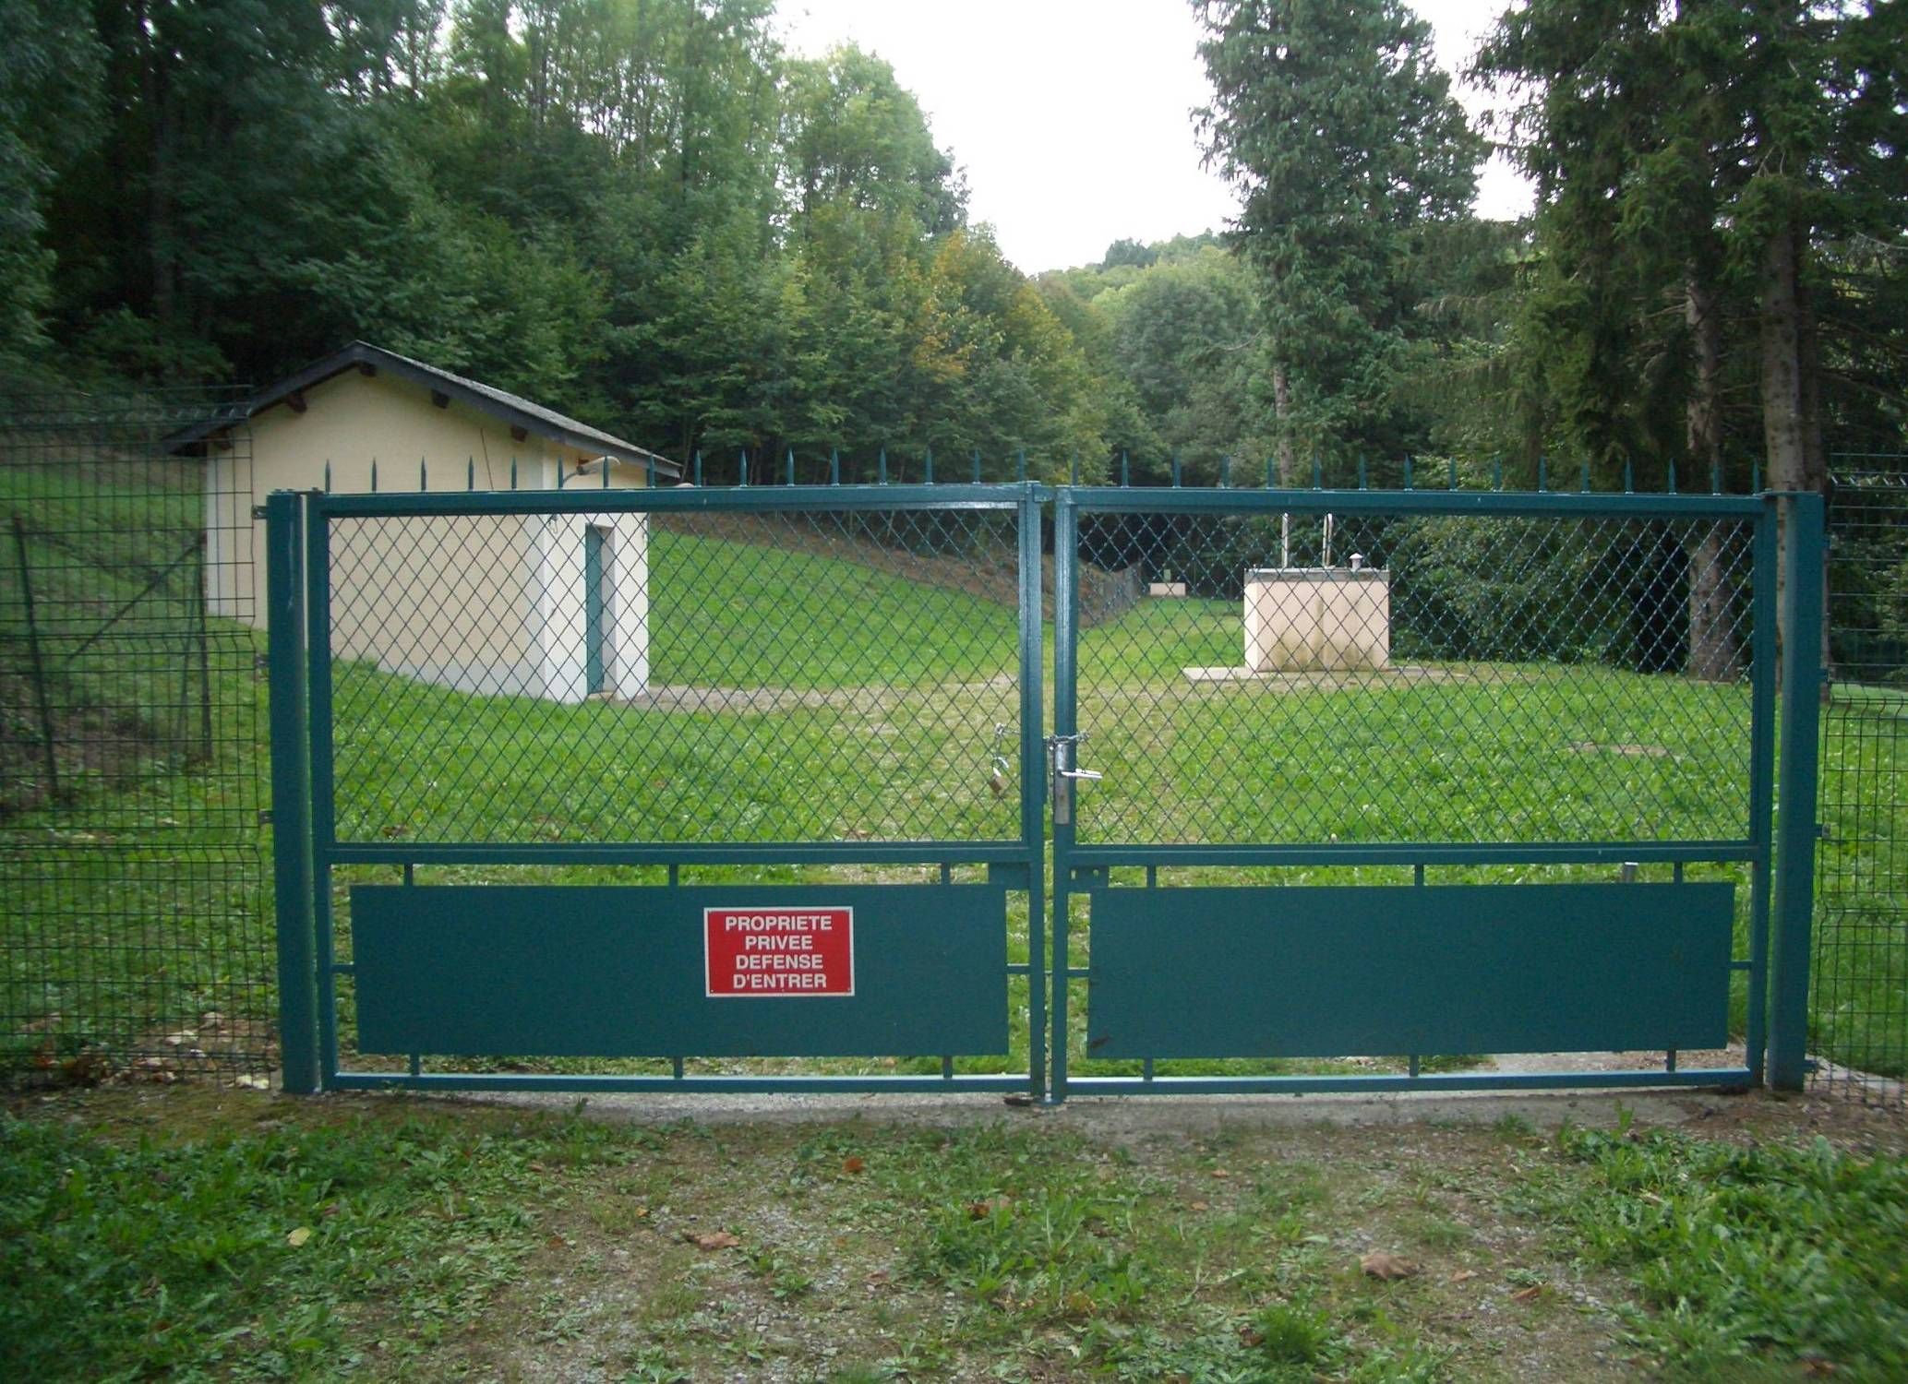
Notes:
Here is “Best practice” for Security and Source Water protection.
It should apply to all facilities
- Ground Water Sources must be protected

Slide 11
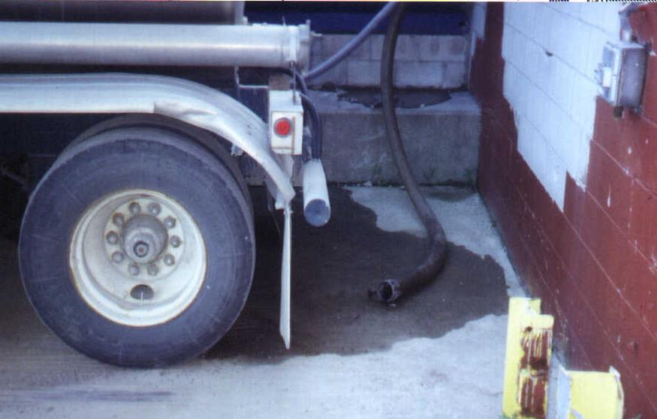
Notes:
This is Not best practice
Transferring water is a “Critical Control Point” where things can go wrong.
Anticipating problems before they happen is critical

Slide 12
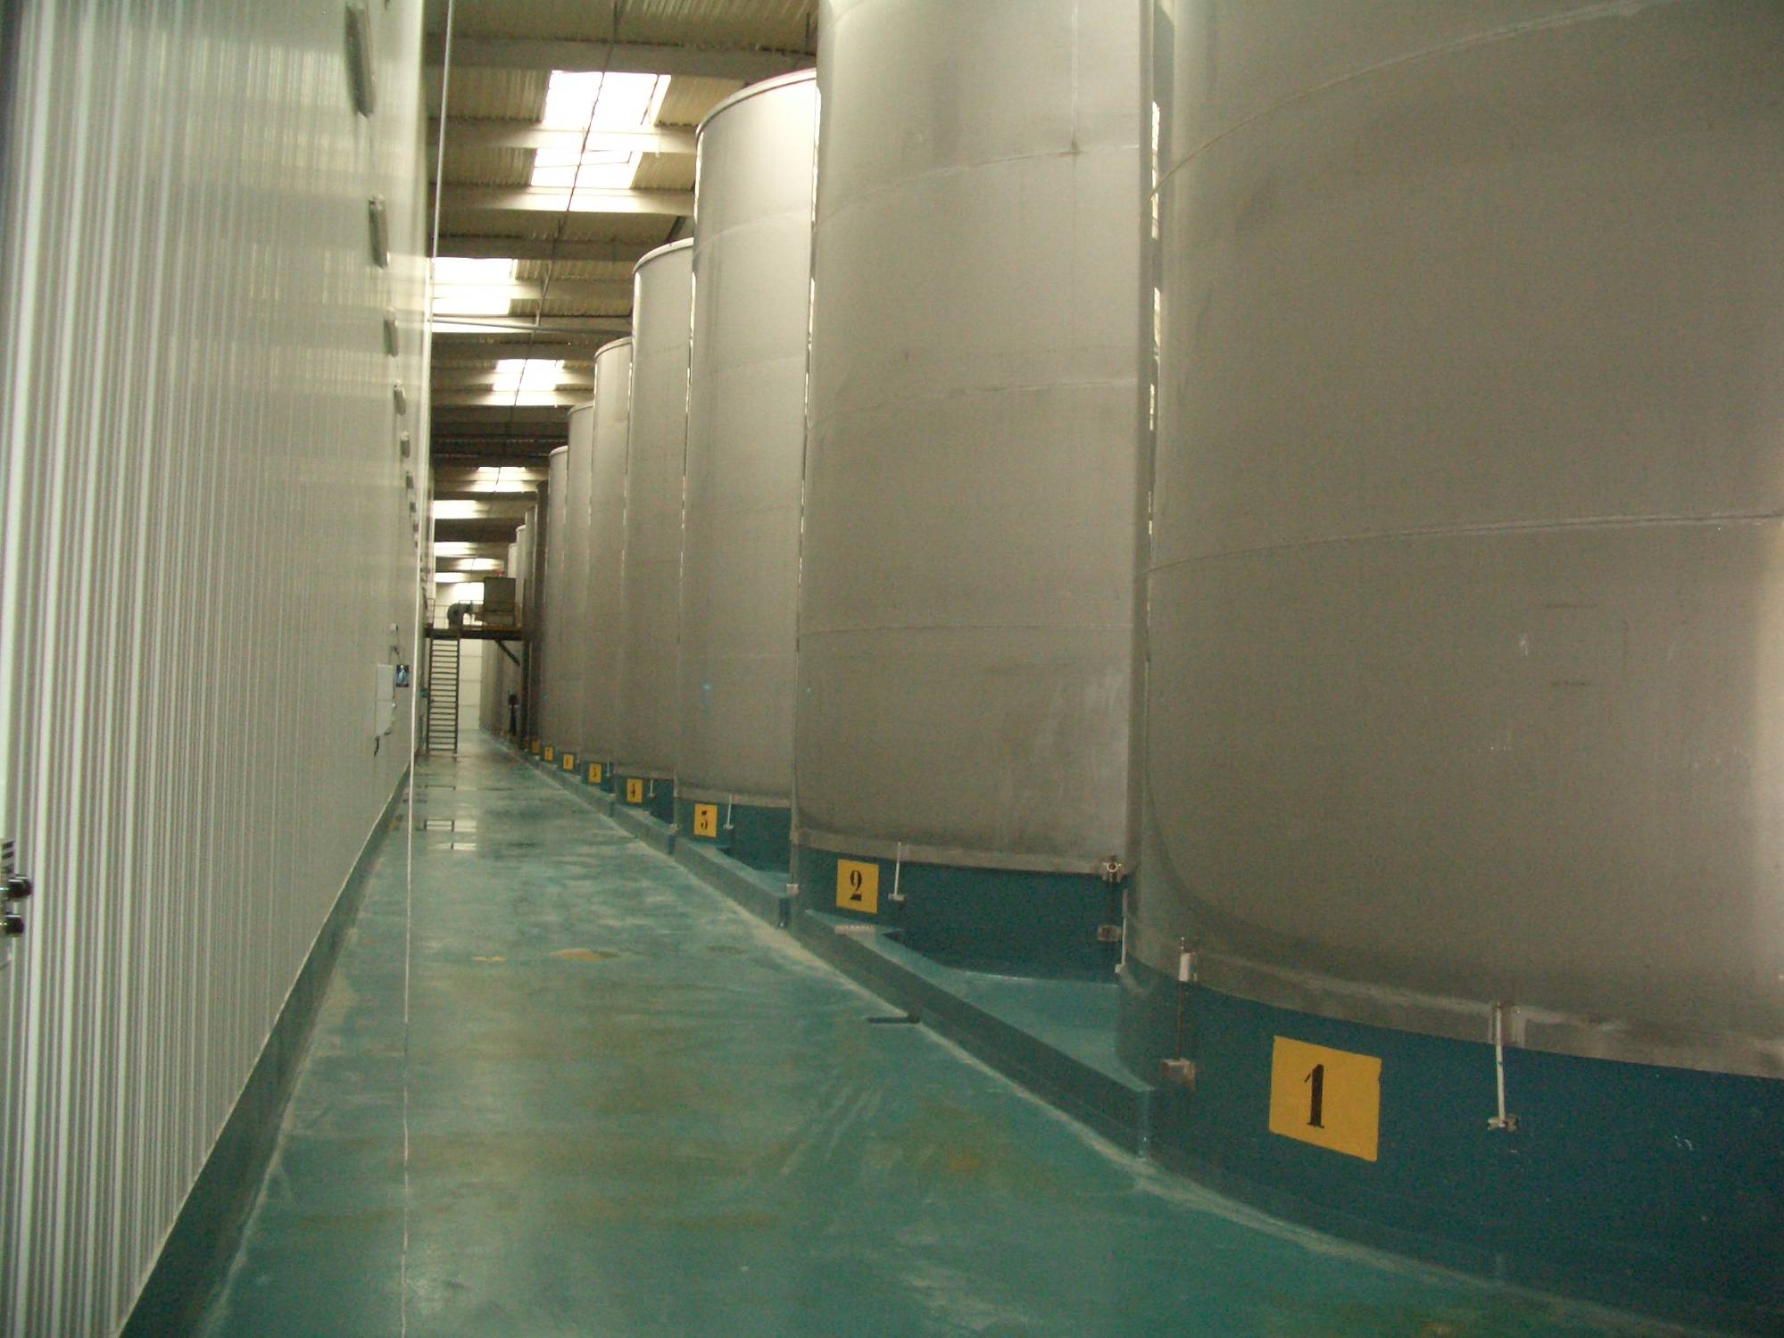
Notes:
Here is another example of Best Practice related to storing water. Clean, Protected, Documented.
This photo shows water storage tanks in one of the largest water plants in the world.

Slide 13
Container Loading and Washing
Notes:
One of the most important operations of the plant – where we handle containers.

Slide 14
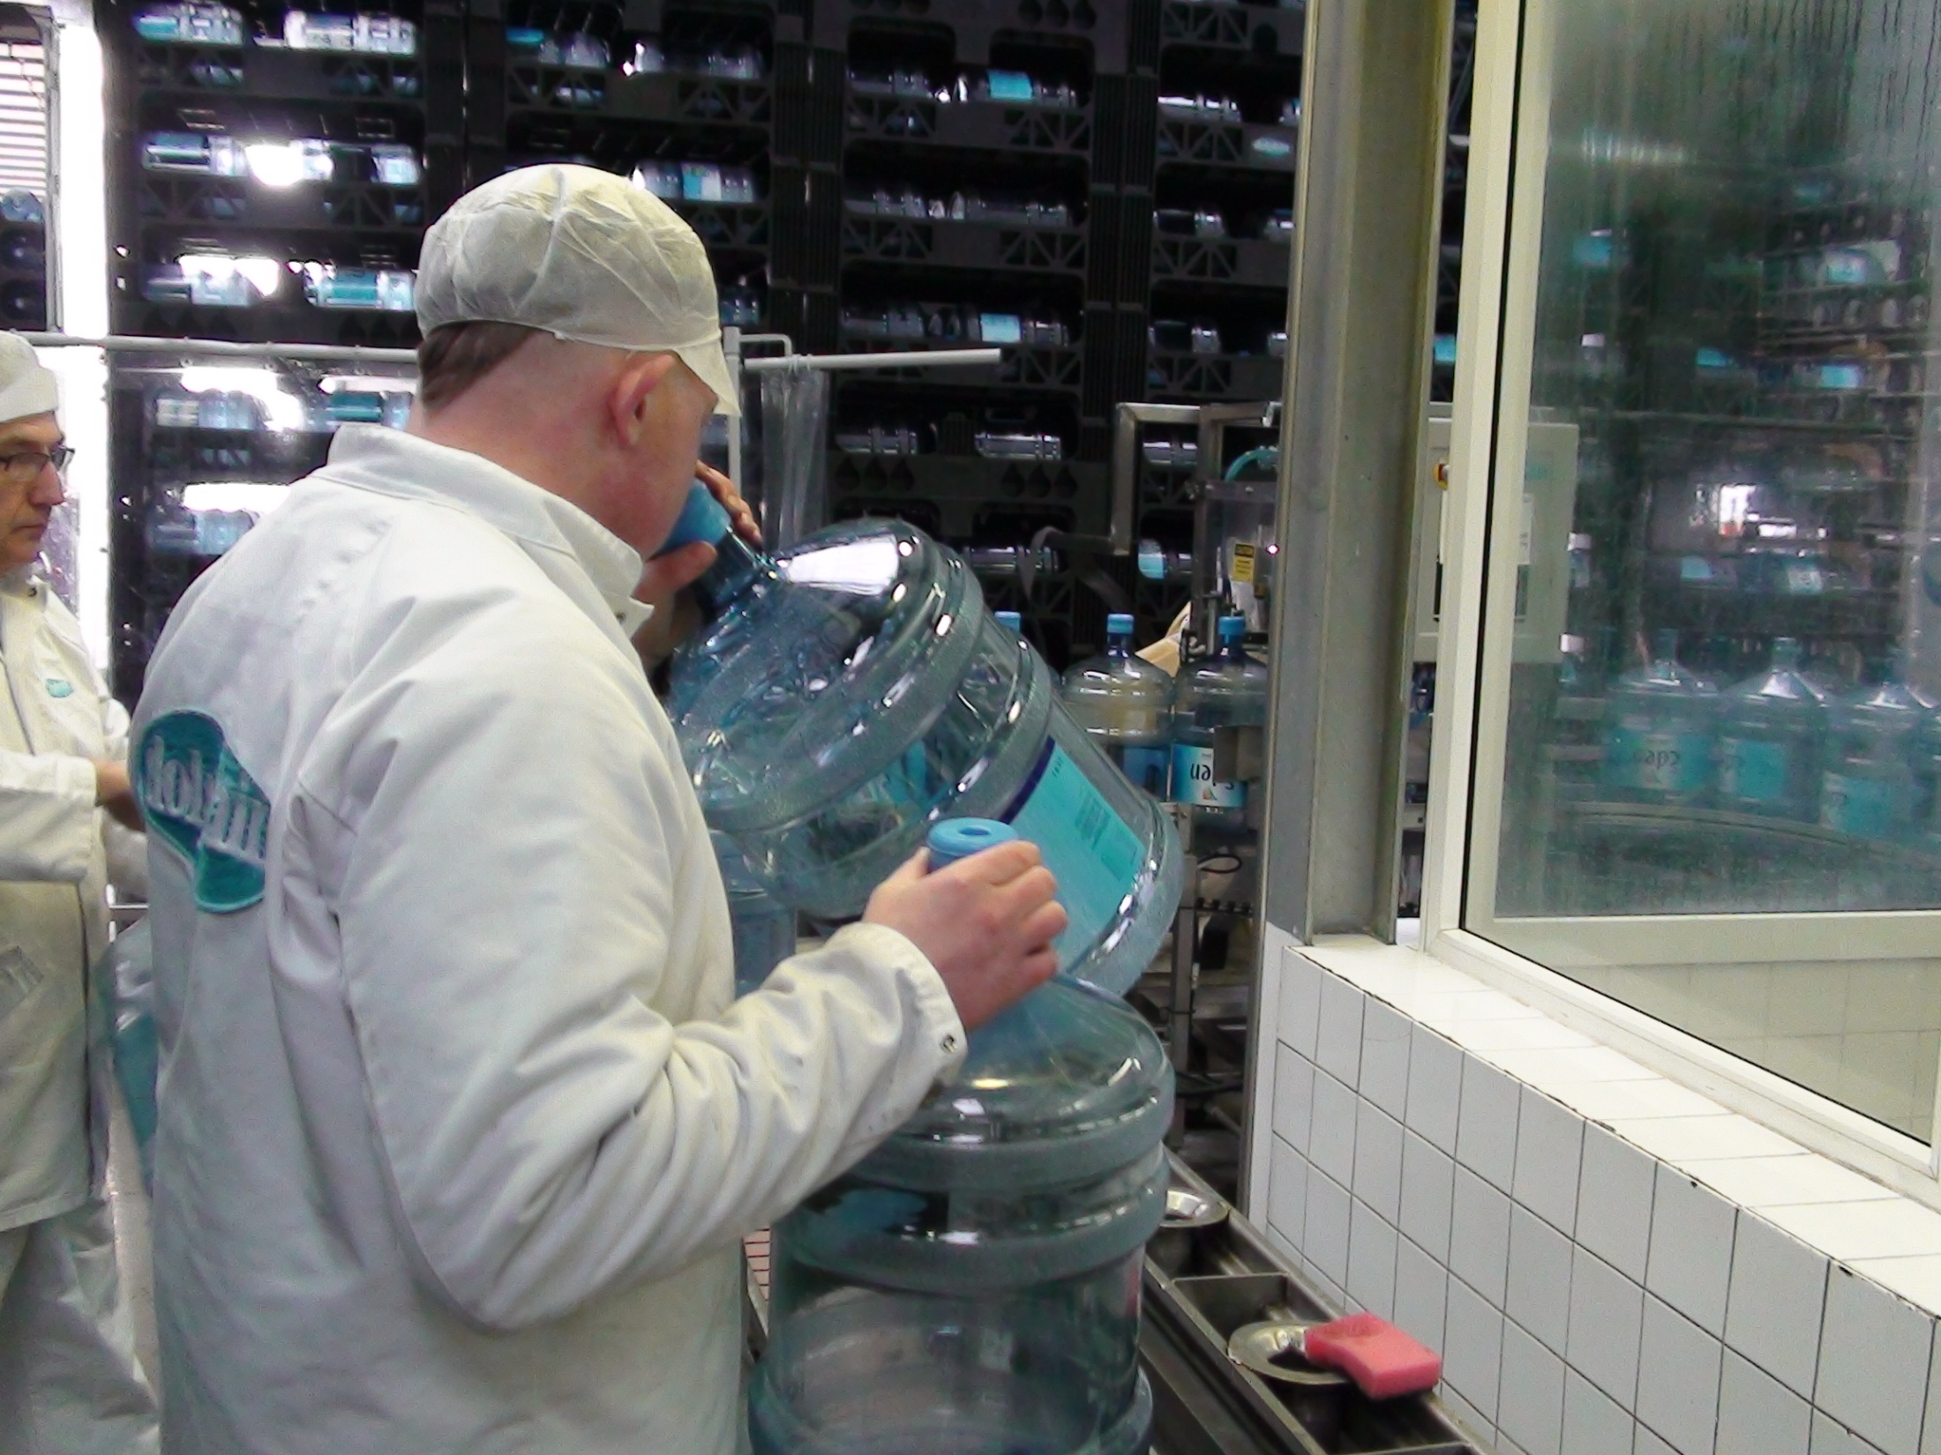
Notes:
There has yet to be a machine invented that is as good as the human nose!

Slide 15
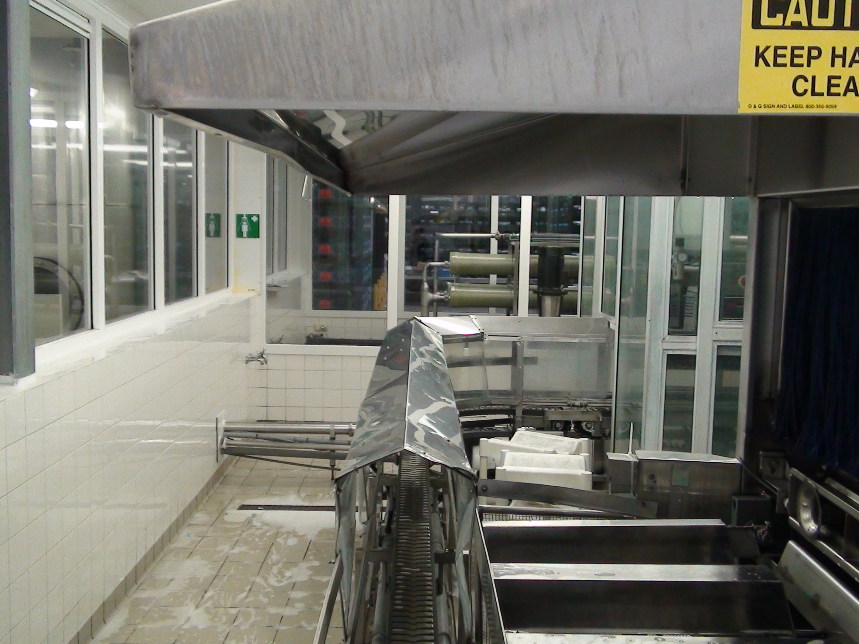
Notes:
It is about attention to detail.
Notice the lid over the area where the 5gallon bottles exit preventing anything from falling in and channeling the water vapor

Slide 16
Bottled Water Filling Operation
Notes:
The filling operations must be …
Well designed and constructed
Anticipate problems
Take precautions

Slide 17
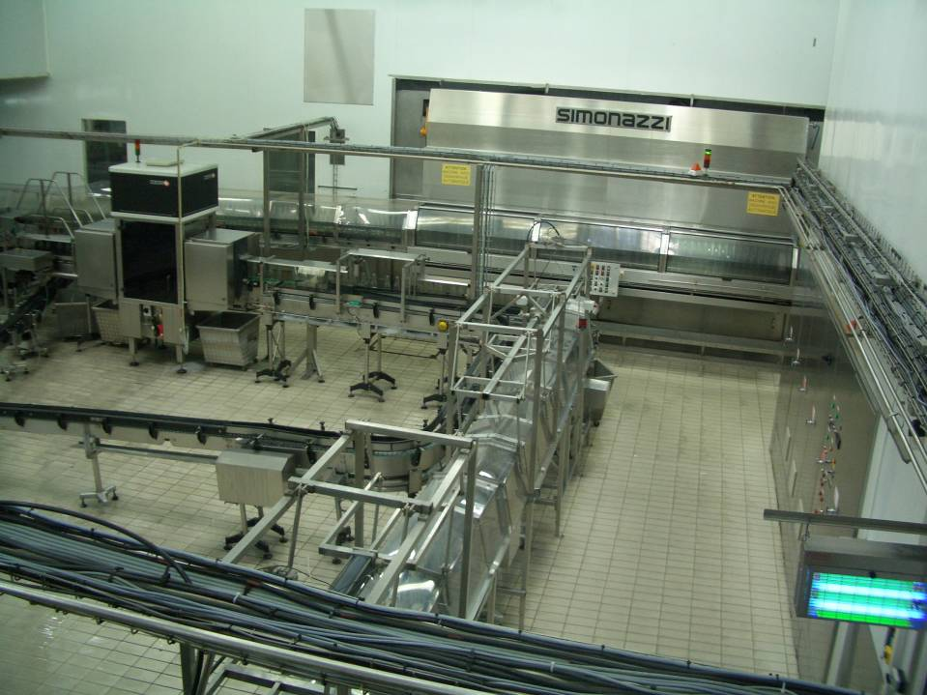
Notes:
From the “big picture” it must be:
Clean
Accessible
Stainless

Slide 18
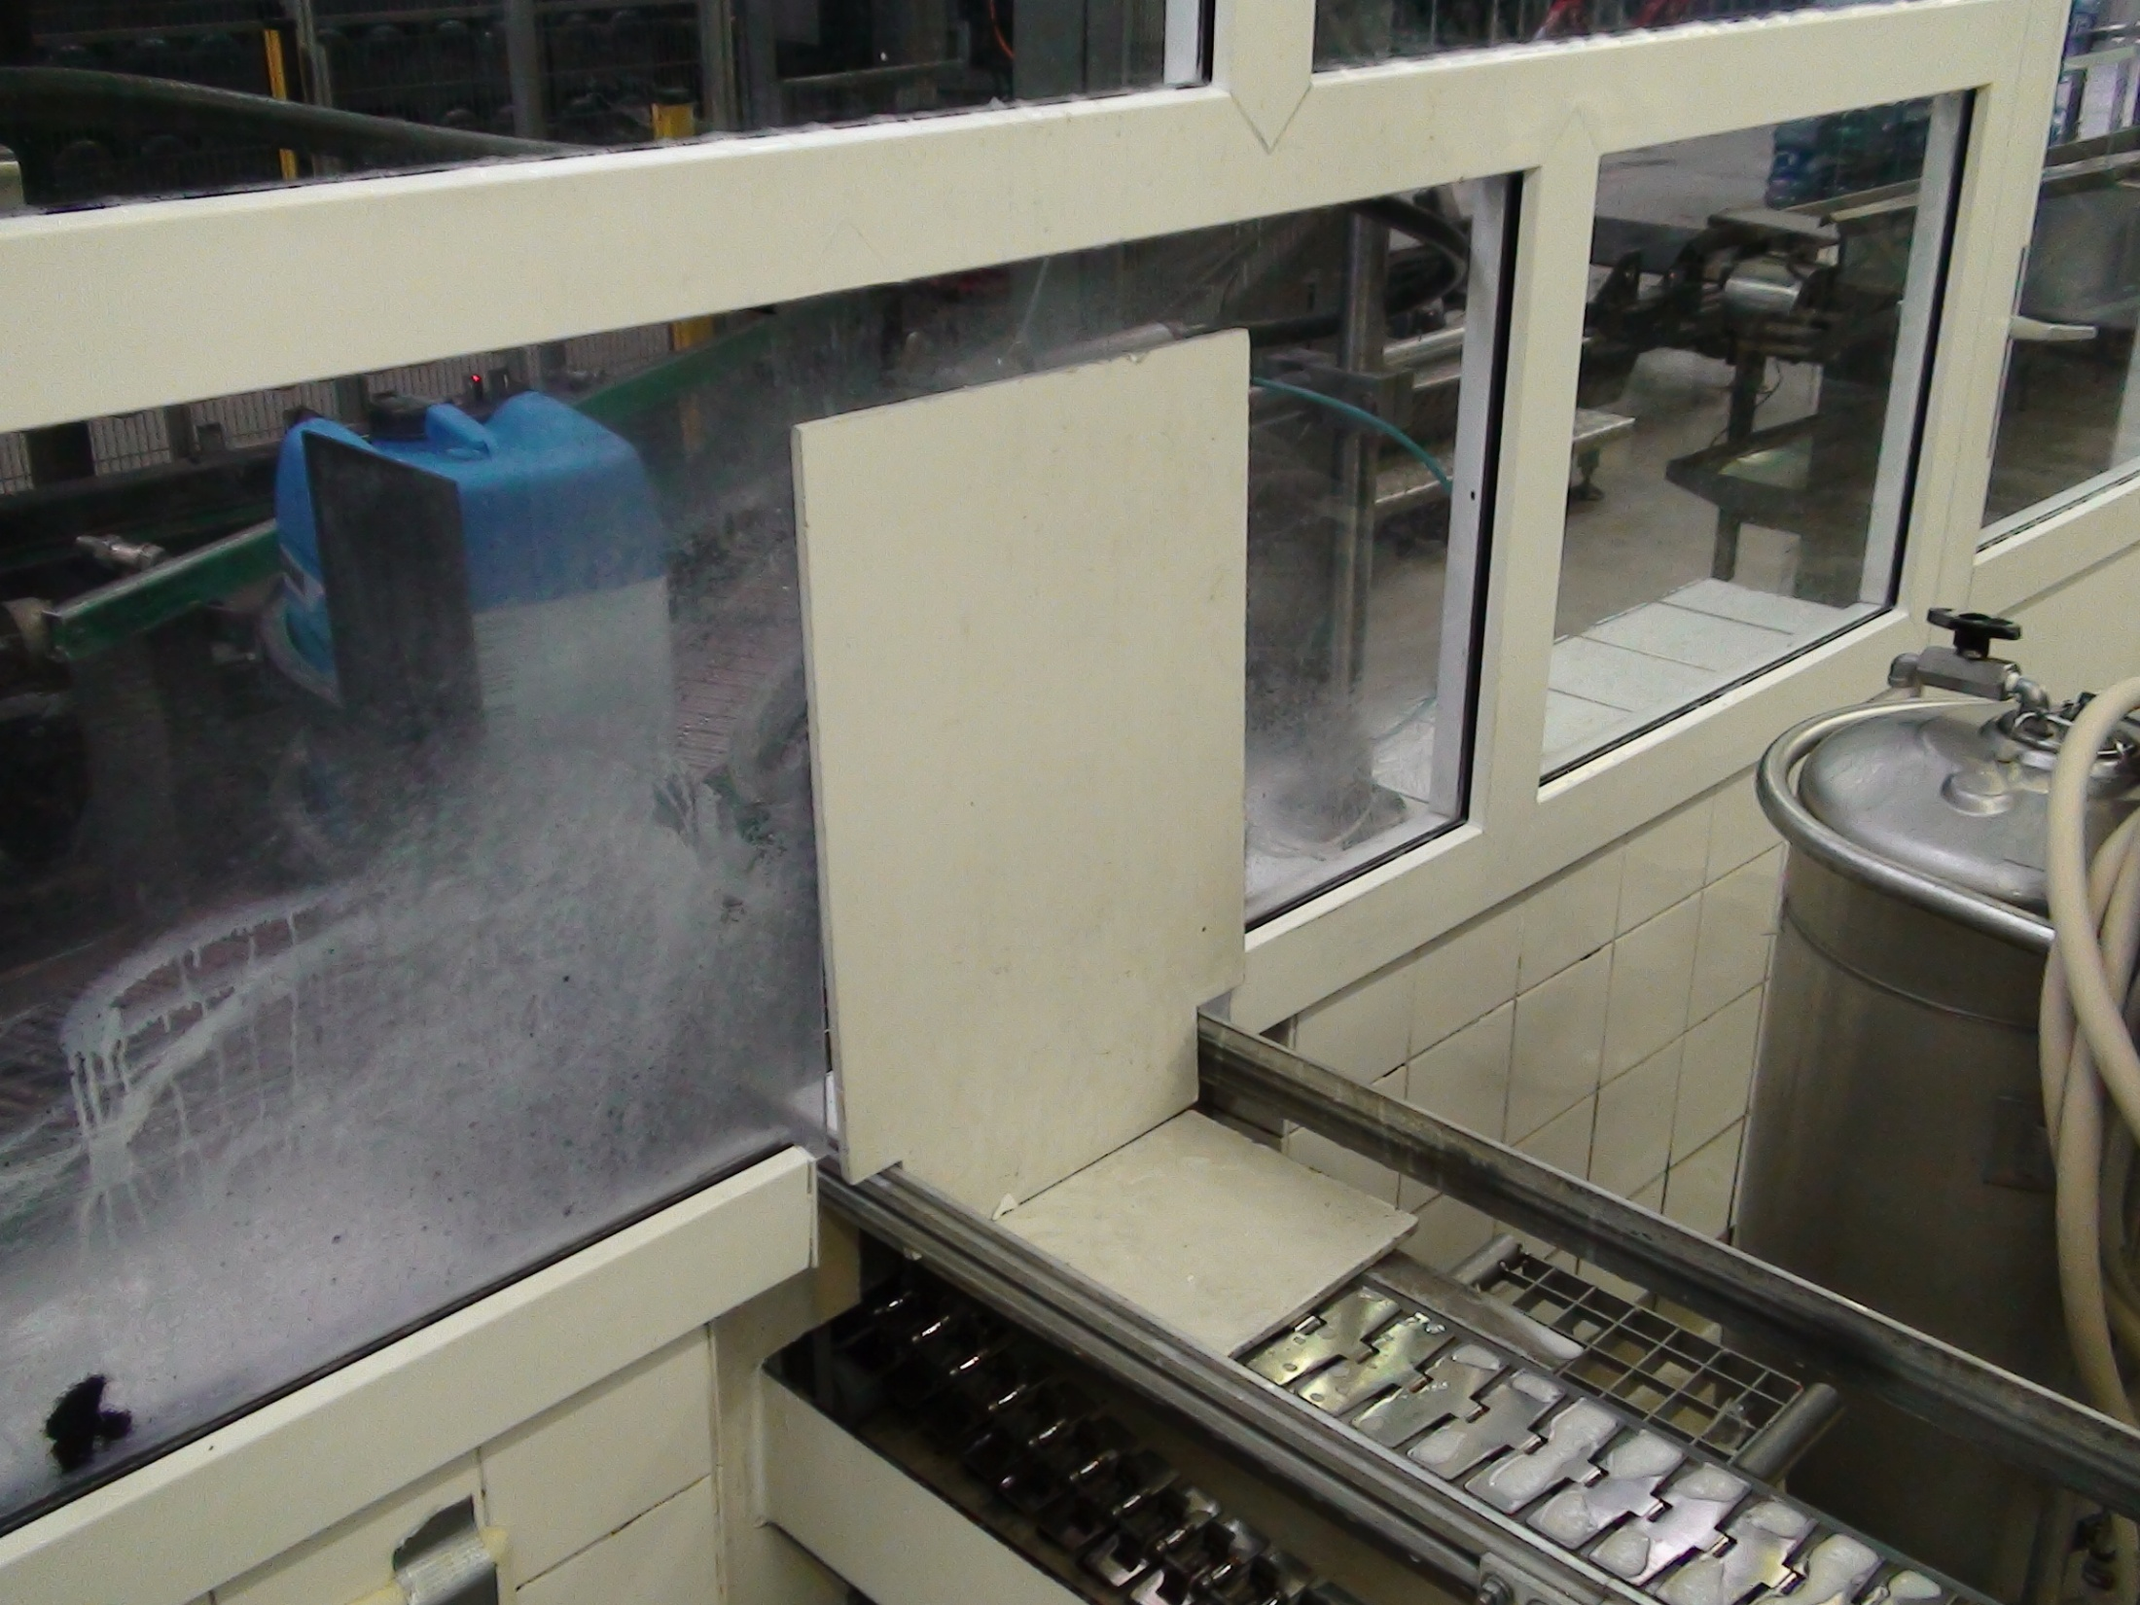
Notes:
Here is an example of “Best Practice”.
There is a Plug designed for the line inside the filler room to keep air from coming in when it is shut down.

Slide 19
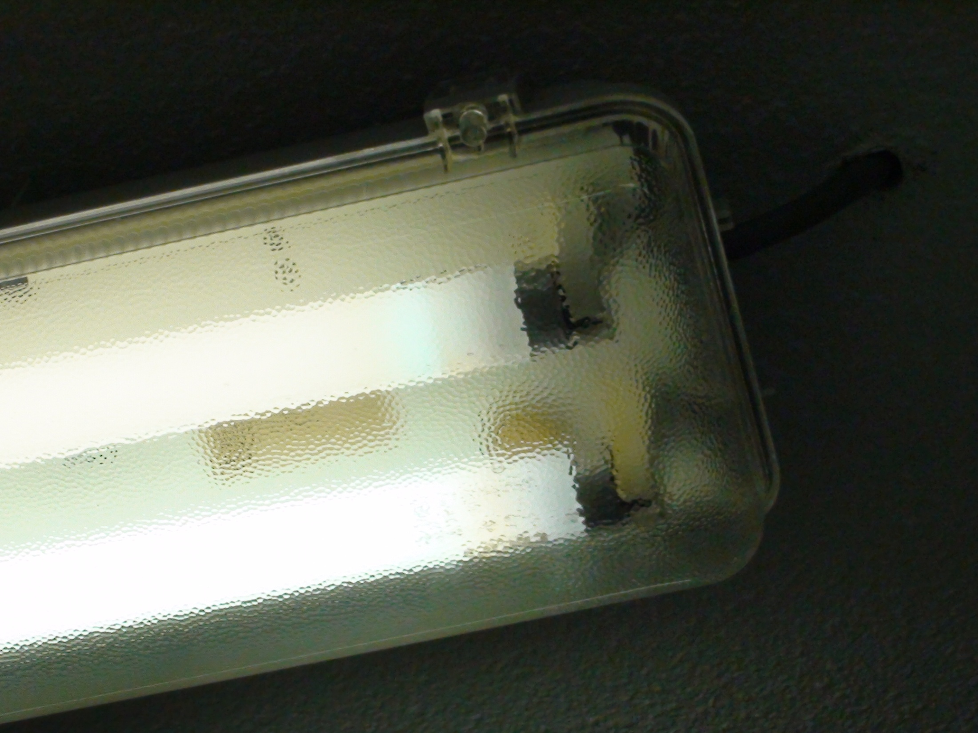
Notes:
Best Practice is to put Shields over the ceiling lights – leave nothing to chance.

Slide 20
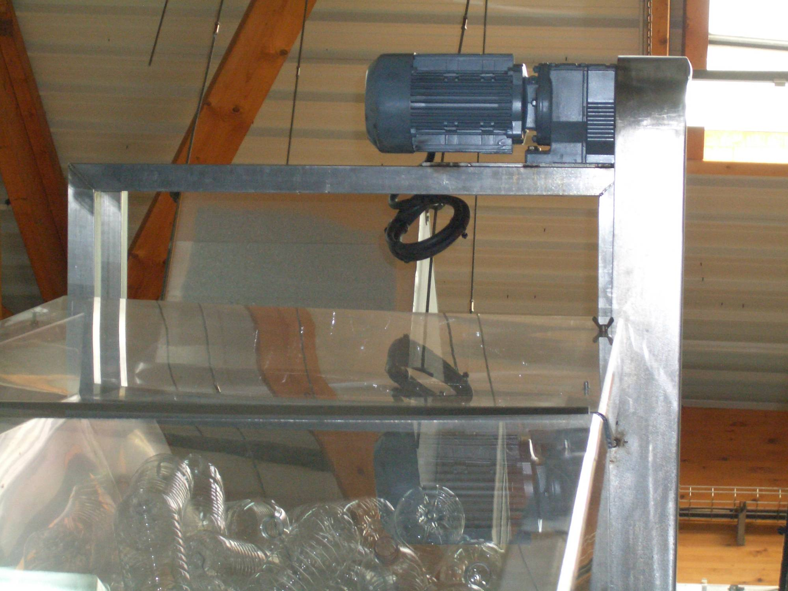
Notes:
On the other hand, here is something not best practice.
Note that the electric motor above primary packaging material without tray for catchment of lubricant

Slide 21
Notes:
Here is a good “best practice”.
Good cover over the cap conveyor. Note that caps transported by conveyor rather than blown through pipe work, thus reducing cap dust problems.

Slide 22
Chemical Control
Notes:
High Risk area

Slide 23
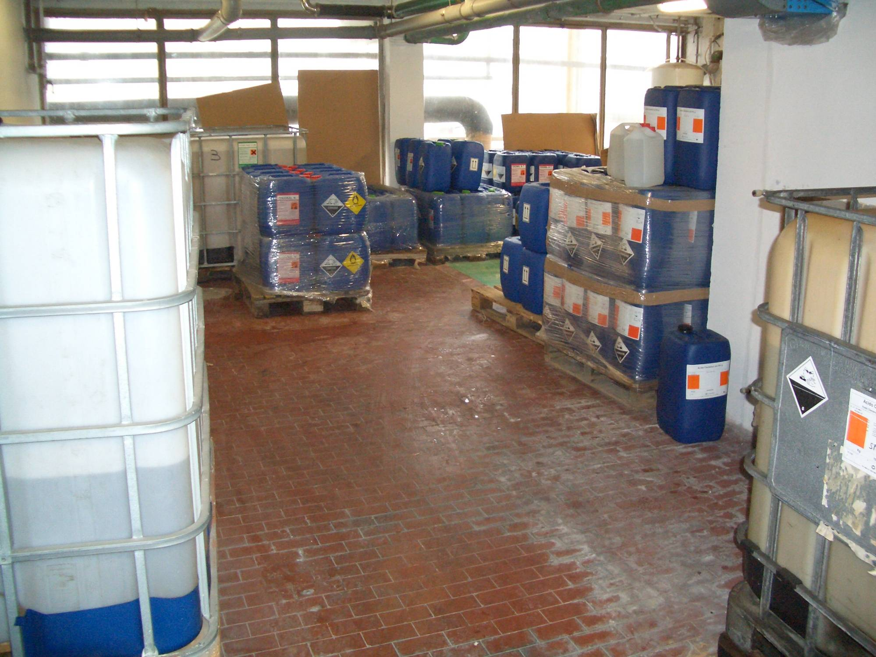
Notes:
Here is a bad practice
Unacceptable chemical storage area – no containers under stored chemicals to catch drips, splashes and leaks.
Chemical control is critical!

Slide 24
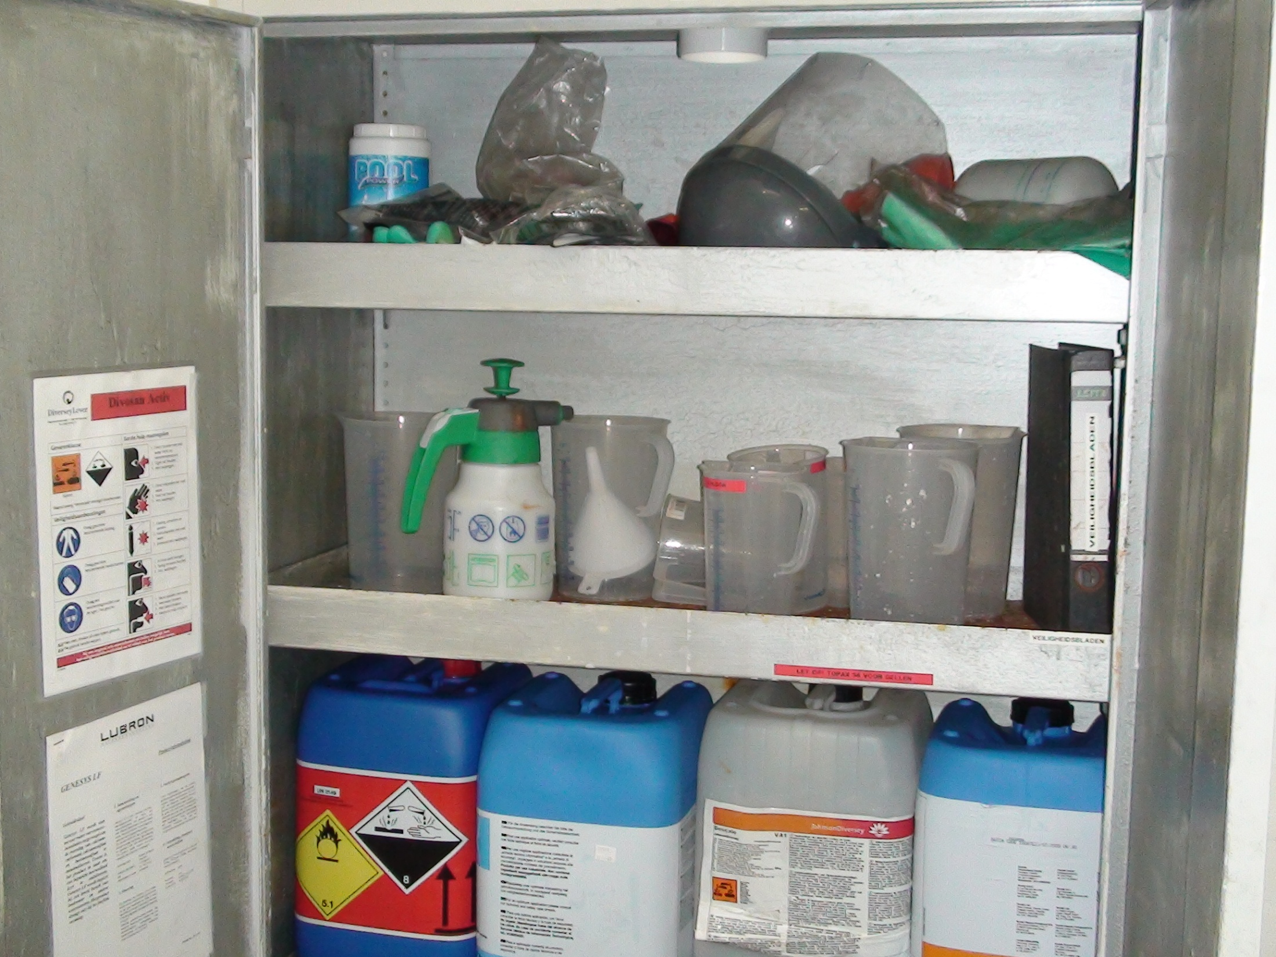
Notes:
Here is good chemical storage.
Lockable cabinet.
Safety manuals nearby.

Slide 25
Warehouse and Storage
Notes:
Vigilance does not stop after production …
It carries over to where finished product is stored

Slide 26
Notes:
Here is final product stored too tight against warehouse wall.
This prevents cleaning, inspection and pest control
Bad practice.
Should be 18 inches space to allow walk behind, pest traps, prevent damage to wall

Slide 27
Employees & Sanitation
Notes:
Watch for the obvious and not-so-obvious
People are extremely important to our operation and best practices

Slide 28
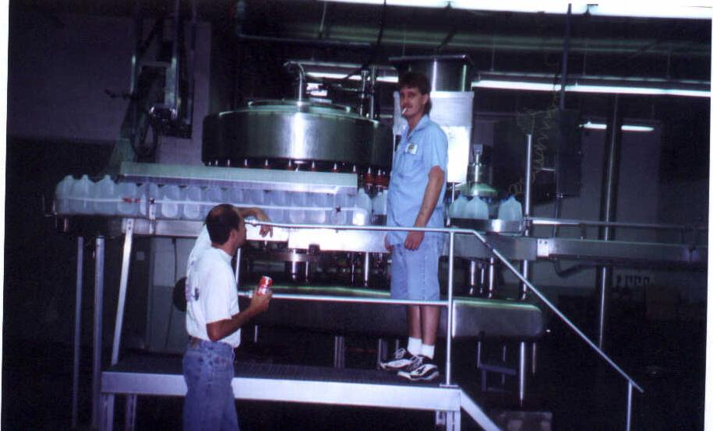
Notes:
BAD PRACTICES
Cigarettes
Food

Slide 29
Notes:
Here is Best Practice
Notice the lockers have slanted roofs to prevent people storing stuff above and collecting dirt.

Slide 30
Notes:
Washing hands.
It takes warm water and soap to remove dirt.
Hand sanitizer solutions only help if your hands are free of visible dirt.
GOOD PRACTICES
Sink is foot operated.
Single use paper towels

Slide 31
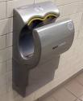
Notes:
EMERGING PRACTICES
Dyson forced air dryer
Hepa filter

Slide 32
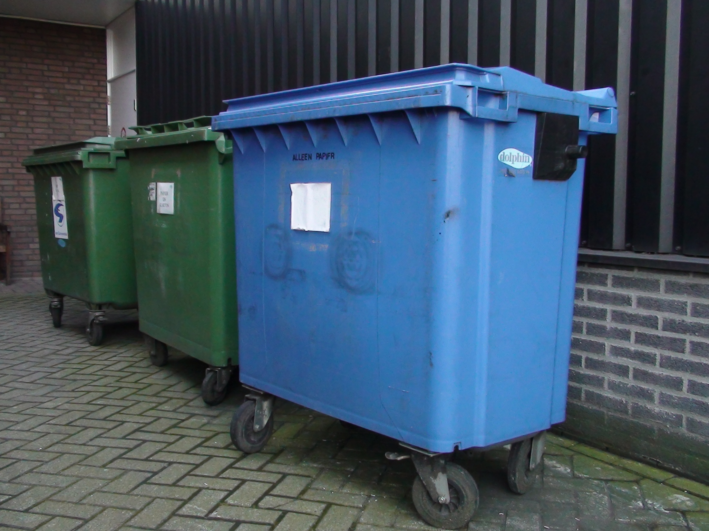
Notes:
This is Best Practice …
Trash cans On Wheels
Color coded for materials

Slide 33
Labeling and Packaging
Notes:
Not to be forgotten is the steps we take to identify and label our product.

Slide 34
Notes:
Laser coding (versus ink jet) can be considered “best practice”.
Smaller, low capital cost, faster.
Less consumables
No ink to test
Less smearing
Higher reliability
Flexible print patterns
Still must be outside filler room.
This concludes my presentation.

Slide 35
“Best Practices” make for better sleep!
For More Information visit nsf.org:
Chris Dunn Vaneet Gupta Valbona Malo
cdunn@nsf.org vgupta@nsf.org malo@nsf.org
Notes:
I hope you now understand how NSF can make the bottled water and beverage plant operators sleep a whole better!
Thank you for your time and attention.
For more ideas on Best Practice visit our web site or send us an email.
Thank you.
Questions

