Slide 1
Food Safety Capacity Development and
Private Standards in Emerging Markets:
Case Studies from India
Deepa Thiagarajan
Michigan State University
March 1, 2011
Dubai International Food Safety Conference

Slide 2
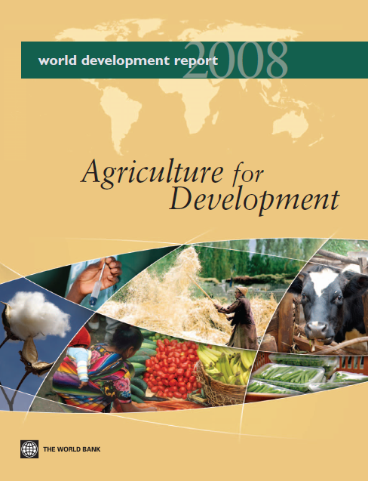
Background
Large proportion of the world’s poor live in rural areas and rely on agriculture for their livelihood
Agriculture market development as a key strategy to improve economic status of the rural poor
2

Slide 3
Agriculture Development Strategies
Reform of domestic markets
Technology transfer and adaptation to local conditions
Investment in infrastructure
Export market development
Focus on high-value domestic segments
  Organized retail
  Foodservice, catering
Smallholder farmers are particularly susceptible to being left behind as markets evolve
3

Slide 4
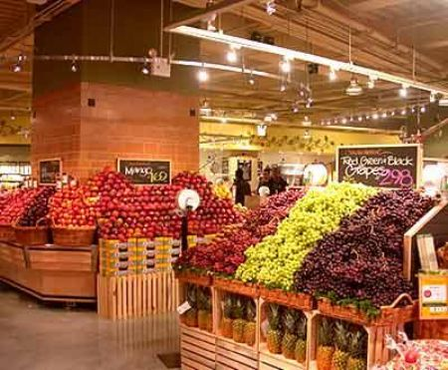
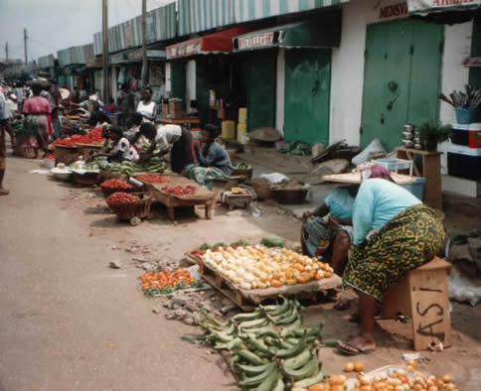
Challenge: Smallholder access to global markets
The Dilemma:
  Global food industry:
    Safe, quality product
    More efficiently and at lower cost.
    Want to work with smallholder producers.
  Small and medium producers/suppliers:
    Excluded from high value markets.
    Lack the capacity to meet rigorous safety and quality standards.
    Large volumes are a challenge.
Development Objectives:
  Value chain development for quality fruits and vegetables
  Market development
4
Notes:
Global food industry is eager to improve the safety and quality of product from suppliers, and to do this more efficiently and at lower cost. They also want to work with smallholder producers.
Small and medium producers/suppliers are largely excluded from high value markets because they lack the capacity to meet rigorous safety and quality standards, as well as large volumes.
Important part of the solution requires coordinated public-private efforts to:
Develop harmonized, internationally recognized (public and private) competencies in relation to food safety for individuals and organizations at all levels and in all sectors of the food supply chain.
Strengthen the local level institutions that will build professional capacity in these areas.
Scale it up by providing an internet-based framework for accessing knowledge and resources enabling institutions and professionals to easily and quickly acquire the core competencies needed to meet food industry requirements.

Slide 5
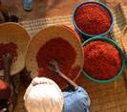
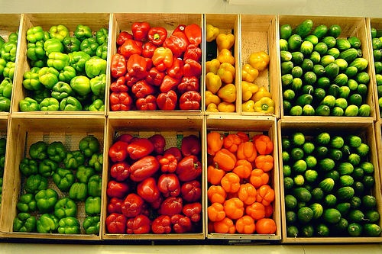
USAID PFID-F&V – Partnerships for Food Industry Development-Fruits and Vegetables
Development of products and services to pave the way for more advantageous market linkages for the small/medium F&V producer.
Examples
  Intelligence on market trends and directions
  Training activities (workshops and field training)
  Assessments (horticulture sector, market assessments, etc)
  Building private sector partnerships between farmers and markets
5
Notes:
The Leader Award for PFID-F&V supported the development of products and services to pave the way for more advantageous market linkages for the small-and medium-scale fruit and vegetable producer, as well as strengthened institutional capacity and access to systematic information on agrifood market development. Over the nine-year course of PFID-F&V, USAID country missions and regional programs supported project Associate Awards
Core Program funds financed research and training activities aimed at establishing longer-term projects (“buy-ins”) with the USAID bilateral and regional missions. Several efforts were launched and a high success rate was obtained, ultimately resulting in buy-ins for over $US 24 million dollars in total

Slide 6
PFID - F&V Model
Building Long-term Capacity for a Competitive Edge
Market Demand
Supermarkets, food service, ethnic markets, etc
Enabling Environment
(Policy, laws & regulations, business services)
Enabling Environment
(Policy, laws & regulations, business services)
Opportunities for Market Access
Traceability
Transport
Labeling
Packaging
Supply reliability
Cold storage
Environmental Certification
Certified quality
Certified safety (SPS)
Product volume
Processing
Etc…
Flow through the Value Chain
Meeting Grades and Standards
Buyer-
Producer
Relationships/
alliances
Market
Intelligence
(trends, windows,
quality, volume,
prices…)
Gender & Disadvantaged Populations
Environment
Market Supply
Producers, associations, agribusiness, MSMEs, and other suppliers
Slide Source:
Dan Clay, MSU, 2010
6
Notes:
What has come to be known as the PFID-F&V model is one that has targeted improvements in smallholder competitiveness through enhanced market information, farm-based upgrades, increased numbers of producer-buyer linkages, and capacity building on grades and standards for improved food safety and quality throughout the value chain.
PFID-F&V’s major distinction relative to other market-led initiatives can be summarized as a strong market-driven approach with tangible contributions from demand-side actors involved in the process, and supplemented by critical information access.

Slide 7
Standards – Safety and Quality
Compliance with standards, both public and private, is essential to enable and sustain access to higher value markets.
  Exports and high-value domestic markets
Domestic food control systems often weak / absent
Private standards and third-party certification, in many cases, are the only viable options to demonstrate compliance.
Cost, lack of local expertise, etc. all can be significant hurdles to smallholder farmers and small-scale packers and processors.
7

Slide 8
Background – India
A “transforming” country
Large proportion (>70%) of population still lives in rural areas and is dependent upon agriculture for their livelihoods
Agriculture’s share of national GDP is decreasing, but still significant (>20%)
Agriculture sector growth (<2% annually) not keeping pace with the rest of the economy (>7% annually)
Average farm size is very small (~ 1 hectare)
Infrastructure is limited, particularly for post-harvest handling and value addition (including processing)
Higher-value market opportunities evolving (supermarkets, exports)
8

Slide 9
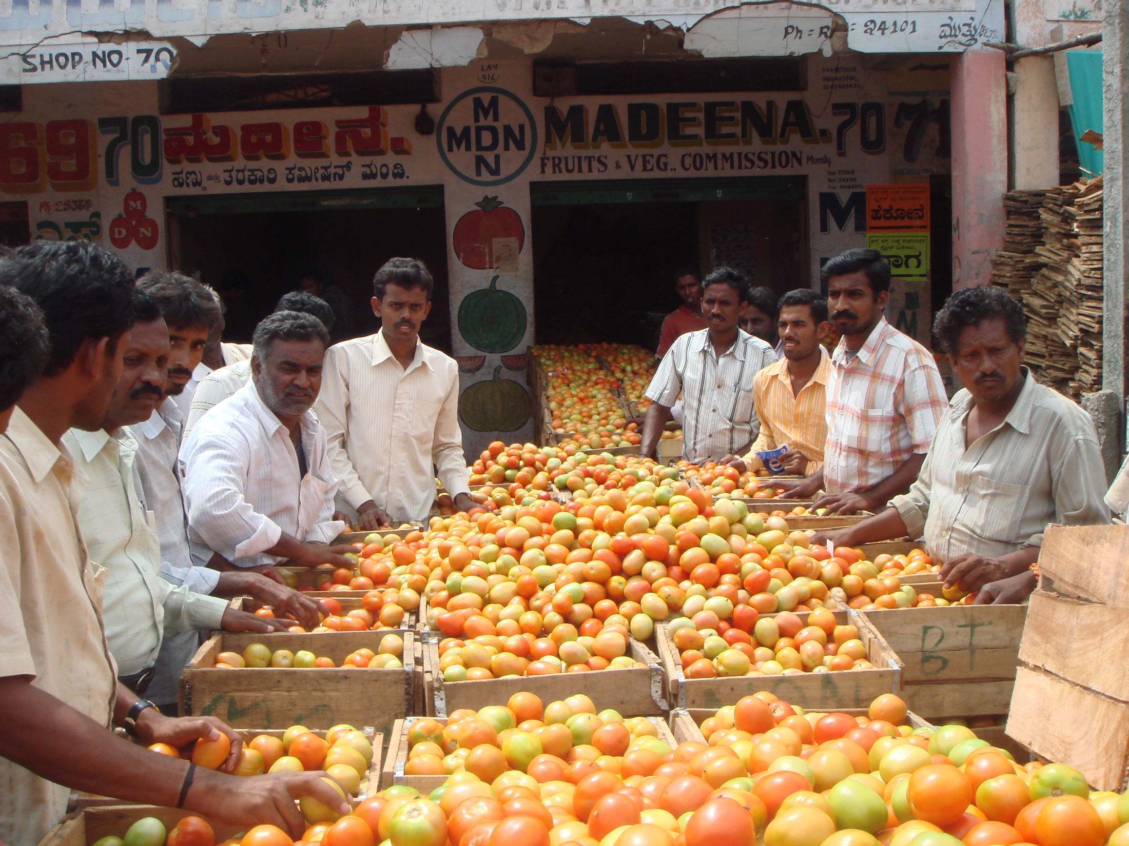
9

Slide 10
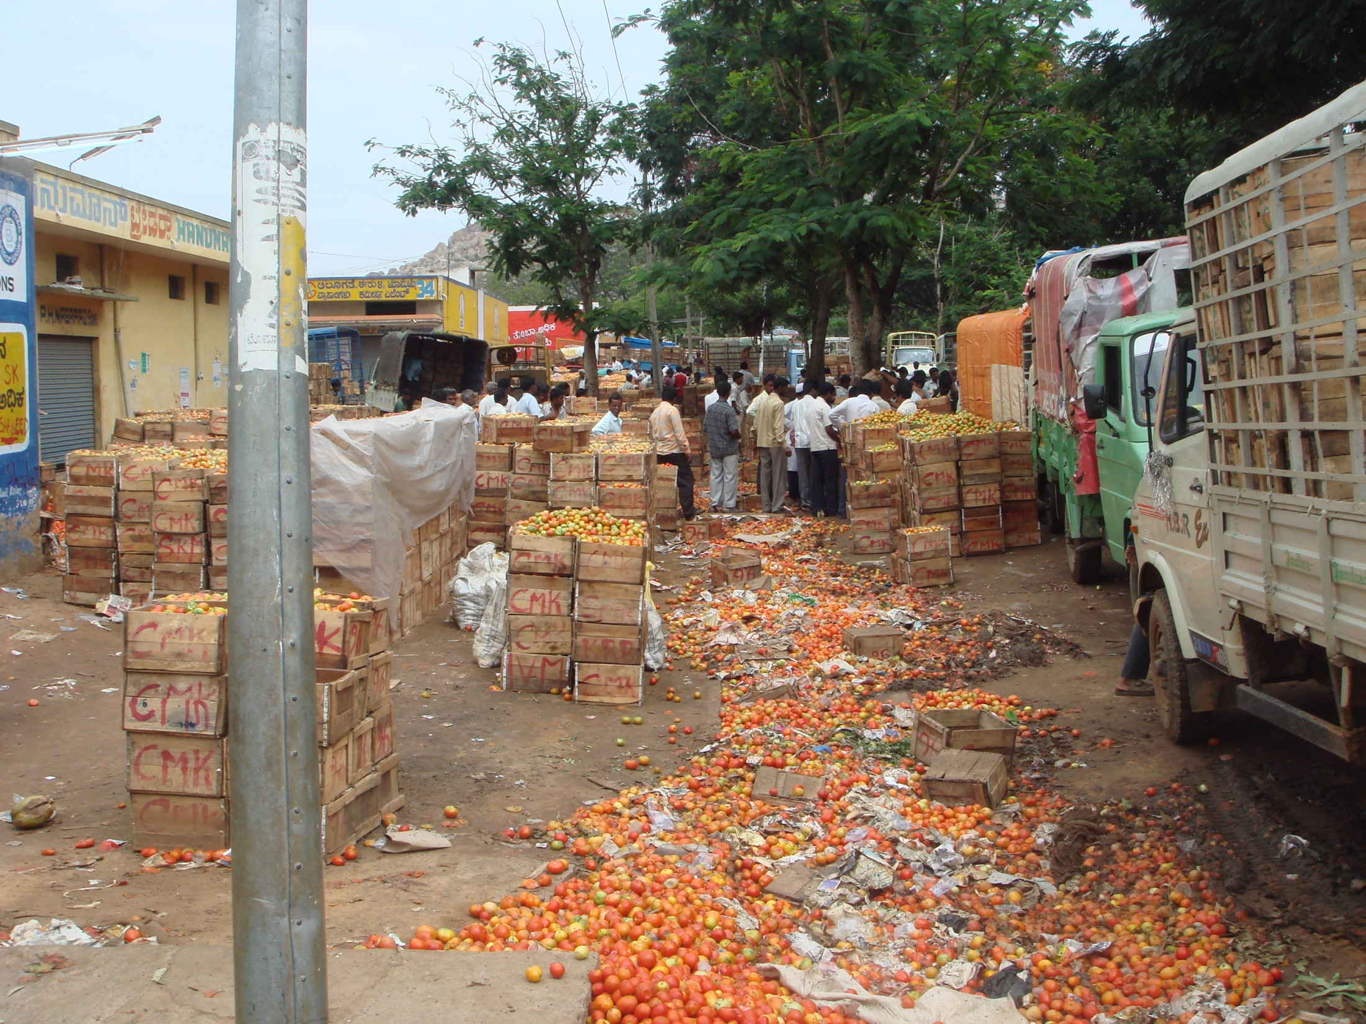
10

Slide 11
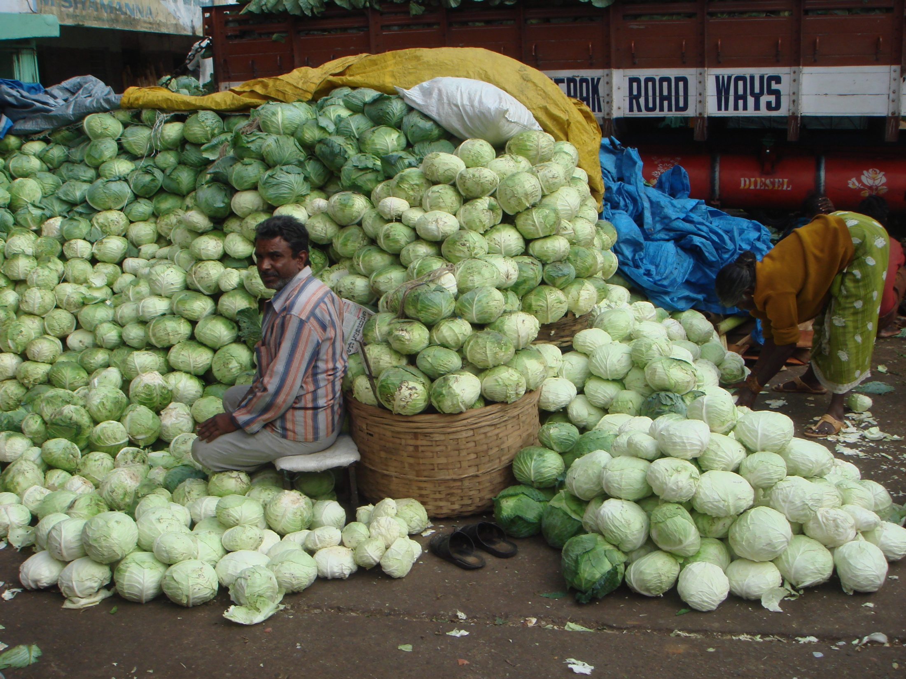
11

Slide 12
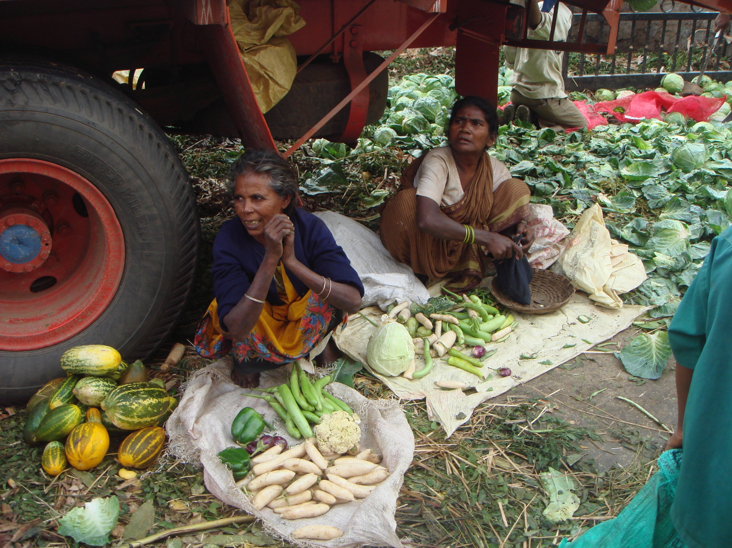
12

Slide 13
India Mango Market Development Project
Funding provided by USAID – India Mission, New Delhi
Project duration: 2004-2007
Focus on fresh and processed Alphonso and Kesar mangoes in Maharashtra state.
Increase net returns to farmers, by:
  Building capability among mango growers and processors to meet market demands
    Food safety, quality, environmental, social responsibility standards
  Strengthening linkages of mango growers and processors with higher value markets (domestic and export)
13

Slide 14
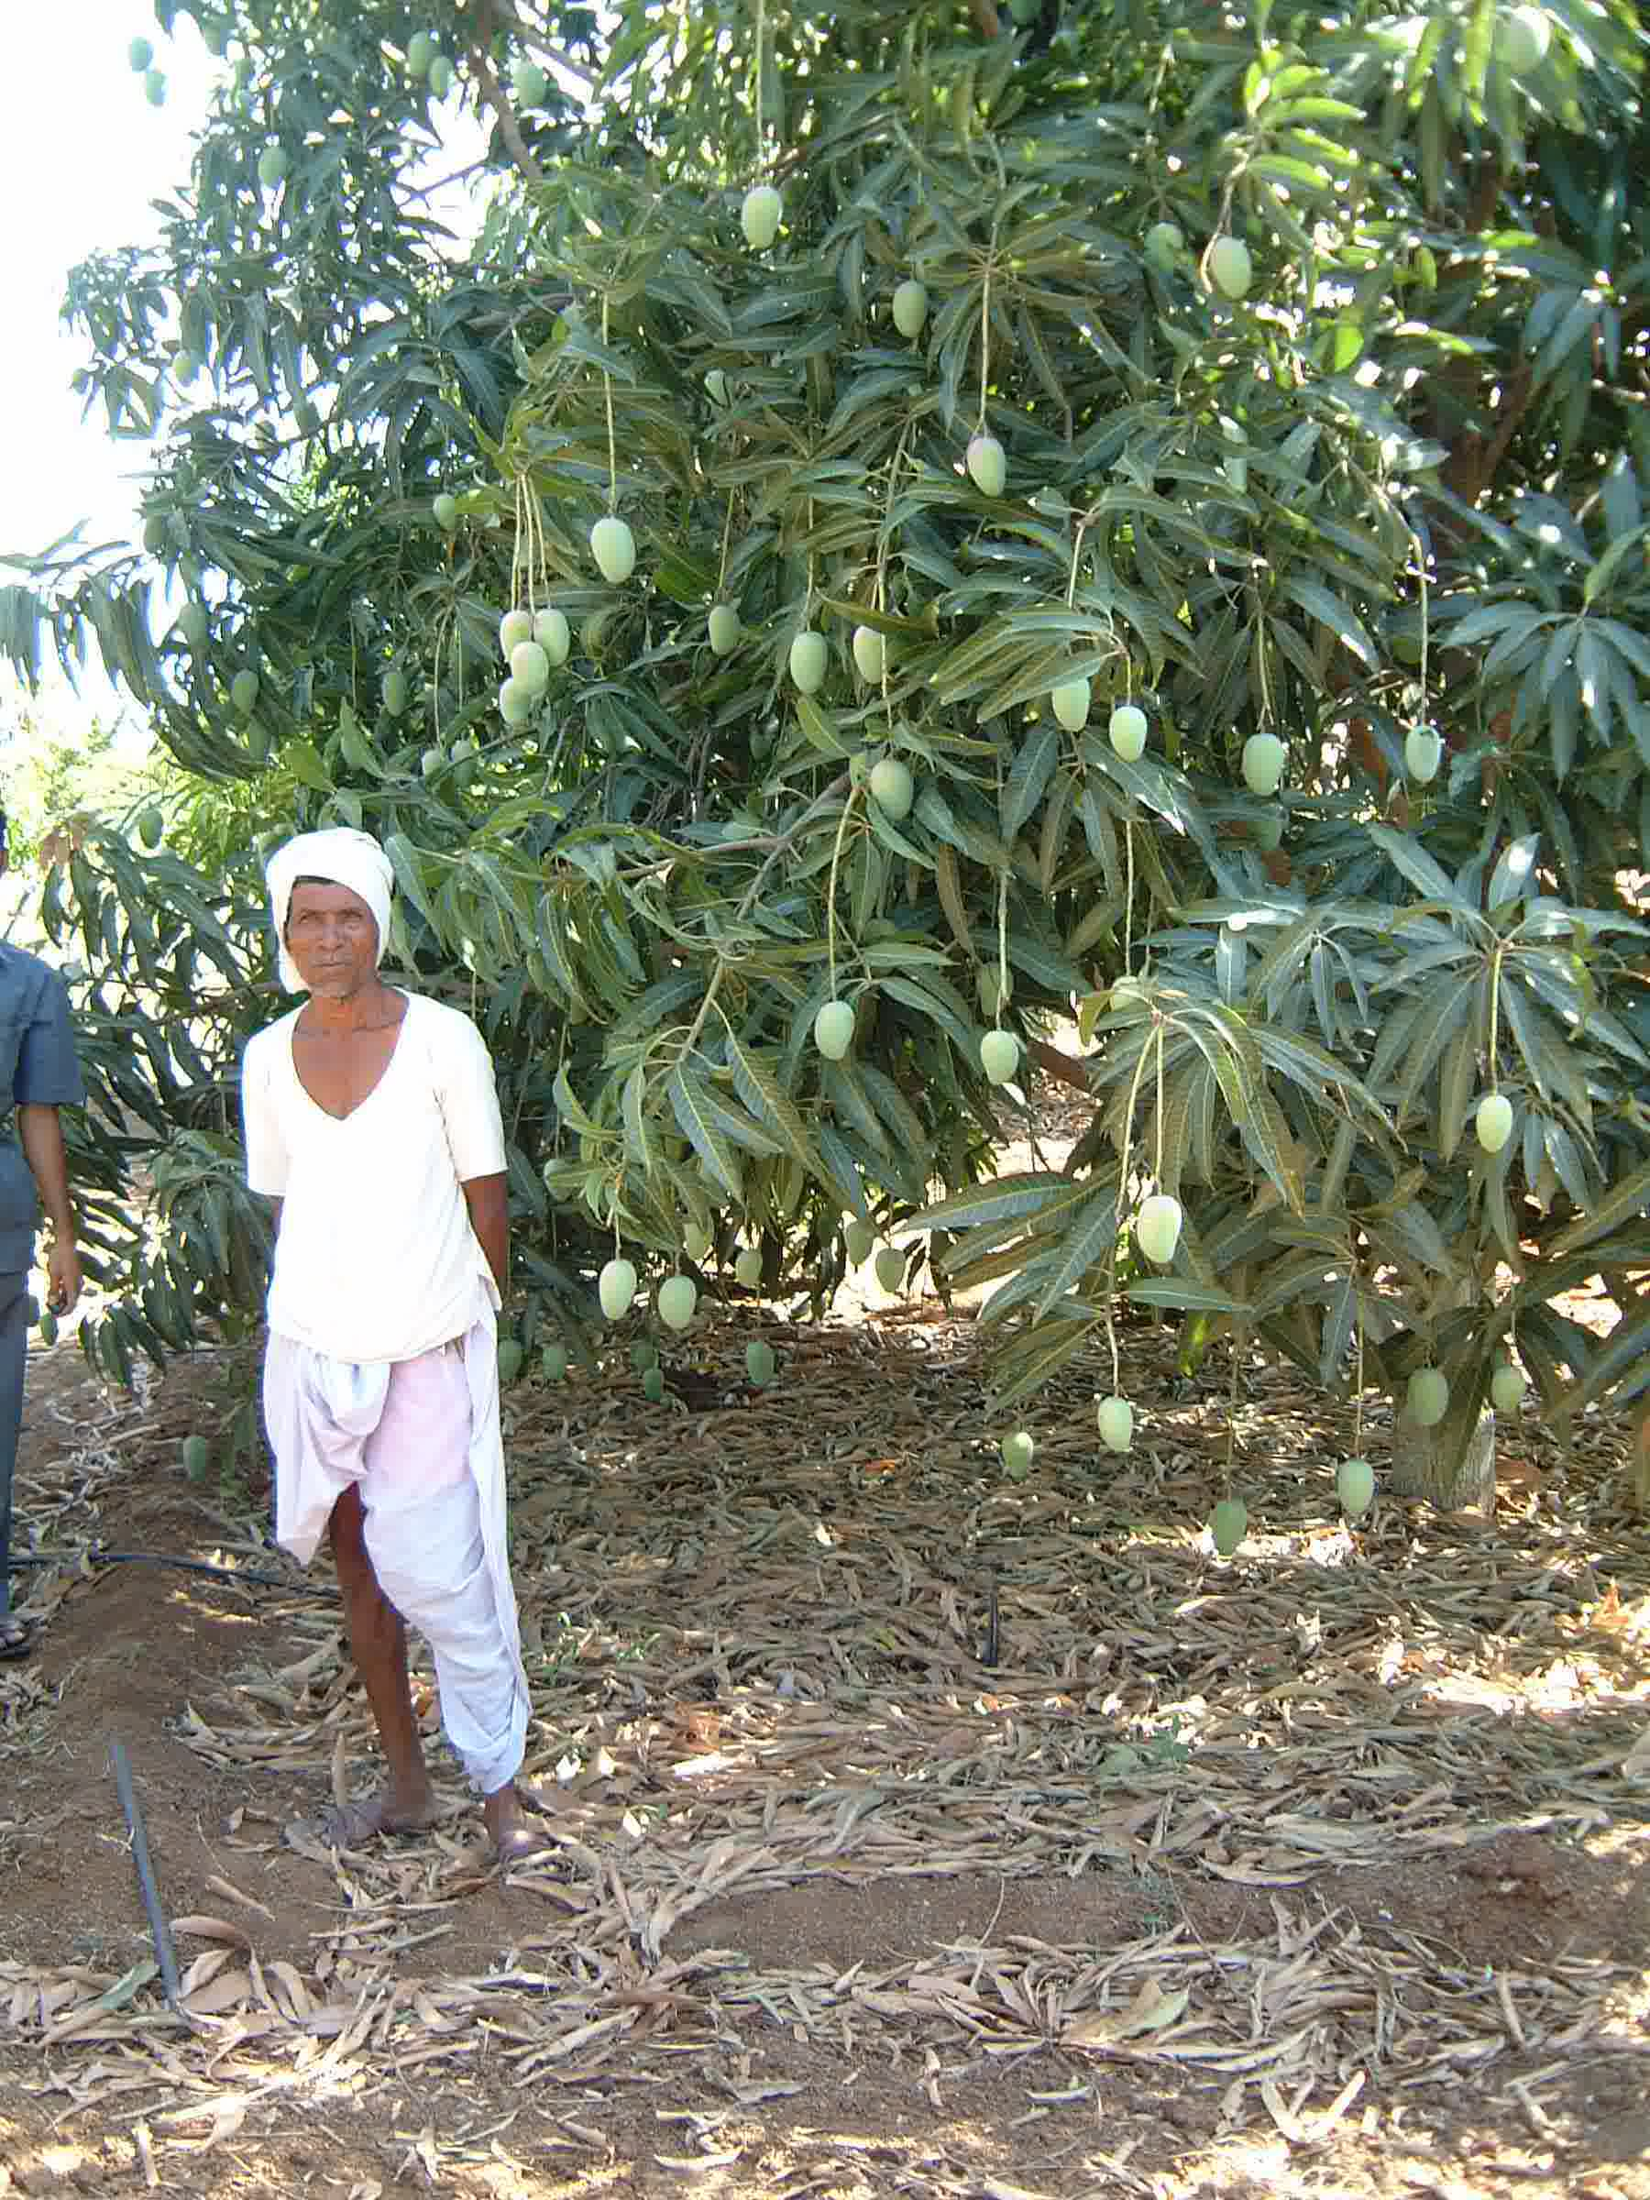
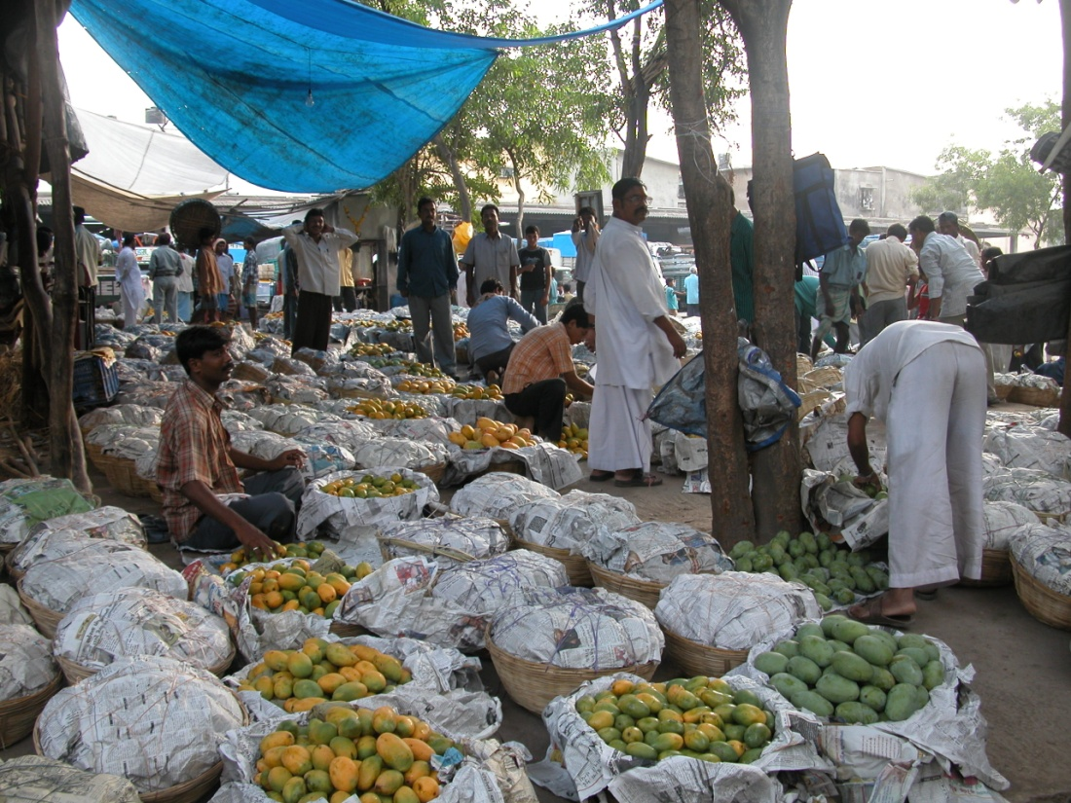
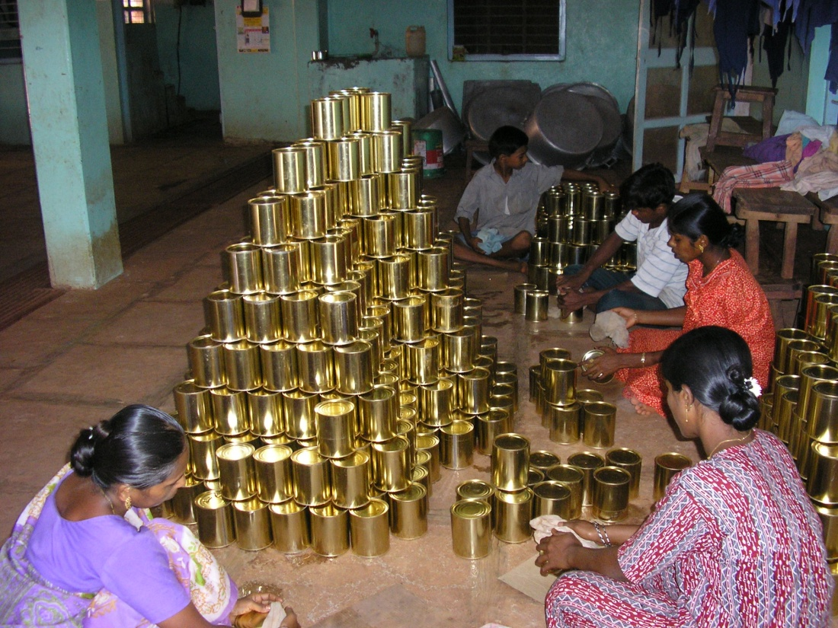
14

Slide 15
Traditional Mango Value Chain in India
Traditional Market = High Transaction Costs (only ~35% of value returned to farmer)
Majority of mango in India sold at flowering stage
Mango
Grower
Local middleman
Commission Agent / Trader
Consumer
Retailer
Wholesaler
15

Slide 16
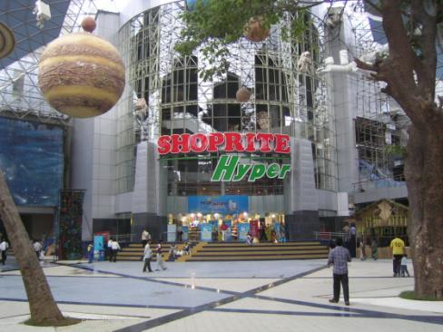
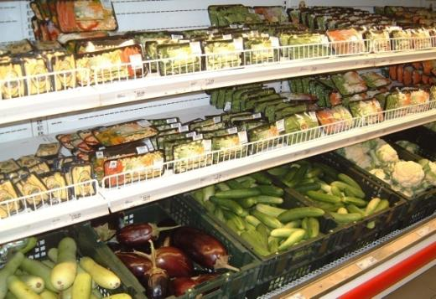
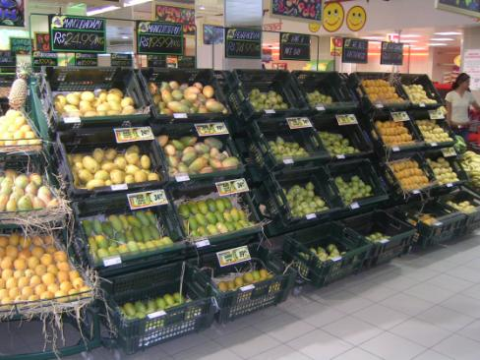
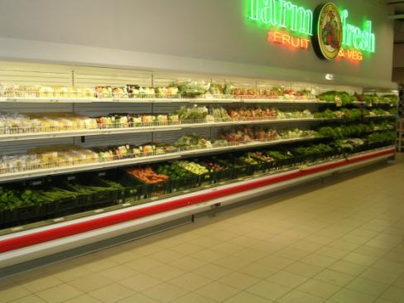
16

Slide 17
India’s Retail Revolution
Tremendous investment by Indian conglomerates
  Reliance, Future Group / Food Bazaar, Spencers, Bharti, Birla, ITC, Spinach, etc.
Growing presence by multinationals
  Metro, Wal-Mart, Carrefour, ShopRite
Existing cap on foreign direct investment by multi-brand retailers is limiting growth rate by multinationals, but Indian companies have been expanding aggressively
17

Slide 18
India – Emerging Markets Demand Produce Meeting High Standards for Safety and Quality
Traditional Markets
APMCs, Mandis
“Wet Markets”
Exports to “less discriminating” markets
“Business as Usual” is acceptable for now, but this is a low-value market segment that will decline over the next decade
Emerging Markets
Organized Retail
Hotels, Foodservice
Exports to Countries with High-Value Markets
Tremendous pressure to improve quality and safety standards in order to participate in this more lucrative and growing market segment
18

Slide 19
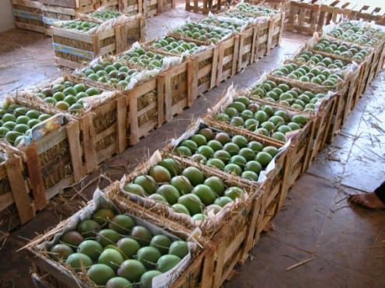
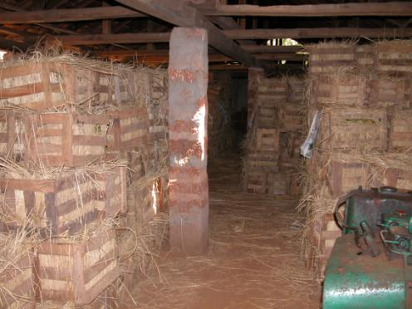
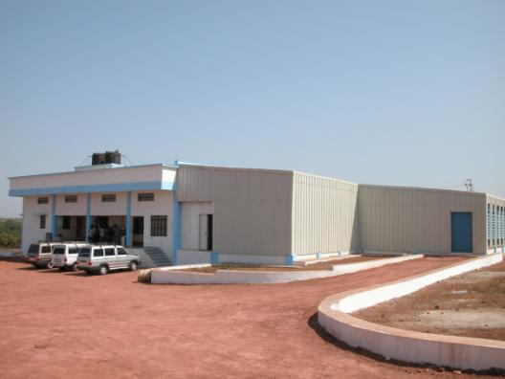
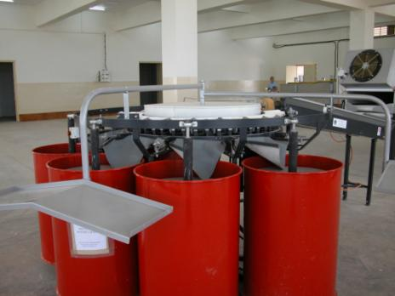
19

Slide 20
Fewer Steps in the Process =
More Margin to the Farmer
Improved supply chain under project
  Direct linkages with retail markets and exporters
Mango Grower
Retail Markets, Exporters
Consumer
Key Advantages
  Lower Transactions Costs
  Improved Quality Control
  Improved Food Safety and Traceability
20

Slide 21
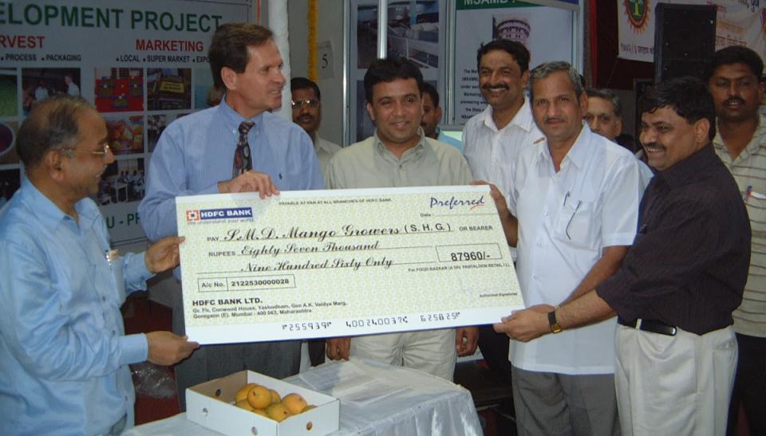
Building Linkages Between Farmers and Retailers
Food Bazaar
21

Slide 22
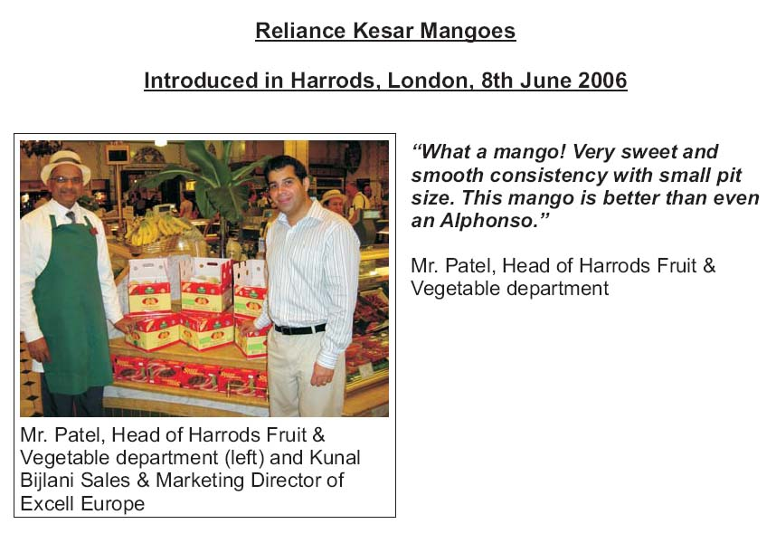
22

Slide 23

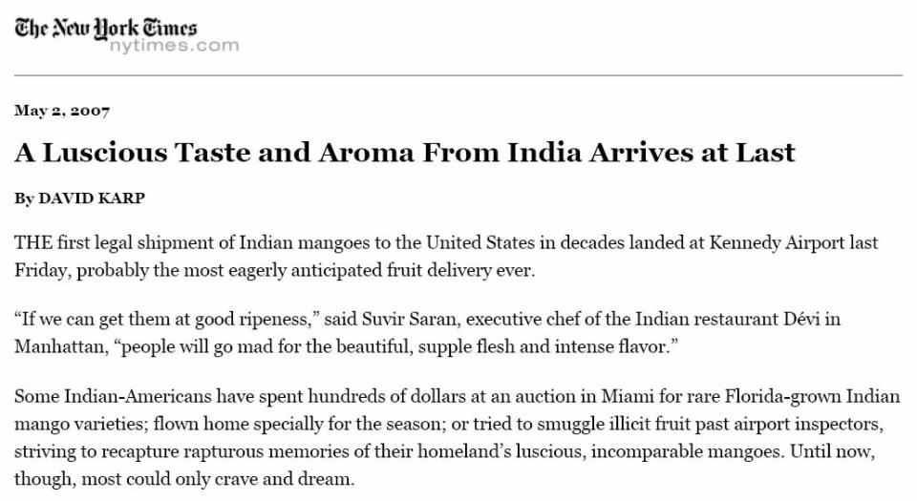
US Market Opens
to Indian Mangoes
April 2007
23

Slide 24
Increased Returns to Farmers
Estimated value of reduced intermediaries and GAP certification in value chain (2006):
Domestic Fresh Market:
Growers received 20 to 30% higher returns than traditional channel
Fresh Export Market:
Growers received 50% higher returns for GAP-certified mangoes when compared to traditional domestic market
24

Slide 25
USAID – Michigan State University – Indian Horticulture Development Alliance (2008-Present)
Based on lessons learned in previous horticulture development projects, expansion to other fruit and vegetable commodities in additional India states
IHDA entails a holistic approach to horticultural value chain development.
Formalized agreements among many partners in public and private sector.
Sustainability and scalability of efforts – establishment of Knowledge Centers and internet-based educational resources.
Inclusive of women and other traditionally disadvantaged groups.
25

Slide 26
Product Flow
Production Clusters
Aggregation and Grading
Specialized Packing and Processing
Markets
Government Markets
Mandis
Terminal Markets
Fresh Domestic
FRESH
Packing Facilities
VHT, Irradiation Facilities
Alphonso
Fresh
Export
Kesar
Private Markets and Aggregation Units;
SNX Spot Markets
Processed
Domestic
PROCESSED
Large Processors
SMEs
Mega Food Parks
Totapuri
Farmer-Led Organizations; Cooperatives
Processed
Export
Other Varieties
Market Information Flow
Sector-Specific Interventions
Cluster & Coop Formation;
Provide Market Orientation;
Training on Inputs, GAPs, Grades and Standards, Production;
Access to Inputs and Finance
Link Clusters to Local Markets;
Training on Post-Harvest Technology, Grades and Standards, Food Safety;
Facilitate Price Discovery
Build Capacity of SMEs;
Training on GAPs, Food Safety, Grades and Standards, Packaging, etc.;
Backward Linkages to Growers
Forward Linkages to Markets
Assess Market Demands and Organize Upstream Sectors to Meet This Demand;
Link Producers and Processors to Markets Based on Grades and Standards, Capacity
26

Slide 27
IHDA Project – Interim Observations
Increased returns in domestic market are largely based on improved marketing efficiency; limited return for improved quality and safety of product currently (this will evolve over time)
Export market development still hindered by limited infrastructure. However, even the infrastructure that is available is not always utilized effectively. Much more attention on post-harvest handling of F&V is required.
Producers / exporters must stay abreast of changes in standards – 3000 sea containers of Indian Thompson seedless grapes suffered >$50 million loss in value due to European MRL issue.
27

Slide 28
Lessons Learned
These development efforts only take hold when driven by specific market opportunities and conducted in partnership with the private sector.
Capacity development efforts must be adapted to the local context and tailored for the needs of specific value chains.
Development of local technical capacity is essential to sustain these efforts beyond the period of donor support.
Producers must be highly responsive to market demands, including appropriate certifications, and react effectively to challenges (e.g. food safety incidents) in order to capture and maintain market share.
28

Slide 29
For Additional Information:
Deepa Thiagarajan
Director, Global Food Standards and Value Chain Development Programs
Institute of International Agriculture
Michigan State University
319 Agriculture Hall
East Lansing, MI 48824 USA
Phone: +1-517-432-8211
Email: thiagara@msu.edu
29

