Slide 1
UAE Food Safety Crosses Borders
Ernest Julian, Ph.D., Chief
Office of Food Protection
RI Department of Health
February 24, 2014

Slide 2
Preliminary Findings
Hard working dedicated people
Many good tools
Required food safety training for
Person in charge and
Workers
Plan review for construction
Requiring blast chillers in hotels
Adding some tools would greatly improve effectiveness

Slide 3
What Are We Trying to Accomplish?
Reduce Foodborne Illnesses, Long Term Disabilities and Deaths
Added Benefit
Preventing Outbreaks Protects the Food Industry, Jobs, and
Tourism (Expo 2020)
Which Has Health Implications

Slide 4
Reported Food Related Illnesses, Rhode Island, 1990-2012 Salmonellosis, Campylobacteriosis, Hepatitis A, E. coli 0157:H7, Listeriosis, Shigellosis

Slide 5
RI Part of CDC Environmental Health Specialist Network (EHS-Net)
Since RI Imports almost all of its food, looked at illnesses for surrounding states
Compared illnesses per 100,000 population

Slide 6
Notes:
2008 VT is 30 cases, with a small population small numbers can cause wide swings in rates
2009 RI is 38 cases

Slide 7
E. coli 0157:H7 Controls
Vermont has the highest rate of illness
High sale of raw milk and raw milk cheeses
Rhode Island has the lowest rate
Required Thorough Cooking of Ground Beef for Kids 12 Years Old and younger in 1993
No raw milk sales
Changed national Food Code to require foods on children’s menus to be thoroughly cooked based on this data

Slide 8
Most Common Salmonella Serotypes

Slide 9
Need Surveillance to Guide Controls
What is working and not working?
What are illness threats from neighbors?
Epidemiologists, cultures, serotyping, and genetic fingerprinting (PFGE) help identify sources of illness
Previously restaurants and markets were blamed when a received food was actually the cause
Are eggs from the same source causing illness throughout the Emirates?

Slide 10
Outbreaks Keep Happening from the Same Place
3 outbreaks from same restaurant in 5 years
Went out with local inspector and found lack of sufficient refrigeration and hot holding equipment
Training students from local high school how to prepare food unsafely
If don’t find and eliminate the source, outbreaks will keep happening

Slide 11
Identify the Root Cause or it Will Happen Again
Food distributed throughout the region
A processor shipping contaminated food
Unsafe equipment
Slicers, etc.

Slide 12
Washington Salmonella Outbreak: Hobart Series 2000 Slicer – Washington swabbed clean and sanitized meat slicer

Slide 13
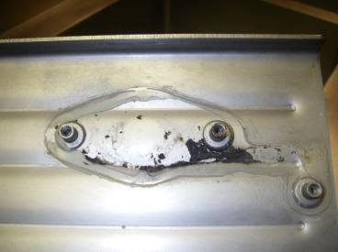
Silicone seal degraded, area positive for Salmonella outbreak strain

Slide 14
Where the handles came from…

Slide 15
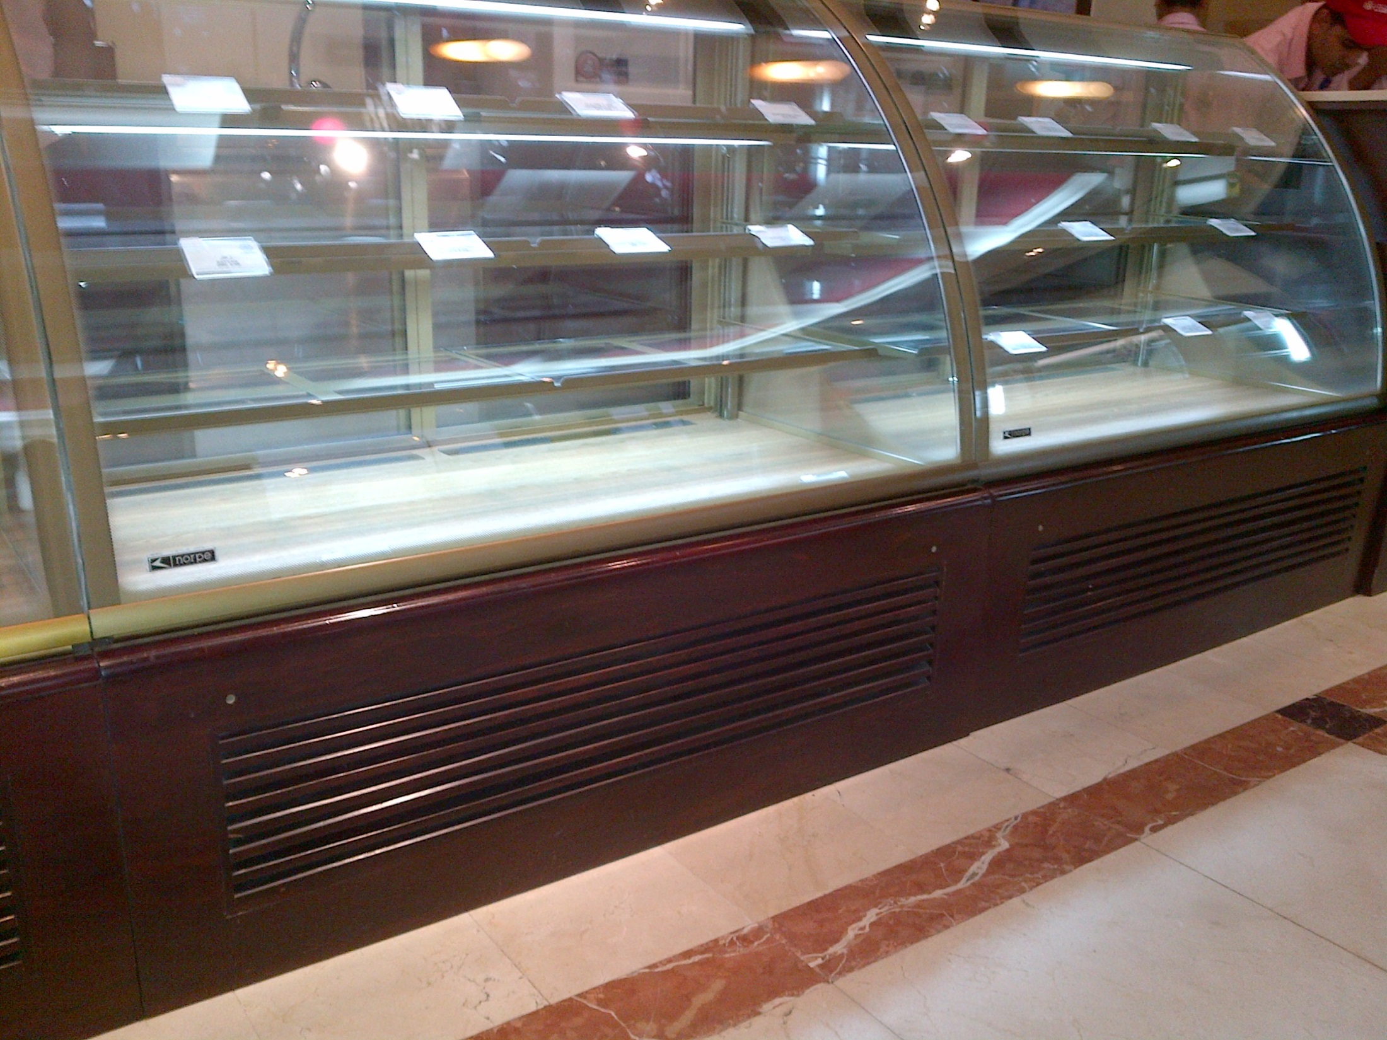
Root Causes Foods at Unsafe Temperature
Use of home refrigerators
Not designed for high heat in commercial kitchens and for cooling large volumes of food
Commercial refrigeration needed to assure safe temperatures
We routinely find even some commercial refrigeration not operating safely at high room temperatures

Slide 16
Communicate
Outbreaks possibly from a food distributed in other Emirates
Recalled products still on the shelf and notification from distributor is not occurring
Bad operator with facilities in multiple Emirates
Instructors not training properly

Slide 17
Summary
Recommendations
Improve surveillance and investigation
Epidemiologist
Serotyping and PFGE
Improve plan review based on menu and volume
HACCP based plan review course
Target inspections to eliminate serious hazards in highest risk facilities versus inspecting all facilities equally

Slide 18
Summary
Inspections should focus on highest risk hazards
Unsafe hot and cold holding
Cooling
Refrigeration
Bare hand contact violations

Slide 19
Summary
Determine root cause of hazards
Lack of equipment or facilities for menu and volume
Corporate policies
Lack of knowledge
Evaluate instructors
Require remedial training if needed
Motivation
Fines if not corrected
Closure if all else fails

Slide 20
Summary
Recommendations
Evaluate the frequency each inspector cites critical violations and rate performance on elimination of hazards versus number of inspections performed
Conduct baseline survey to determine frequency of critical hazards
Use fines as incentive for compliance
Implemented if hazards are not eliminated
Evaluate chains
Coordination throughout the Emirates

