Slide 1
Allergen Thresholds: Risk Based Approach to Allergen Management Dr Brett Jeffery
22nd February 2012
Mars Incorporated

Slide 2
Introduction
Allergen management has matured considerably over the last 10-15 years
Labelling regulations
Agreed principles
However, there is more to do to minimise risk and offer the widest choice to allergic consumers
Application of allergen management principles is still inconsistent
Allergic consumers are frustrated with precautionary labelling

Slide 3
Current industry approach – hazard based
Management of allergen hazards, based around classic HACCP and including:
Identification of allergen presence
Integration of allergen controls into existing Good Manufacturing Practices, including traceability through the supply chain
Segregation of allergenic constituents
Application of specific sanitation measures
Declaration of the presence of allergenic ingredients on product labels

Slide 4
Risk vs. hazard based allergen management
Current allergen management is based on the hazard
Consequences
Cannot eliminate 100% allergen molecules from plants, lines or products.
Overuse of precautionary statements
Less consumer choice
All industrially manufactured food will eventually carry a precautionary label unless action levels can be agreed.

Slide 5
Precautionary (“May contain”) labelling
To warn allergic consumers for possible contamination of a product with allergen and to protect companies from claims
Use “may contain” labelling (only) when needed:
No “may contain” if risk (chance and severity) is acceptable, to optimize
- food choice of consumers
- information value of warning
Use “may contain” labelling in case of relevant/unacceptable risk !
But:
What residual risk is acceptable/unacceptable?
What levels of allergens should trigger labelling?
Need for quantitative guidance !

Slide 6
Risk vs. hazard based allergen management
Risk-based approach addresses these issues:
Shares responsibility across the supply chain.
Action levels based on good science allow industry to manage cross contact within clear, quantifiable boundaries which are accepted by regulators and consumers.
Provides transparent guidance on labelling decisions and management actions.
Promotes better understanding and management of personal food allergy.
Knowledge to apply risk-based approach has become available in recent years.
The way ahead: approach based on quantitative assessment of allergen risk

Slide 7
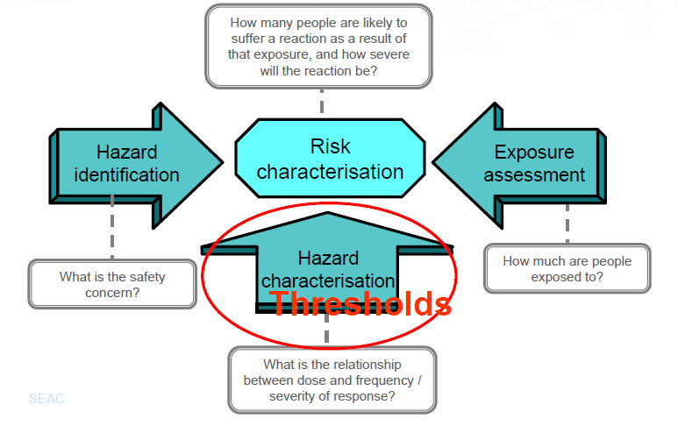
Risk vs. hazard based allergen management

Slide 8
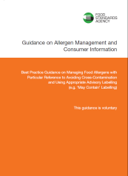
Action Levels for Allergen Management
Commonly accepted levels have yet to be established (with the exception of gluten) and Directive 2003/89/EC gives no threshold or guidance to what constitutes a safe level.
Current UK FSA Approach
FSA Guidance on Allergen Management
UK FSA Future Plans
Produce revised guidance with allergen management levels
Validate analytical methods

Slide 9
How thresholds could help?
We can estimate the risk posed by defined levels of allergen
We can measure how much different interventions further reduce risk
Threshold data enables an evidence-based approach
Setting regulatory / management thresholds (action levels)
As a basis for use of precautionary labelling
In fostering consistency across industry sectors
For allergic individuals, knowing one’s threshold can:
Reduce uncertainty, improve quality of life & management of their allergy
Some physicians provide advice based on patients’ thresholds
Individual management advice could be given, based on individual thresholds and regulatory thresholds (action levels)
But this can only be achieved if harmonised regulatory thresholds (action levels) are set

Slide 10
Action Levels for Allergen Management
There have been attempts to establish management/regulatory threshold values in other countries, for example:
Swiss Authorities
The Australian Food and Grocery Council Voluntary Incidental Trace Allergen Labelling (VITAL) system
International activities towards establishing action levels
FSA/ EuroPrevall Workshop in Madrid (May 2007) “ Approaches to Risk Assessment in Food Allergy”
FSA/ EuroPrevall Workshop in Vienna (May 2009) “What is a tolerable level of risk?”

Slide 11
Action Levels for Allergen Management
Gluten legislation
Currently no consensus on action levels
EU exemptions
Switzerland 1g/kg (2001)
Japan > 10mg/kg
Allergen Bureau (initiative of the Australian Food and Grocery Council) developed a voluntary system based on ALs
VITAL (Voluntary Incidental Trace Allergen Labelling)
Standardised risk assessment tool
Used by several food manufacturers in Australia

Slide 12
Allergen thresholds

Slide 13
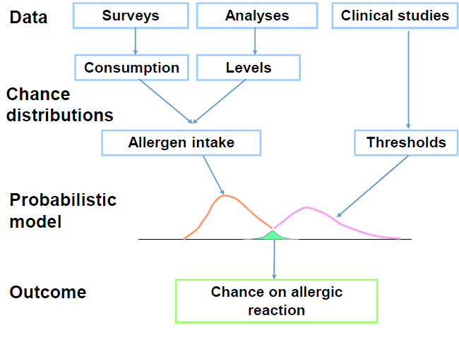
Derivation of allergen thresholds

Slide 14
Aus. VITAL Recommendations – Reference Doses
Allergen
Protein Level (mg)
Peanut
Milk
Egg
Hazelnut
Soy
Wheat
Cashew
Mustard
Lupin
Sesame
Shrimp
Celery
Fish
0.2
0.1
0.03
0.1 (VITAL – Level used as generic tree nut value)
1.0 (VITAL – Soy protein isolates not soy milk)
1.0 (VITAL – GCC (Coeliac & wheat allergic population)
2.0 *(VITAL - Hazelnut as generic tree nuts value)
0.05
4.0
0.2
10.0
NA
NA (VITAL – original VITAL value applied)
Notes:
This information has been supplied as part of the VSEP Review summary
Explain the VITAL approach

Slide 15
Questions?
Latest threshold data should be applied.
Require to take into account threshold information when considering labelling but also:
Probability of the allergen appearing in the product (e.g., is it found in 50 % of the produced products or 1 out of 1 million).
What do we want to protect against?
All reactions or severe reactions?
VITAL system only applies to products where allergens are homogeneously mixed into the product (e.g., milk powder, soy lecithin, etc.) and not for particulate materials (e.g., peanuts, nuts, etc
Legal position – is there an acceptable risk level?

Slide 16
(Inter)national developments
VITAL Scientific Expert Panel Assistance
ILSI Europe: Expert Group “From Thresholds to Action Levels’
USA FDA: new U.S. Food Safety Legislation
UK FSA: actively involved in probabilistic approach
Fooddrink Europe guidance: qualitative > quantitative
EFSA: review on risk assessment and threshold data
NLD: 2007: Health Council Report

Slide 17
Thank you and questions

