Slide 1


Outbreak of Listeria Infections Associated with Whole Cantaloupe – United States, 2011
Donald J. Sharp, MD, DTM&H
Deputy Director, Food Safety Office
Division of Foodborne, Waterborne, and Environmental Diseases
National Center for Emerging Zoonotic and Infectious Diseases
Centers for Disease Control and Prevention
Jeff McCollum, DVM, MPH
Colorado Department of Public Health and Environment
Communicable Disease Epidemiology Program
The findings and conclusions in this presentation are those of the author and do not necessarily represent the views of the Centers for Disease Control and Prevention

Slide 2
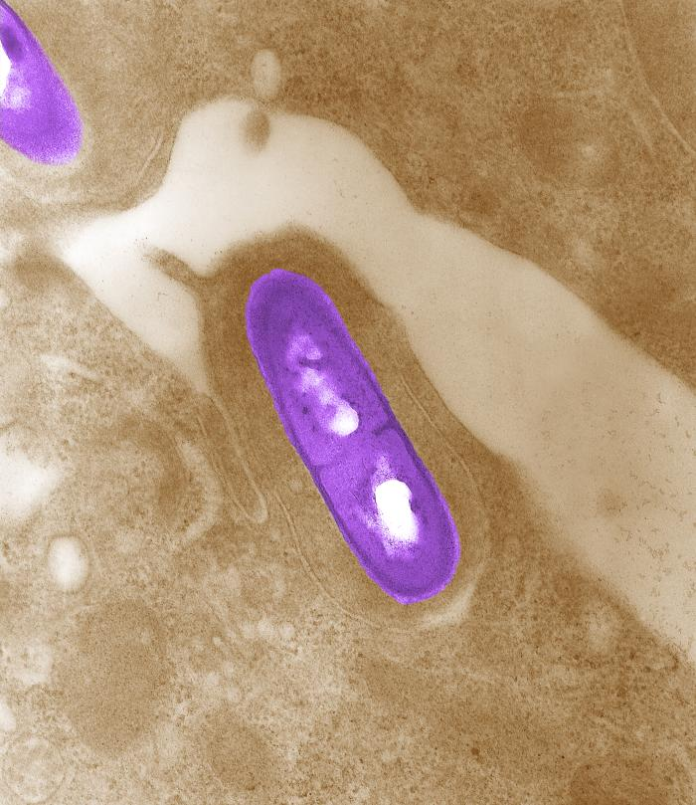
Listeria monocytogenes (LM)
Annual public health impact — United States
  1,591 illnesses
  1,455 hospitalizations
  255 deaths
Foodborne pathogen
  <1% bacterial foodborne illnesses
  19% food-related deaths
94% hospitalization rate
  Highest among foodborne pathogens
15.9% overall case-fatality rate
  25–50% among newborns
Scallan E et. al., Emerging Infectious Diseases; 2011 Jan; 17(1); 7-15.
Notes:
Listeria monocytogenes is a foodborne illness resulting in approximately 1,600 illnesses, 1,450 hospitalizations, and 250 deaths annually in the United States. While LM accounts for well below 1% of all estimated episodes of bacterial foodborne illness, it ranks as the third-leading cause of food-related deaths among all major bacterial, viral, and parasitic foodborne pathogens accounting for 19% of total deaths. Its 94% hospitalization rate is the highest among all foodborne pathogens. The overall case-fatality rate for Listeriosis approaches 16%, or about 1 death for every 6 recognized infections, and is even higher among specific at-risk populations. Neonates have the highest death rate which can be as high as 50%.

Slide 3
Estimated Annual Health Burden — Select Bacterial Foodborne Pathogens, United States
Pathogen | Illnesses | Deaths | Fatality Rate
Salmonella | 1,027,561 | 378 | 0.04%
Campylobacter | 845,024 | 76 | 0.01%
E. coli O157 | 63,153 | 20 | 0.03%
Listeria | 1,591 | 255 | 16%
Scallan E et. al., Emerging Infectious Diseases; 2011 Jan; 17(1); 7-15.
Notes:
Listeria monocytogenes is a foodborne illness resulting in approximately 1,600 illnesses, 1,450 hospitalizations, and 250 deaths annually in the United States. While LM accounts for well below 1% of all estimated episodes of bacterial foodborne illness, it ranks as the third-leading cause of food-related deaths among all major bacterial, viral, and parasitic foodborne pathogens accounting for 19% of total deaths. Its 94% hospitalization rate is the highest among all foodborne pathogens. The overall case-fatality rate for Listeriosis approaches 16%, or about 1 death for every 6 recognized infections, and is even higher among specific at-risk populations. Neonates have the highest death rate which can be as high as 50%.

Slide 4

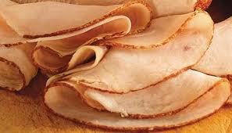


LM: Epidemiology
Ubiquitous in soil and water
Animal reservoirs
Typical food vehicles
  Unpasteurized (raw) milk
  Raw-milk cheeses
  Hot dogs
  Deli meats
  Smoked seafood
Growth during refrigeration
Mostly sporadic illness
  2–3 U.S. outbreaks annually

Slide 5
LM Outbreaks: Historical Perspective
Coleslaw
41 cases
Canada
Mexican-style cheese
142 cases
California
1981
1983
1985
1998
2000
2002
2008
2009
2010
2011
Pasteurized milk
49 cases
Massachusetts
Notes:
While a majority of LM infections are sporadic, significant outbreaks of LM infections have occurred. In 1981, the first conclusive evidence of foodborne transmission of LM was found during investigation of an outbreak in Canada caused contaminated cabbage used to make cole slaw. 41 cases were eventually identified. In 1983, an outbreak with 49 illnesses occurred in Massachusetts and was attributed to pasteurized milk. In 1985, a large outbreak with 142 cases in California was associated with Mexican-style cheese and established LM as an important foodborne pathogen. Beginning in the 1990s, contaminated ready-to-eat meats have become an important recognized source of human listeriosis large multistate outbreaks in the United States attributed to hot dogs with 108 cases in 1998 and two separate outbreaks associated with turkey deli meats during in 2000 and 2002 with 30 and 54 cases, respectively. More recently, produce items have been implicated in outbreaks of LM infections including alfalfa sprouts in 2008-2009 with 20 cases, 10 cases associated with chopped celery in 2010, and of course the multistate cantaloupe-associated outbreak with ** cases to date.

Slide 6
LM Outbreaks: Historical Perspective
Coleslaw
41 cases
Canada
Turkey deli meat
30 cases
Multistate
Mexican-style cheese
142 cases
California
Turkey deli meat
54 cases
Multistate
1981
1983
1985
1998
2000
2002
2008
2009
2010
2011
Pasteurized milk
49 cases
Massachusetts
Hot dogs
108 cases
Multistate
Mexican-style cheese
13 cases
North Carolina
Notes:
While a majority of LM infections are sporadic, significant outbreaks of LM infections have occurred. In 1981, the first conclusive evidence of foodborne transmission of LM was found during investigation of an outbreak in Canada caused contaminated cabbage used to make cole slaw. 41 cases were eventually identified. In 1983, an outbreak with 49 illnesses occurred in Massachusetts and was attributed to pasteurized milk. In 1985, a large outbreak with 142 cases in California was associated with Mexican-style cheese and established LM as an important foodborne pathogen. Beginning in the 1990s, contaminated ready-to-eat meats have become an important recognized source of human listeriosis large multistate outbreaks in the United States attributed to hot dogs with 108 cases in 1998 and two separate outbreaks associated with turkey deli meats during in 2000 and 2002 with 30 and 54 cases, respectively. More recently, produce items have been implicated in outbreaks of LM infections including alfalfa sprouts in 2008-2009 with 20 cases, 10 cases associated with chopped celery in 2010, and of course the multistate cantaloupe-associated outbreak with ** cases to date.

Slide 7
LM Outbreaks: Historical Perspective
Coleslaw
41 cases
Canada
Turkey deli meat
30 cases
Multistate
Chopped celery 10 cases
Texas
Mexican-style cheese
142 cases
California
Turkey deli meat
54 cases
Multistate
1981
1983
1985
1998
2000
2002
2008
2009
2010
2011
Pasteurized milk
49 cases
Massachusetts
Hot dogs
108 cases
Multistate
Mexican-style cheese
13 cases
North Carolina
Alfalfa sprouts
20 cases
Multistate
Cantaloupe
146 cases
Multistate
Notes:
While a majority of LM infections are sporadic, significant outbreaks of LM infections have occurred. In 1981, the first conclusive evidence of foodborne transmission of LM was found during investigation of an outbreak in Canada caused contaminated cabbage used to make cole slaw. 41 cases were eventually identified. In 1983, an outbreak with 49 illnesses occurred in Massachusetts and was attributed to pasteurized milk. In 1985, a large outbreak with 142 cases in California was associated with Mexican-style cheese and established LM as an important foodborne pathogen. Beginning in the 1990s, contaminated ready-to-eat meats have become an important recognized source of human listeriosis large multistate outbreaks in the United States attributed to hot dogs with 108 cases in 1998 and two separate outbreaks associated with turkey deli meats during in 2000 and 2002 with 30 and 54 cases, respectively. More recently, produce items have been implicated in outbreaks of LM infections including alfalfa sprouts in 2008-2009 with 20 cases, 10 cases associated with chopped celery in 2010, and of course the multistate cantaloupe-associated outbreak with ** cases to date.

Slide 8
Relative Rates of Laboratory-confirmed Infections with Listeria Compared with 1996-1998 Rates, by Year, FoodNet 1996-2010*
Relative rate (log scale)
* The position of each line indicates the relative change in the incidence of that pathogen compared with 1996-1998. The actual incidences of these infections cannot be determined from this graph.

Slide 9
LM: Clinical Manifestations
Long incubation: 3–70 days (median: 21 days)
“Healthy” individuals
  Asymptomatic
  Febrile gastroenteritis
High-risk groups
  Immunocompromised
  Older adults (≥60 years)
  Pregnant women
  Newborns
Invasive disease
  Septicemia
  Meningitis
Notes:
The incubation period, or the time from consumption of a contaminated food item to onset of illness, can be considerably longer with Listeria than for other foodborne pathogens, ranging from 3 to 70 days for LM, with a median incubation of around 3 weeks. This long incubation poses challenges in investigations where outbreaks may be protracted and patient recall of foods consumed in the several weeks to months preceding illness onset is difficult. Infections in normal healthy children and adults generally result in asymptomatic infection or a self-limiting acute febrile gastroenteritis and rarely result in serious illness. These types of infections are rarely recognized, diagnosed, or reported. Most persons diagnosed with Listeriosis experience invasive disease, where the bacteria spreads beyond the gastrointestinal system causing systemic disease. Invasive disease often results in significant clinical sequelae including septicemia and meningitis. The disease primarily affects older adults ≥60 years of age, pregnant women, their newborn babies, and adults with weakened immune systems. However, infection in pregnant women more commonly causes milder flu-like illness with more severe consequences for the fetus. Adverse pregnancy outcomes including miscarriage, stillbirth, premature delivery, or life-threatening infection of the newborn are possible.

Slide 10
Cantaloupe-Associated Outbreaks — United States, 1973–2003
28 outbreaks
  1,615 illnesses
  57 hospitalizations
  2 deaths
Causative pathogen
  11 (39%) Salmonella
  7 (25%) Norovirus
  1 (4%) Campylobacter
  1 (4%) E. coli O157
21 (75%) linked to prepared cantaloupe
  17 (61%) restaurant or caterer
  4 (14%) grocery store
Bowen A et. al., Epidemiol. Infect. (2006), 134, 675–685.
Notes:
Causative agent unknown in 8 (29%) of these outbreaks. At least two additional multistate Salmonella outbreaks associated with cantaloupes have been reported since 2003, one each in 2008 and 2011.

Slide 11
LM in Cantaloupes?
No documented Listeria outbreaks linked to whole fresh-cut cantaloupes
Sporadic illnesses
  Associated with eating commercially-prepared melons
  Retail environments’ role in contamination and amplification of LM
Research
  LM survives on cantaloupe rind ≤15 days with refrigeration
  Fresh-cut cantaloupe pieces positive for LM after inoculation of rind at ≤15 days refrigerated storage

Slide 12
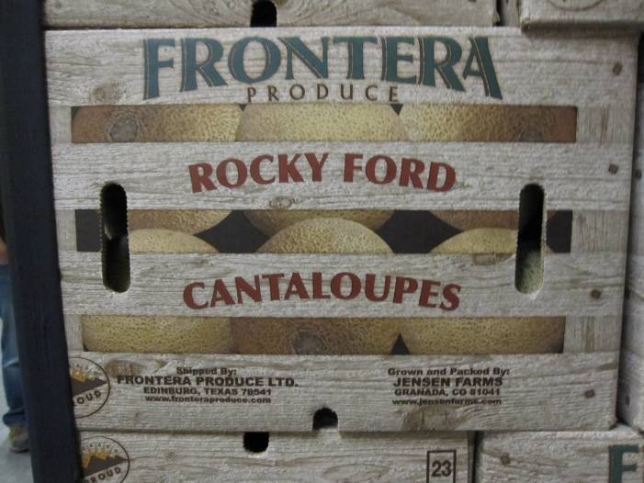
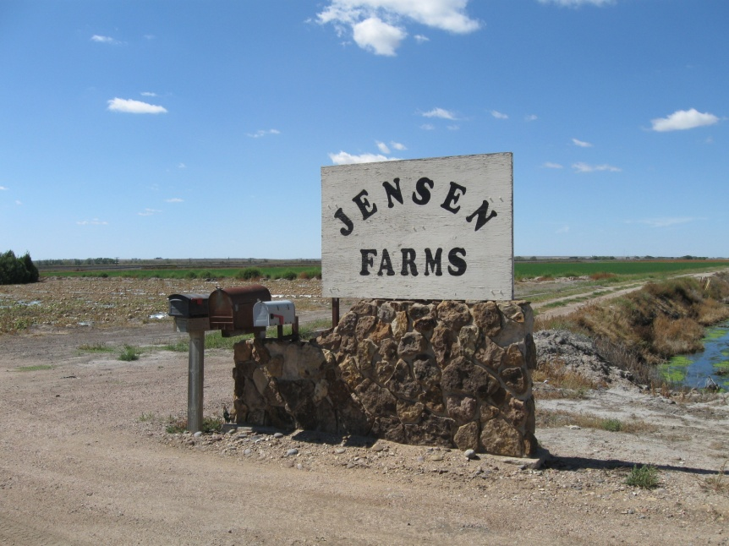
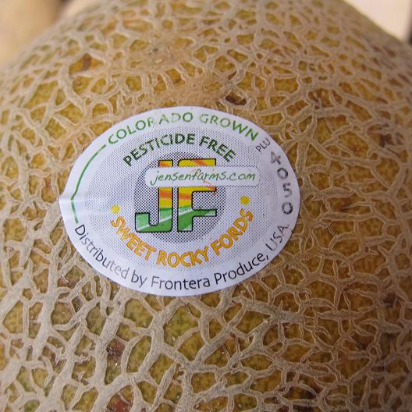
Multistate Outbreak of Listeriosis Linked to Whole Cantaloupes from Jensen Farms, Colorado — 2011

Slide 13
Investigation Methods
Case definition
  Illness onset July 31–October 31, 2011
  Culture-confirmed Listeria clinical infection
  Isolate indistinguishable from any of four outbreak strains by pulsed-field gel electrophoresis (PFGE)
PulseNet
  PFGE pattern repository
Patient interviews
Listeria Initiative data
Product traceback
On-farm environmental assessments
Notes:
We defined a case as a patient with illness onset during July 31–October 31. Only Laboratory-confirmed cases were included and required both culture confirmation of Listeria infection and a pulsed-field gel electrophoresis, or PFGE, pattern indistinguishable from one of the outbreak strains. PFGE patterns of culture isolates from patients and food products were uploaded to PulseNet, a national PFGE pattern database repository, to facilitate additional case finding through comparison with other patterns in the database. Patient interviews were used to confirm course of illness, determine food exposures, and generate hypotheses. Shopper card data were also used to determine food shopping activity prior to illness.

Slide 14
Timeline of Events: Multistate Listeriosis Outbreak Linked to Whole Cantaloupes —
July–October, 2011 (n = 8)
September 2 — CDPHE notifies CDC
  8 cases reported since August 15
  7 cases reported since August 29
  3 distinct PFGE patterns among cases
Expect 1–2 cases in August in Colorado
Colorado cases
Number of Illnesses
August
September
October
Date of Illness Onset
Notes:
Sept 2 – CDPHE notifies CDC of 8 confirmed cases of Listeriosis in Colorado residents with 7 cases were reported since August 29. Results of laboratory testing results indicates 3 distinct PFGE patterns among patients. In Colorado, 1-2 Listeriosis cases are typically reported in August each year. Outbreak cases of Listeriosis occurring in Colorado are indicated in green.

Slide 15
Timeline of Events: Multistate Listeriosis Outbreak Linked to Whole Cantaloupes —
July–October, 2011 (n = 11)
September 5
  CDPHE collects cut and whole cantaloupe from a single ill patient’s home for Listeria testing
Colorado cases
Number of Illnesses
August
September
October
Date of Illness Onset
Notes:
Sept 5 – CDPHE collects cut and whole cantaloupes from the home of an ill person for Listeria testing.

Slide 16
Timeline of Events: Multistate Listeriosis Outbreak Linked to Whole Cantaloupes —
July–October, 2011 (n = 13)
September 6
  PulseNet defines outbreak strains
  Two additional illnesses in Nebraska and Texas
  7/7 Colorado patients report consuming cantaloupe ≤30 days before onset
Colorado cases
Non-Colorado cases
Number of Illnesses
August
September
October
Date of Illness Onset
Notes:
Sept 6 – PulseNet defines outbreak strains in CO patients and identifies an ill person in NE and TX, each infected with an outbreak strain of Listeria. Cases occurring outside of Colorado are indicated in orange. Initial interview data for 7 Colorado patients find all ate cantaloupe.

Slide 17
Timeline of Events: Multistate Listeriosis Outbreak Linked to Whole Cantaloupes —
July–October, 2011 (n = 15)
September 7
  CDC begins coordinating multistate investigation
Colorado cases
Non-Colorado cases
Number of Illnesses
August
September
October
Date of Illness Onset
Notes:
Sept 7 – CDC begins coordinating the multi-state outbreak investigation.

Slide 18
Timeline of Events: Multistate Listeriosis Outbreak Linked to Whole Cantaloupes —
July–October, 2011 (n = 15)
September 8
  CDPHE collects cantaloupes from retail stores for Listeria testing
Colorado cases
Non-Colorado cases
Number of Illnesses
August
September
October
Date of Illness Onset
Notes:
Sept 8 – CDPHE collects cantaloupes for Listeria testing from retail locations where ill persons reported shopping. Preliminary interview and product traceback investigation data suggests cantaloupes marketed as “Rocky Ford” and grown in Colorado potentially tied to illnesses.

Slide 19
Timeline of Events: Multistate Listeriosis Outbreak Linked to Whole Cantaloupes —
July–October, 2011 (n = 15)
September 9
  Significant cantaloupe association rapidly determined using Listeria Initiative data and case-case analysis (p = 0.02)
  CDPHE issues consumer warning
  FDA collects cantaloupes from retail
Colorado cases
Non-Colorado cases
Number of Illnesses
August
September
October
Date of Illness Onset
Notes:
Sept 9 – CDC rapidly determines a statistically significant association between consumption of cantaloupes and illness using existing Listeria Initiative data and case-case analysis. CDPHE announces that cantaloupes are the likely cause of illness and warns high-risk residents not to eat them. FDA also collects cantaloupes from retail locations where ill persons reported shopping.

Slide 20
Timeline of Events: Multistate Listeriosis Outbreak Linked to Whole Cantaloupes —
July–October, 2011 (n = 15)
September 10
  CDPHE and FDA conduct joint on-farm environmental assessment of two Colorado cantaloupe producers
  Environmental and product samples are collected
  Jensen Farms halts harvest and distribution
Colorado cases
Non-Colorado cases
Number of Illnesses
August
September
October
Date of Illness Onset
Notes:
Sept 10 – CDPHE and FDA visit two cantaloupe producers in the Rocky Ford region including Jensen Farms to conduct preliminary environmental inspections and to collect environmental and product samples. The last shipment of Jensen Farms’ cantaloupe is shipped and further harvest and distribution of Jensen Farms’ cantaloupes ceases as a precautionary measure.

Slide 21
Timeline of Events: Multistate Listeriosis Outbreak Linked to Whole Cantaloupes —
July–October, 2011 (n = 15)
September 11
  CDPHE successfully cultures Listeria from a patient’s whole and cut cantaloupe collected September 5, and from Jensen Farms’ cantaloupes from retail stores
  Preliminary interview and traceback implicate cantaloupes marketed as “Rocky Ford”
Colorado cases
Non-Colorado cases
Number of Illnesses
August
September
October
Date of Illness Onset
Notes:
Sept 11 – Ongoing distribution traceback investigations of cantaloupe purchased by ill persons converge on Jensen Farms as the single common source of cantaloupe supplying retail stores where ill persons shopped. CDPHE successfully cultures Listeria from whole and cut cantaloupe collected from an ill person’s home and from Jensen Farms’ cantaloupes collected from two retail locations with PFGE results pending.

Slide 22
Timeline of Events: Multistate Listeriosis Outbreak Linked to Whole Cantaloupes —
July–October, 2011 (n = 28)
September 14
  Ongoing traceback investigations converge on Jensen Farms
  Jensen Farms voluntarily recalls all cantaloupe
Colorado cases
Non-Colorado cases
Number of Illnesses
August
September
October
Date of Illness Onset
Notes:
Sept 14 – Jensen Farms issues a voluntary recall of all whole cantaloupes. Any remaining Jensen Farms cantaloupes are removed from store shelves at retail.
n=28

Slide 23
Timeline of Events: Multistate Listeriosis Outbreak Linked to Whole Cantaloupes —
July–October, 2011 (n = 41)
September 16
  Jensen Farms’ cantaloupes collected by CDPHE at retail September 8 yield outbreak strains of Listeria
Colorado cases
Non-Colorado cases
Number of Illnesses
August
September
October
Date of Illness Onset
Notes:
Sept 16 – Multiple samples of whole Jensen Farms’ cantaloupes collected by CDPHE September 8 yield outbreak strains of Listeria.
n=41

Slide 24
Timeline of Events: Multistate Listeriosis Outbreak Linked to Whole Cantaloupes —
July–October, 2011 (n = 53)
September 19
  Samples collected at Jensen Farms September 10 yield several outbreak strains of Listeria
  Fourth outbreak strain of Listeria identified
Colorado cases
Non-Colorado cases
Number of Illnesses
August
September
October
Date of Illness Onset
Notes:
Sept 19 – Cantaloupes and environmental samples collected September 10 at Jensen Farms packing facility yield several outbreak strains of Listeria. These samples identify an additional strain of Listeria causing illnesses in several states, and this fourth Listeria PFGE pattern is added to the outbreak. This adds 7 additional cases not previously included in the outbreak.
n=53

Slide 25
Timeline of Events: Multistate Listeriosis Outbreak Linked to Whole Cantaloupes —
July–October, 2011 (n = 73)
September 22
  FDA conducts root cause environmental assessment at Jensen Farms
  CDPHE, Colorado Department of Agriculture, Prowers County Public Health
Colorado cases
Non-Colorado cases
Number of Illnesses
August
September
October
Date of Illness Onset
Notes:
Sept 22 – FDA, CDPHE, Colorado Department of Agriculture, and Prowers County Public Health officials begin a comprehensive two-day root cause environmental assessment at Jensen Farms.
n=73

Slide 26
Timeline of Events: Multistate Listeriosis Outbreak Linked to Whole Cantaloupes —
July–October, 2011 (n = 131)
October 19
  FDA announces findings of Jensen Farms root cause environmental assessment conducted September 22–23
Colorado cases
Non-Colorado cases
Number of Illnesses
August
September
October
Date of Illness Onset
Notes:
October 19 – FDA announces findings of the joint environmental root cause assessment conducted at Jensen Farms September 22–23.
n=131

Slide 27
Timeline of Events: Multistate Listeriosis Outbreak Linked to Whole Cantaloupes —
July–October, 2011 (n = 145)
October 27
  Illness onsets for the final two outbreak-associated cases occur
Colorado cases
Non-Colorado cases
Number of Illnesses
August
September
October
Date of Illness Onset
Notes:
October 27 – Illness onsets for the final two outbreak-associated cases occur.
n=145

Slide 28
Timeline of Events: Multistate Listeriosis Outbreak Linked to Whole Cantaloupes —
July–October, 2011 (n = 145)
October 31
  Last day of the outbreak period determined by CDC
  Illness onsets during July 31–October 31 due to outbreak strains of Listeria considered part of outbreak
Colorado cases
Non-Colorado cases
Number of Illnesses
August
September
October
Date of Illness Onset
Notes:
October 31 –Surveillance through November reveals no additional outbreak cases, and CDC declares this outbreak over effective October 31.
n=146

Slide 29
Number of Patients by Date of Illness Onset — All States, July–October, 2011 (n = 145)
Colorado cases
Non-Colorado cases
Number of Illnesses
August
September
October
Date of Illness Onset

Slide 30
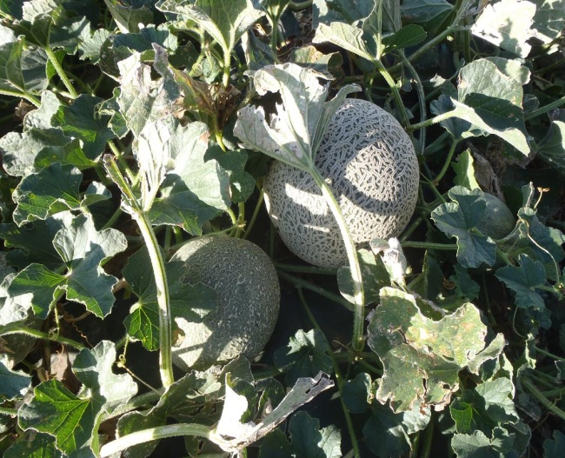
Final Case Finding: PulseNet
146 cases identified in residents of 28 states
  Colorado: 40 cases
Bordering states east and south of Colorado have high numbers of reported cases
  Texas (18)
  New Mexico (15)
  Oklahoma (12)
  Kansas (11)
Four different PFGE patterns
Notes:
PFGE results yielded indistinguishable isolates among all 11 Colorado patients, indicating a common O157:H7 source. This pattern was uploaded to PulseNet. Over the following weeks, thirty additional cases were identified, resulting in a total of 41 outbreak cases among residents of 5 states including California, Nevada, Arizona, Colorado, and New Mexico. PFGE analysis yielded a novel pattern not previously registered in the PulseNet database, further strengthening the association among outbreak cases.

Slide 31
Persons Infected with Outbreak Strains of LM, by State*
MT
1
ND
2
OR
1
NY
2
ID
2
WI
2
SD
1
WY
4
PA
1
IA
1
NV
1
NE
6
IN
3
UT
1
IL 4
CO
40
WV
1
KS
11
MO
7
VA
1
CA
4
OK
12
AR
1
MD
1
NM
15
AL
1
TX
18
LA
2
1-4 cases
5-9 cases
10-19 cases
≥20 cases
* n= 146 for whom information was reported to CDC on December 2, 2011
Notes:
Among affected states, Colorado had the greatest number of cases with 40 reported, Texas 18, New Mexico 15, Oklahoma 12, Kansas 11, Missouri 7, Nebraska 6; remaining affected states displayed in the lightest shade of green each had 4 or fewer cases reported.

Slide 32
Characteristics — All Patients (n = 146)
Characteristic | Number (%)
Age, median years (range) | 77 (<1–96)
≥ 60 years of age | 126 (86)
Female | 85 (58)
Hospitalized* | 142 (99)
Died | 30 (21)
Pregnancy-associated | 6 (4)
* Among 144 patients with available data
Notes:
Median age overall is 77 years; reported deaths do not include a single reported miscarriage. Pregnancy-associated cases include infections in 3 pregnant women and 3 infants. Among pregnant women, one gave birth to an infected infant, one gave birth to a non-infected infant, and the infection status of one infant is unknown. Among infants, one infection was in an infant born to a known infected mother; the maternal infection status of the other two infants is unknown.

Slide 33
Number of Patients by Age — All Affected States (n = 146)
≥60 Years
86%
Number of Patients
Age in Years

Slide 34
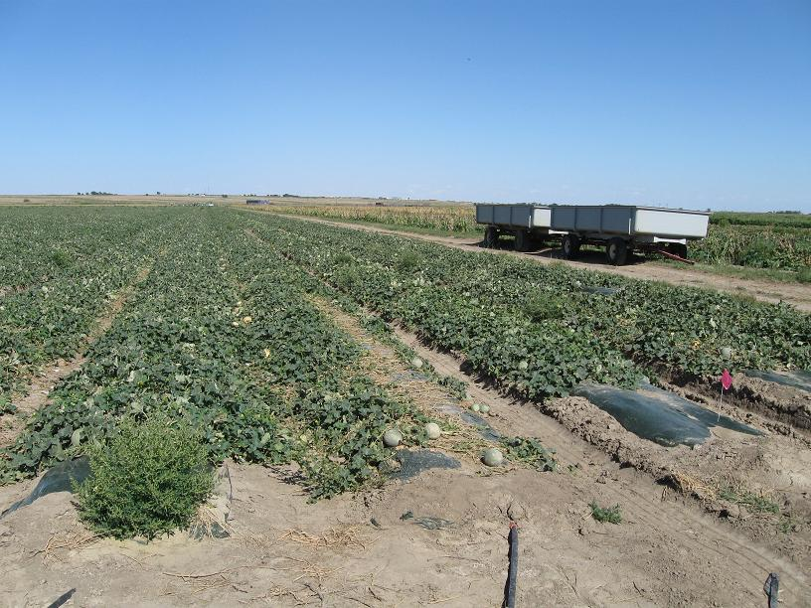
Jensen Farms Cantaloupe Field

Slide 35
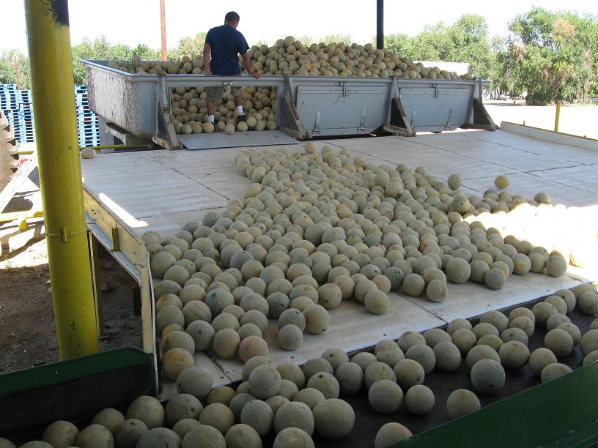
Jensen Farms Packing Operations

Slide 36
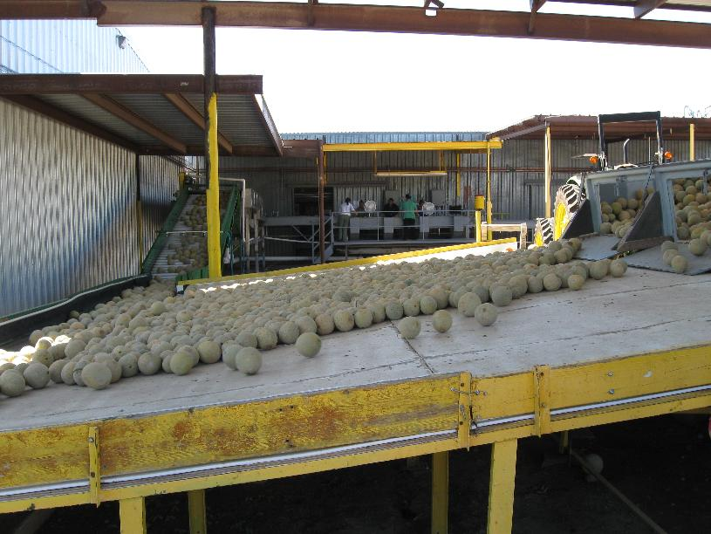
Jensen Farms Packing Operations

Slide 37
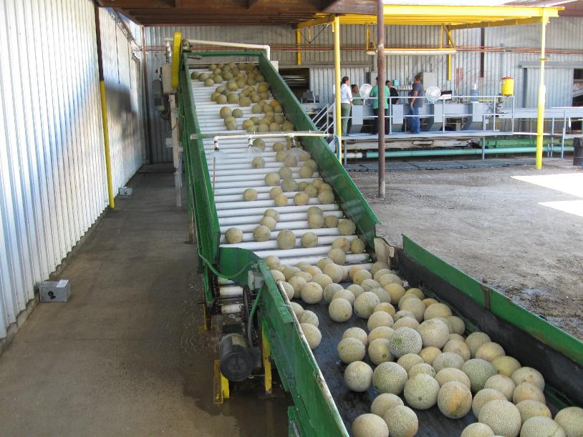
Jensen Farms Packing Operations

Slide 38
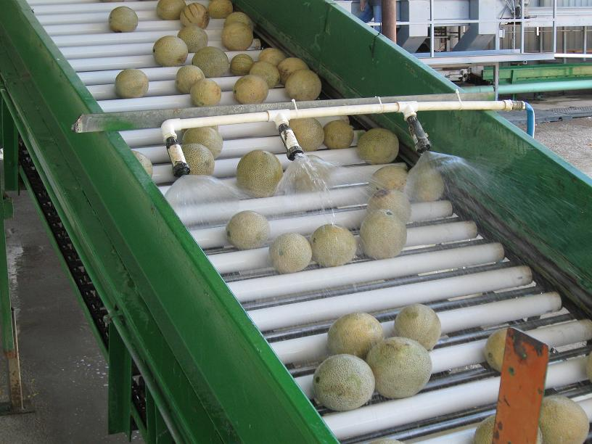
Jensen Farms Packing Operations

Slide 39
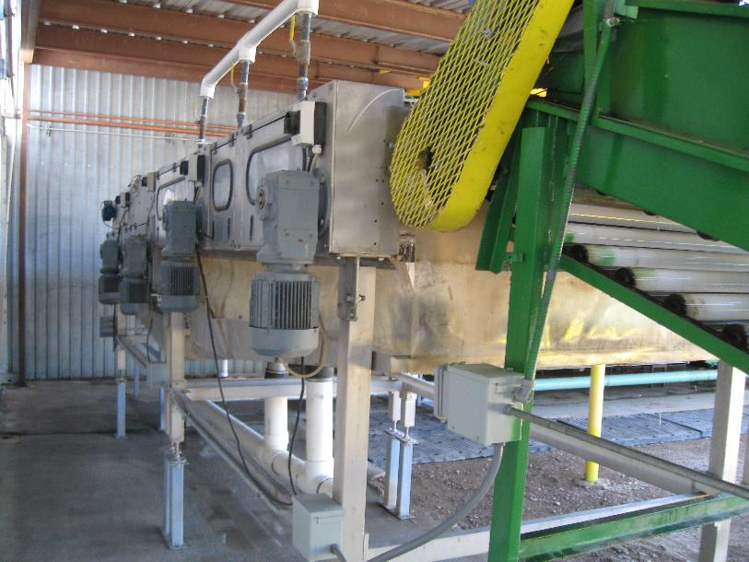
Jensen Farms Packing Operations

Slide 40
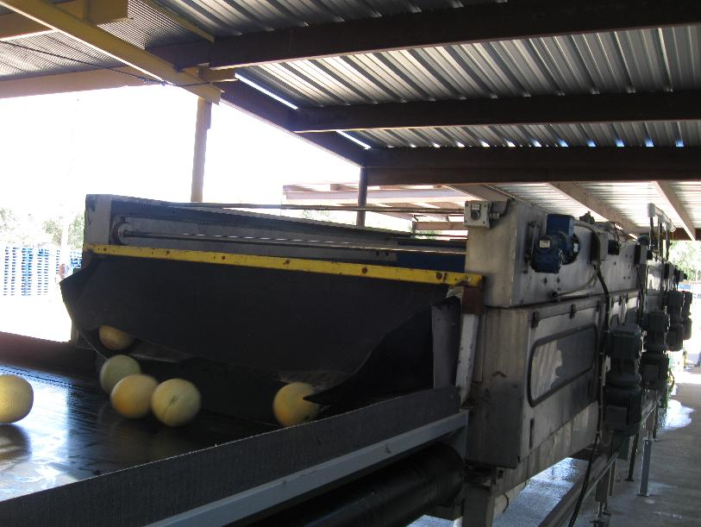
Jensen Farms Packing Operations

Slide 41
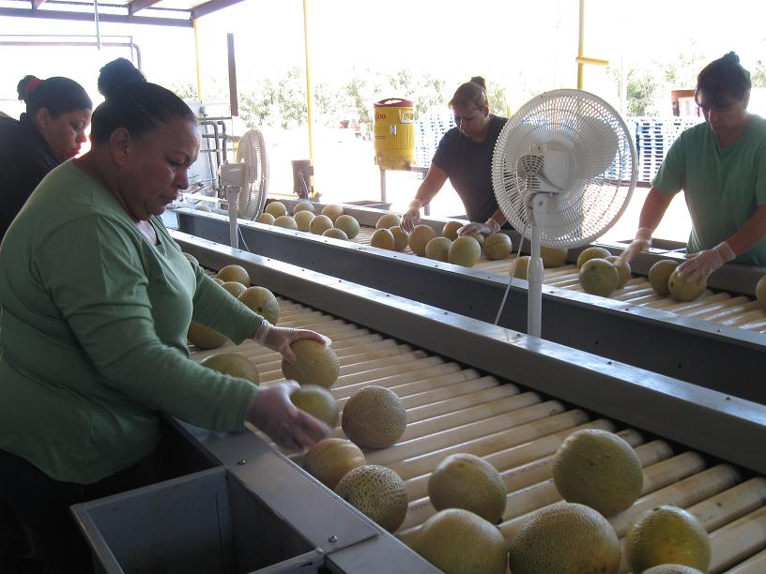
Jensen Farms Packing Operations

Slide 42
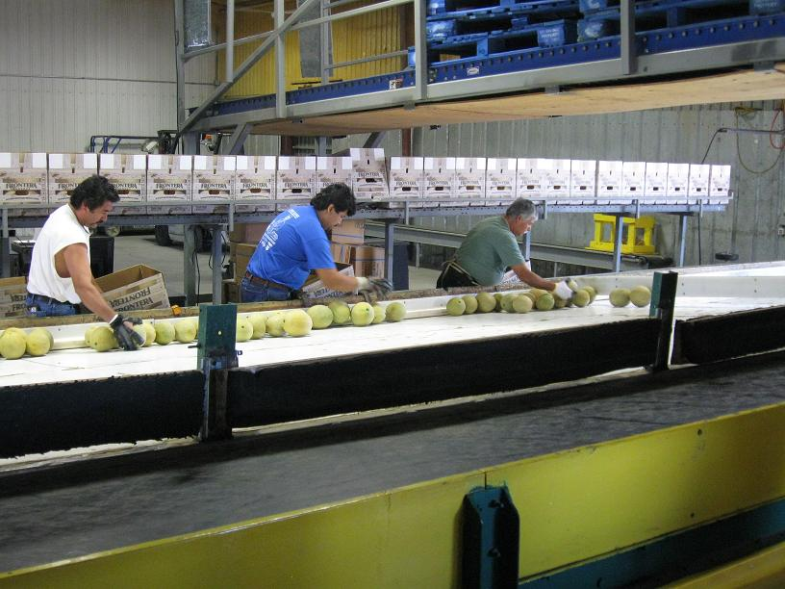
Jensen Farms Packing Operations

Slide 43
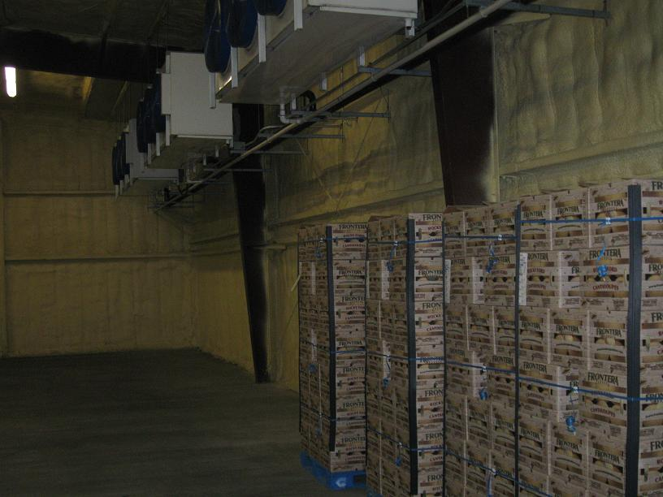
Jensen Farms Packing Operations

Slide 44
Summary of LM PFGE Pattern Data Among Cantaloupe and Environmental Samples
 |  | PFGE Outbreak Pattern
 |  | 1 | 2 | 3 | 4
Cantaloupe | Patient | X | X | X
 | Retail | X | X | X
 | JF cooler |  | X |  | X
Swabs, JF processing |  |  | X | X | X

Slide 45
Summary: Jensen Farms Root Cause Environmental Assessment
Multiple Listeria outbreak strains found
  Food contact surfaces
  Whole, processed cantaloupes
Processing facility most likely source of cantaloupe contamination
Deficiencies
  Inadequate sanitation
  Facility design and use
  Equipment
  Lack of postharvest cooling

Slide 46
Conclusions
Whole cantaloupes produced and packed by Jensen Farms caused outbreak
First reported Listeriosis outbreak associated with whole cantaloupe
  Ready-to-eat and processed foods previously
Older adults ≥60 a majority of patients
Few pregnancy-associated cases
Largest documented U.S. outbreak of Listeriosis
  Deadliest U.S. foodborne outbreak in >90 years

Slide 47
Thank You!

Slide 48
Cantaloupe Association and The Listeria Initiative*
Date | Cantaloupe | Ham
Sept 9 | OR (95% CI) = 8.54 (1.32-∞) Cases: 11/11 (100%) Controls: 54/85 (64%) P=0.02 | OR (95% CI) = 2.01 (0.51–9.44) Cases: 7/11 (64%) Controls: 360/774 (47%) P=0.41
Sept 12 | OR (95% CI) = 10.13 (1.60–∞) Cases: 13/13 (100%) Controls: 54/85 (64%) P=0.01 | OR (95% CI) = 2.58 (0.71–11.58) Cases: 9/13 (69%) Controls: 360/774 (47%) P=0.18
Sept 14 | OR (95% CI) = 14.93 (2.43–∞) Cases: 19/19 (100%) Controls: 54/85 (64%) P=0.001 | OR (95% CI) = 1.44 (0.50–4.24) Cases: 10/18 (56%) Controls: 360/774 (47%) P=0.60
* In controls, cantaloupe exposures limited to those with isolation dates in August. Controls are non-pregnancy associated sporadic cases among persons 60 years or greater.
** Cases initially limited to PFGE patterns 1 and 2.

