Slide 1
Incorporating HACCP into national food control systems - Analyzing progress in the United Arab Emirates
Dina Al-Kandari and David J. Jukes

Slide 2
Outline
Introduction
International guidance on HACCP implementation
Food control in the UAE
HACCP in the UAE
Conclusions

Slide 3
Food-borne disease
Global: food-borne disease (together with water) is a significant contributor to mortality from diarrheal disease. Estimate at1.8 million deaths worldwide in 2005 (WHO, 2007)
USA: estimated 76 million illnesses, 325,000 hospitalizations and 5000 deaths each year (CDC, 2005)
UK: estimated1.7 million illnesses, 22,000 hospitalizations and 687 deaths each year (Adak, Meakins, Yip, Lopman, & O’Brien, 2005)

Slide 4
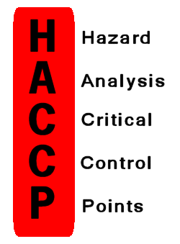
HACCP
Hazard Analysis Critical Control Points:
Recognised worldwide
Systematic and preventive approach
Addresses biological, chemical and physical hazards
Anticipates and prevents hazards rather than removing them through end-product inspection and testing

Slide 5
Development of international guidance
HACCP concept developed in late 1960s
1976: WHO Expert Committee on Microbiological Aspect of Food Hygiene – reference to HACCP system
1980: WHO/ICMSF Meeting on the Hazard Analysis Critical Control Point System in Food Hygiene - recommendations on possible application.
1983: FAO/WHO Expert Committee on Food Safety - advised that HACCP should replace traditional approaches

Slide 6
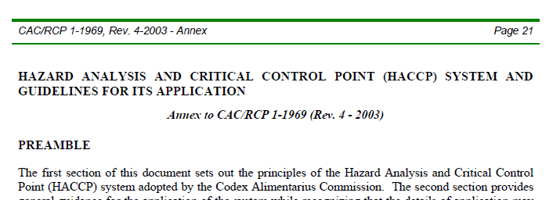
Development of international guidance
1993: FAO/WHO Codex Alimentarius Commission - adoption of Codex Guidelines for the Application of the Hazard Analysis Critical Control Point (HACCP) System
1997: FAO/WHO Codex Alimentarius Commission - adoption of revised text: “The Hazard Analysis and Critical Control Point (HACCP) System and Guidelines for its Application”

Slide 7
1993 WHO Consultation
Emphasised role of government health and food authorities in “ensuring the appropriate application of HACCP principal activities by the various food sectors and to facilitate HACCP implementation as deemed practical or necessary”
“Government authorities have a responsibility to provide leadership in food safety control by accepting and promoting the HACCP principal activities .. for the food processing and manufacturing industry”
(WHO, 1993)

Slide 8
Development of international guidance
1994: FAO Expert Technical Meeting on the Use of Hazard Analysis Critical Control Point Principles in Food Control
The Role of Government in Developing a HACCP Based Food Safety System (HACCPEXP 94/2)
1995: WHO Consultation on Hazard Analysis Critical Control Point System: Concept and Application
1998: FAO/WHO Joint Consultation on the role of government agencies in assessing HACCP
2006: FAO/WHO Guidance to governments on the application of HACCP in Small and/or Less-Developed Businesses (SLDBs) (FAO/WHO, 2006).

Slide 9
Benefits of HACCP implementation for national authorities
When used as an inspection tool in food control, the HACCP system leads to more efficient inspection of food operations, as the role of food inspectors is centred on the assessment of the HACCP plan and confirmation that it is properly designed and operating effectively (Motarjemi, Y., et al., 1996).
While the improved level of food safety associated with implementation of HACCP and the leading role taken by the food industry are recognized, the application of HACCP as a public policy requires definition of the role of government in the HACCP process (Whitehead, A.J. & Orriss, G., 1995)
With the HACCP system one can expect an improvement in the relationship between (i) food processors and food inspectors, and (ii) food processors and consumers (WHO, 1997)
HACCP is a systematic approach which can be applied to cover all aspects of food safety, including biological, chemical and physical hazards, at all stages of the food chain, including raw materials, growth, harvesting, purchase, production, distribution and storage, to final product use (WHO, 1993).
The HACCP system overcomes many of the limitations of traditional approaches to food safety control (generally based on 'snap-shot' inspection and end-product testing) (WHO, 1997).
HACCP systems focus on the prevention of food safety hazards instead of relying on traditional inspection practices to detect unsafe products before consumption (WHO, 1993)

Slide 10
Role and responsibilities of government agencies
In the implementation of HACCP, these can be summarized as:
The need to provide leadership based on understanding and commitment
The need to provide appropriate legislation and policies
The need to define and establish nationally-acceptable levels of food safety risks and to base food safety policies on them
Develop appropriate strategies to facilitate and encourage the implementation of HACCP and to monitor the progress of HACCP

Slide 11
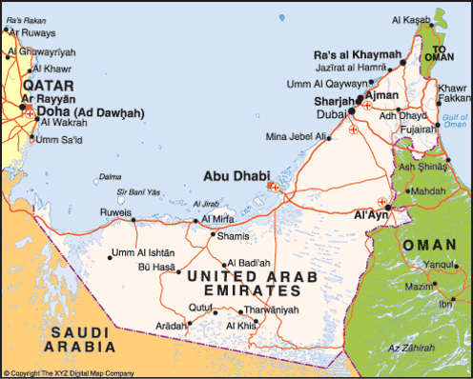
UAE – some data
Population estimate (2009): 5 million
Emiratis less than 20%; expatriates more than 80%
Food: 90+% imported but about 50% then exported to other GCC countries
GCC Food market: $9.5 billion (2008) of which UAE $3-4 billion

Slide 12
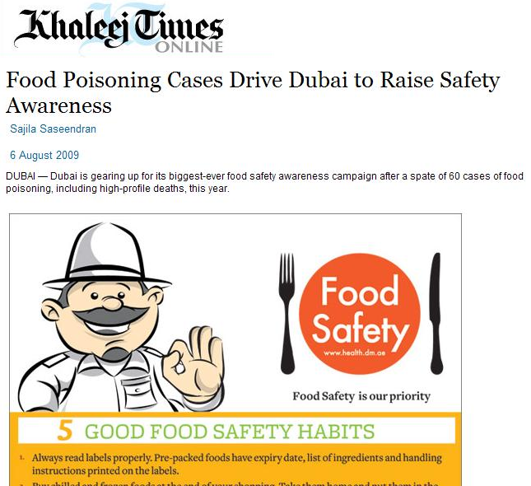
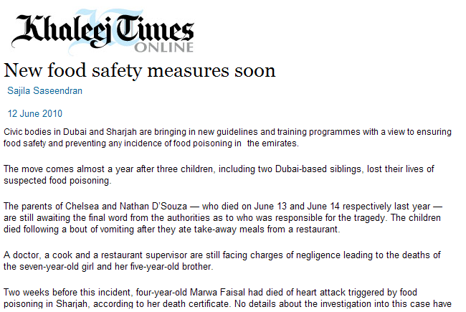
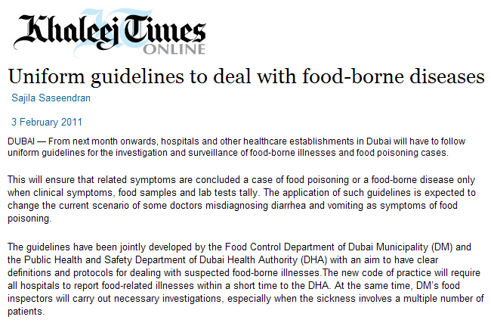
Food safety in the news (1)

Slide 13
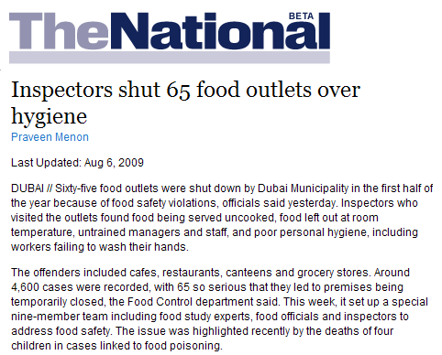
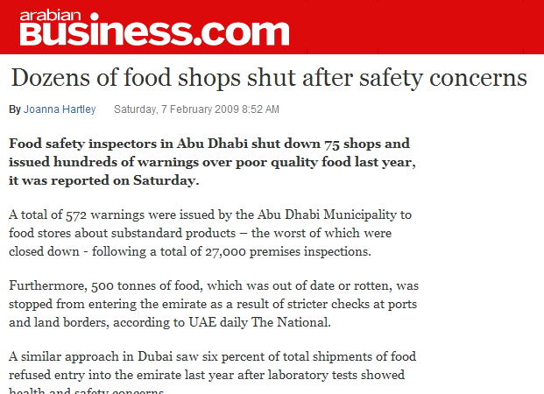
Food safety in the news (2)
2.1% warnings
0.3% shut down

Slide 14
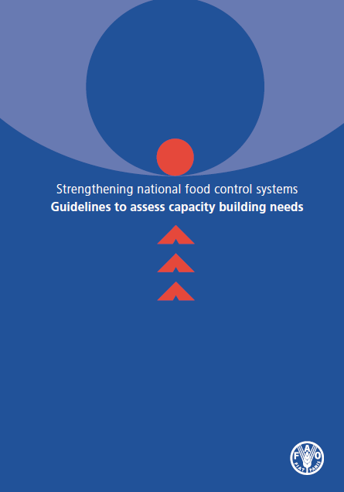
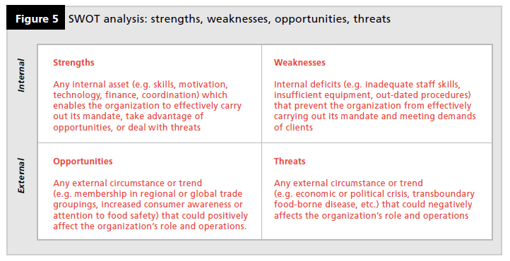
SWOT analysis
FAO Guidelines to assess capacity building needs (FAO, 2006)
Strengths
Weaknesses
Opportunities
Threats

Slide 15
UAE and HACCP: (1) Government commitment and leadership
Strengths
Weaknesses
Competent staff
Electronic services and computerized systems for food inspections
Positive partnership with the major stakeholders
Government communicates with industry representatives and with consumers through food safety campaigns
Annual International Food Safety Conference
Limitations in scientific and technical expertise in the region
Government still depends on 3rd party certifications for HACCP

Slide 16
UAE and HACCP: (1) Government commitment and leadership
Opportunities
Threats
Availability of funds and full government commitment for investment in health
Since the country is a federal state regionalization and decentralization are facilitated
Recent food safety threats have increased attention to food safety and quality
Membership in the International Association of Food Protection (IAFP)
More than 90% of the foods are imported
Imports in terms of tons are on the rise

Slide 17
UAE and HACCP: (2) Appropriate legislation and enforcement
Strengths
Weaknesses
Regulatory policy changes are being made
Food sector is operating according to Codex General Principles of Food Hygiene
Recommendations from Codex are used for decision-making
HACCP is mandatory in large food manufacturers, catering companies and large hotels
Food laws do not encompass risk principles to a great deal
HACCP is not yet mandatory for imported foods

Slide 18
UAE and HACCP: (2) Appropriate legislation and enforcement
Opportunities
Threats
Plans to implement a new federal food law to unify food control across all emirates
Plans to develop a new food code to incorporate pre-requisite programmes for implementing effective food safety management systems
Efforts to harmonize national standards with Codex
HACCP is not mandatory in most of the countries that the UAE imports food from

Slide 19
UAE and HACCP: (3) Food safety risks
Strengths
Weaknesses
Introduction of risk-based inspections
Food inspectors are trained to identify risk factors and advise appropriate corrective actions
Training of inspectors to use risk-based inspections in smaller businesses as well
Food-borne disease surveillance is lacking
The application of risk analysis is not yet strong

Slide 20
UAE and HACCP: (3) Food safety risks
Opportunities
Threats
HACCP certification companies are undergoing an accreditation process
Government is working with external bodies (CDC, WHO, FAO) to help us set up a food-borne illness investigation system
Government introducing risk-based sampling of foods imported into the country
3rd party certifications in the country of export a future option
Many businesses are struggling to find HACCP certified suppliers and difficulties exist in ensuring that all the suppliers are HACCP compliant

Slide 21
UAE and HACCP: (4) Strategies to facilitate implementation
Strengths
Weaknesses
Government gives resources to train regulatory food control officials and training is conducted regularly
Procedures for inspecting, sampling and auditing safety systems set up
Inspectors moved to the ‘audit’ approach in food facilities that had HACCP system in place
Frequent meetings and team work have been key to implementation of the HACCP programme
etc…
Language barrier by the largely-foreign workforce
Work culture of people where most food workers come from less-developed countries
Small food businesses lack awareness
There is a shortage of auditors
There are inconsistencies in auditing

Slide 22
UAE and HACCP: (4) Strategies to facilitate implementation
Opportunities
Threats
Government is currently designing a training programme for business owners to run a safe food business
Inspection programmes are being designed to support the industry and also to tackle non-compliance
Sudden growth in business
Most organizations faced a huge turnover of people

Slide 23
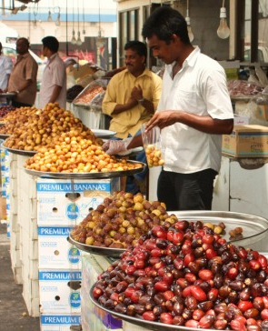
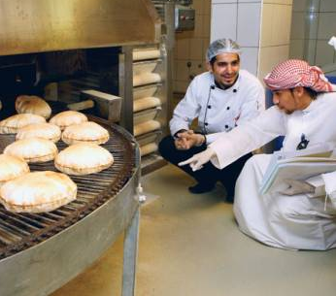
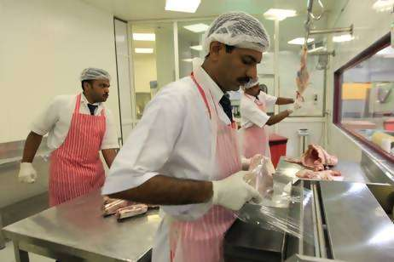
Conclusions
UAE is making good progress in meeting international guidance on HACCP implementation.
For the region and for other countries, the UAE can be seen to represent ‘good practice’.

Slide 24
Main references
Adak, G. K., Meakins, S. M., Yip, H., Lopman, B. A., & O’Brien, S. J. (2005). Disease risks from foods, England and Wales, 1996e2000. Emerging Infectious Diseases,11(3). Available at, http://www.cdc.gov/ncidod/EID/vol11no03/04-0191.htm
Centre for Disease Control and Prevention (CDC). (2005). Foodborne illness: Frequently asked questions, USA: Department of Health and Human Services. http://www.cdc.gov/ncidod/dbmd/diseaseinfo/files/foodborne_illness_FAQ.pdf
FAO (2006). Strengthening national food control systems: Guidelines to assess capacity building needs, FAO, Rome. ftp://ftp.fao.org/docrep/fao/009/a0601e/a0601e00.pdf
Motarjemi, Y., Kaferstein, F., Moy, G., Miyagawa, S., & Miyagishima, K. (1996), Importance of HACCP for public health and development: the role of the World Health Organization, Food Control, 7(2), 77e85
Whitehead, A. J., & Orriss, G. (1995), Food safety through HACCP - the FAO approach, Food, Nutrition and Agriculture, 15. http://www.fao.org/docrep/v9723t/v9723t0e.htm#food%20safety%20through%20haccp%20%20%20the%20fao%20approach
WHO. (1993). Training considerations for the application of the hazard analysis critical control point system to food processing and manufacturing. Report of a WHO Consultation. http://whqlibdoc.who.int/hq/1993/WHO_FNU_FOS_93.3.pdf WHO document WHO/FNU/FOS/93.3, 1993.
WHO. (2007). Food safety and foodborne illness. http://www.who.int/mediacentre/factsheets/fs237/en/

Slide 25
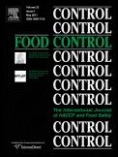
Thank you!
Dr David Jukes
Department of Food and Nutritional Sciences
The University of Reading
Whiteknights
Reading RG6 6AP
UK
d.j.jukes@reading.ac.uk
Dina Al-Kandari and David J. Jukes (2011), “Incorporating HACCP into national food control systems - Analyzing progress in the United Arab Emirates”, Food Control, Volume 22, Issue 6, June 2011, Pages 851-861

