Slide 1
3rd Party Audits and Regulatory Inspections
Food Industry Perspective
Tim Ahn
Mars Chocolate
Global Director - Quality & Food Safety
1
Notes:
1

Slide 2
Agenda
Introduction to Mars, Incorporated
Overview of regulatory inspections
Overview of 3rd party audits
Using 3rd party audits to drive Quality & Food Safety Management System effectiveness.

Slide 3


Slide 4


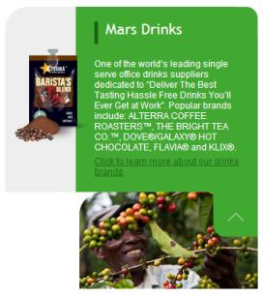
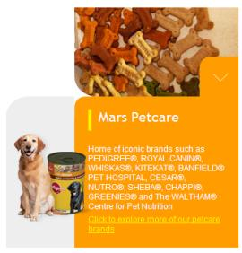



Slide 5
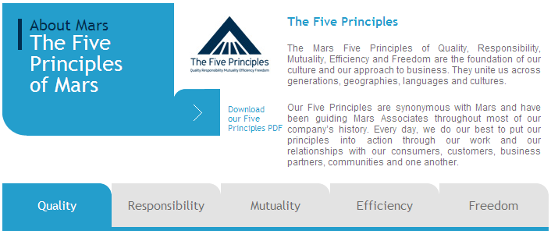





Slide 6



Regulatory Inspections
Regulatory inspections are key part of national and local food law enforcement framework.
Important role in assuring compliance with regulations regarding:
  public health & safety
  food quality
  labelling
Inspections are government funded.
Important tool in assuring retail food establishments
Focused on basics – GMP/GHP.

Slide 7
Regulatory Inspections
Inspections are usually unannounced. Frequency can vary. Can be routine or “for cause”.
Inspections are not audits Designed to identify issues and non-complaint processors.
Inspector training can vary by country and local jurisdictions.
Regulatory inspections collect evidence - need to be treated as legal proceedings. Can result in publicity, warning letters, recall, fines, etc...
Depending on country and laws, processors need to be aware of their legal rights. Processors need to prepare in advance for expected inspections.

Slide 8
3rd Party Audits
Audit - Planned, independent, and documented examination and verification of activities, records, processes, and other elements of a quality system to determine their conformity with the requirements of a quality standard.
Different types of standards
  International standards – ISO 9000, ISO 22000
  Global Food Safety Initiative (GFSI) audit schemes
  Other GMP/GHP, HACCP standards
Quality Management System & Food Safety Management System audit
  Management review
  Internal audit
  Corrective action

Slide 9



3rd Party Audits
Processor pays cost of audit.
Certification demonstrates food safety compliance.
Standardize auditor training and certification.
Standards and certifications
  International recognition
  GFSI accepted by major retailers
  May be required in certain situations

Slide 10

3rd Party Audits & Effective Q&FS Programs
Quality and Food Safety Management Systems provide structure from which to produce safe, wholesome, and legal foods.
  Meet regulatory requirements
  Achieve required customer certifications
  Drive continuous improvement activities
  Demonstrate organizational governance
3rd party audits provide independent verification of Q&FS Management Systems implementation and effectiveness.

Slide 11


3rd Party Audits & Effective Q&FS Programs
Customized 3rd party assurance can be used to assess implementation and effectiveness of company specific standards and processes.
Mars Incorporated has partnered with LRQA to develop a customized program of comprehensive site audits.
  Mars specific standards implementation
  International standards certification
  Corporate Q&FS reporting and metrics
  Enable corporate Q&FS governance

Slide 12
THANK YOU
Notes:
For discussion

